Slide 1

Jefferson County Study on Bacterial Contamination of Drinking Water Wells
Carissa Caruso-DiPaolo
NEHA / CDC Intern
Environmental Science & Forestry
State University of New York – Syracuse
Josh Griffin, CPO-I
Sanitarian
Jefferson County Health Department
Bob Custard, RS, CP-FS, CPO-I
Environmental Health Consultant
Jefferson County Health Department

Slide 2
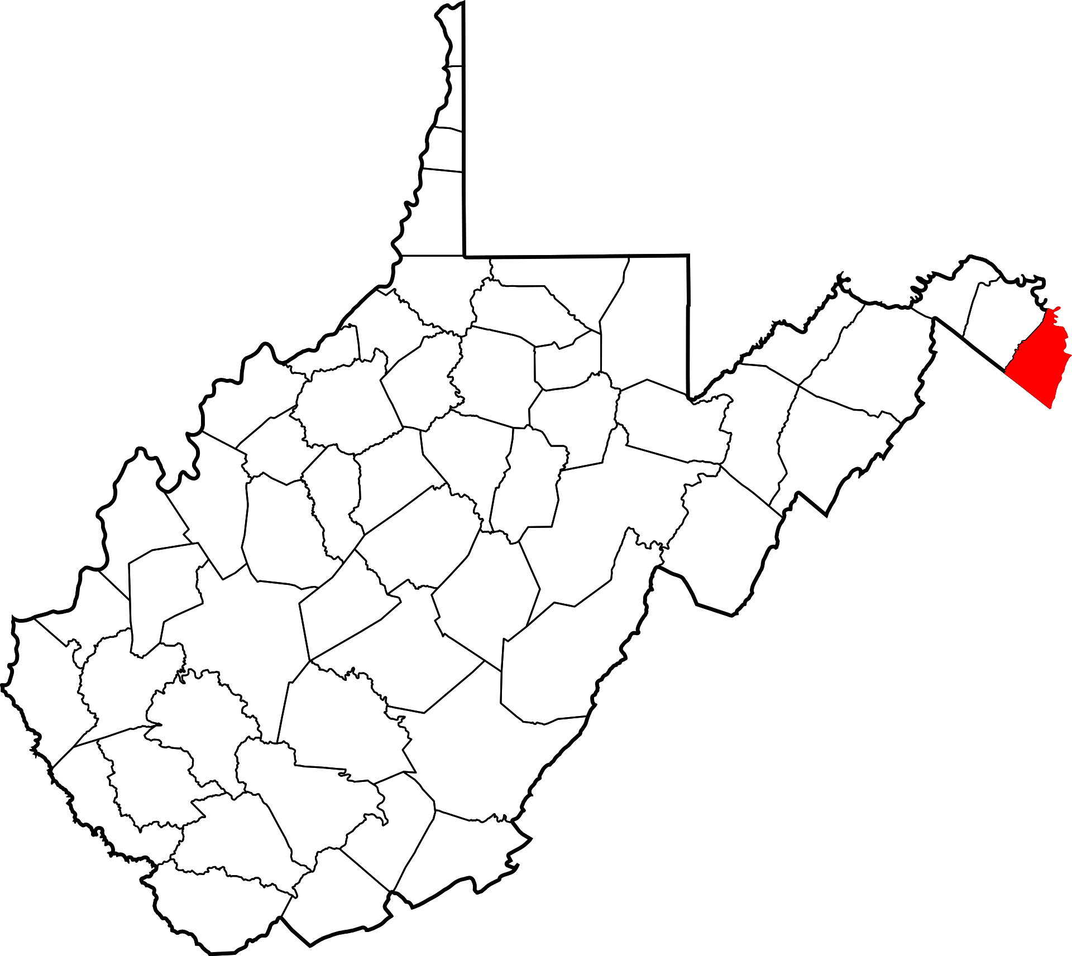
Objectives of Study
Identify areas in Jefferson County with a high risk for biological groundwater contamination
Hypothesize reasons for why biological contamination is occurring

Slide 3
Methodology
State lab data on 770 samples of water from private drinking water wells with physical addresses in Jefferson County was analyzed for the 7-year period from July 2012 through June 2019
Colilert test
  Wells positive for total coliform indicate surface water contamination
  Wells positive for E. Coli indicate fecal contamination
Only the data from the first sample from each location was used

Slide 4
Limitations of this Study
A convenience sample (not random sampling)
Sampling error
Sample tampering
Inaccurate locations
  P.O. box addresses
  Illegible addresses on sample form
  Addresses of sampler rather than sample location
Sample size when looking at neighborhoods

Slide 5
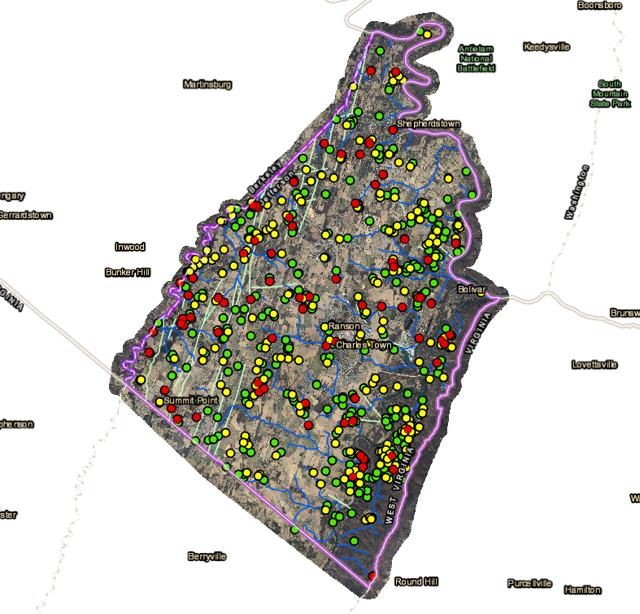
Jefferson County Well Contamination Study
N = 770

Slide 6
What Did We Learn?
46% of the 770 drinking water wells were positive for total coliform bacteria, an indicator of groundwater contamination by surface water
11% of the 770 drinking water wells were contaminated with E. coli bacteria, an indicator of contamination with mammalian feces from septic systems, pets, wild animals, livestock, or application of manure or poultry litter
These both exceeded the average results from water samples taken by USGS from major aquifers throughout the U.S.

Slide 7
What Did We Learn?
Reference: DeSimone, L.A., Hamilton, P.A., and Gilliom, R.J., 2009, The quality of our nation’s waters—Quality of water from domestic wells in principal aquifers of the United States, 1991–2004—Overview of major findings: U.S. Geological Survey Circular 1332, 48 p.

Slide 8
What Did We Learn?

Slide 9
What Did We Learn?
The percentage of samples positive for total coliform bacteria (indicating surface water contamination) has increased by 35% since FY13
+35%

Slide 10
What Did We Learn?

Slide 11
What Did We Learn?
The percentage of samples positive for E. coli bacteria (indicating mammalian fecal contamination) has increased by 203% since FY13

Slide 12
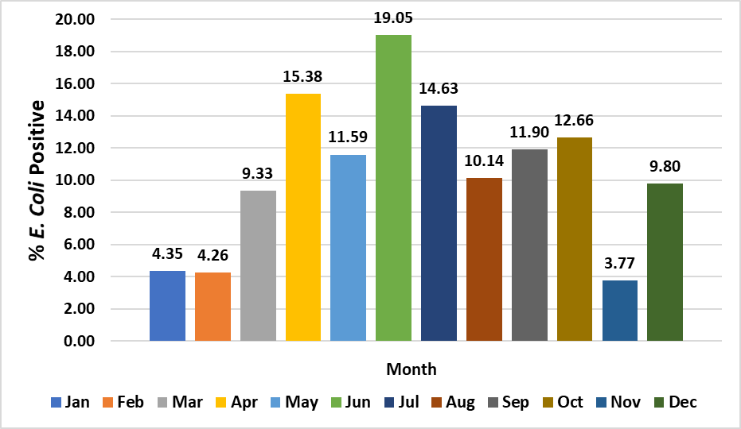
What Did We Learn?
Warmer months (April - October) had more fecal contamination than colder months (November - March)

Slide 13
What Did We Learn?
There was some correlation between the average monthly rainfall and the percentage of samples that were E. coli positive.

Slide 14
What Did We Learn?
The increase in the percentage of E. coli positive samples appears to not be entirely related to rainfall. The trend was occurring prior to the very heavy rainfall in FY19.

Slide 15

Hypotheses That Didn’t Hold Water
“What gets us into trouble is not what we don't know. It's what we know for sure that just ain't so.”
- Mark Twain

Slide 16

Hypothesis #1
In Jefferson County wells are more likely to be contaminated in areas with intensive agriculture

Slide 17
South Agricultural
Part of County
Some areas of intensive agriculture have little fecal contamination.

Slide 18
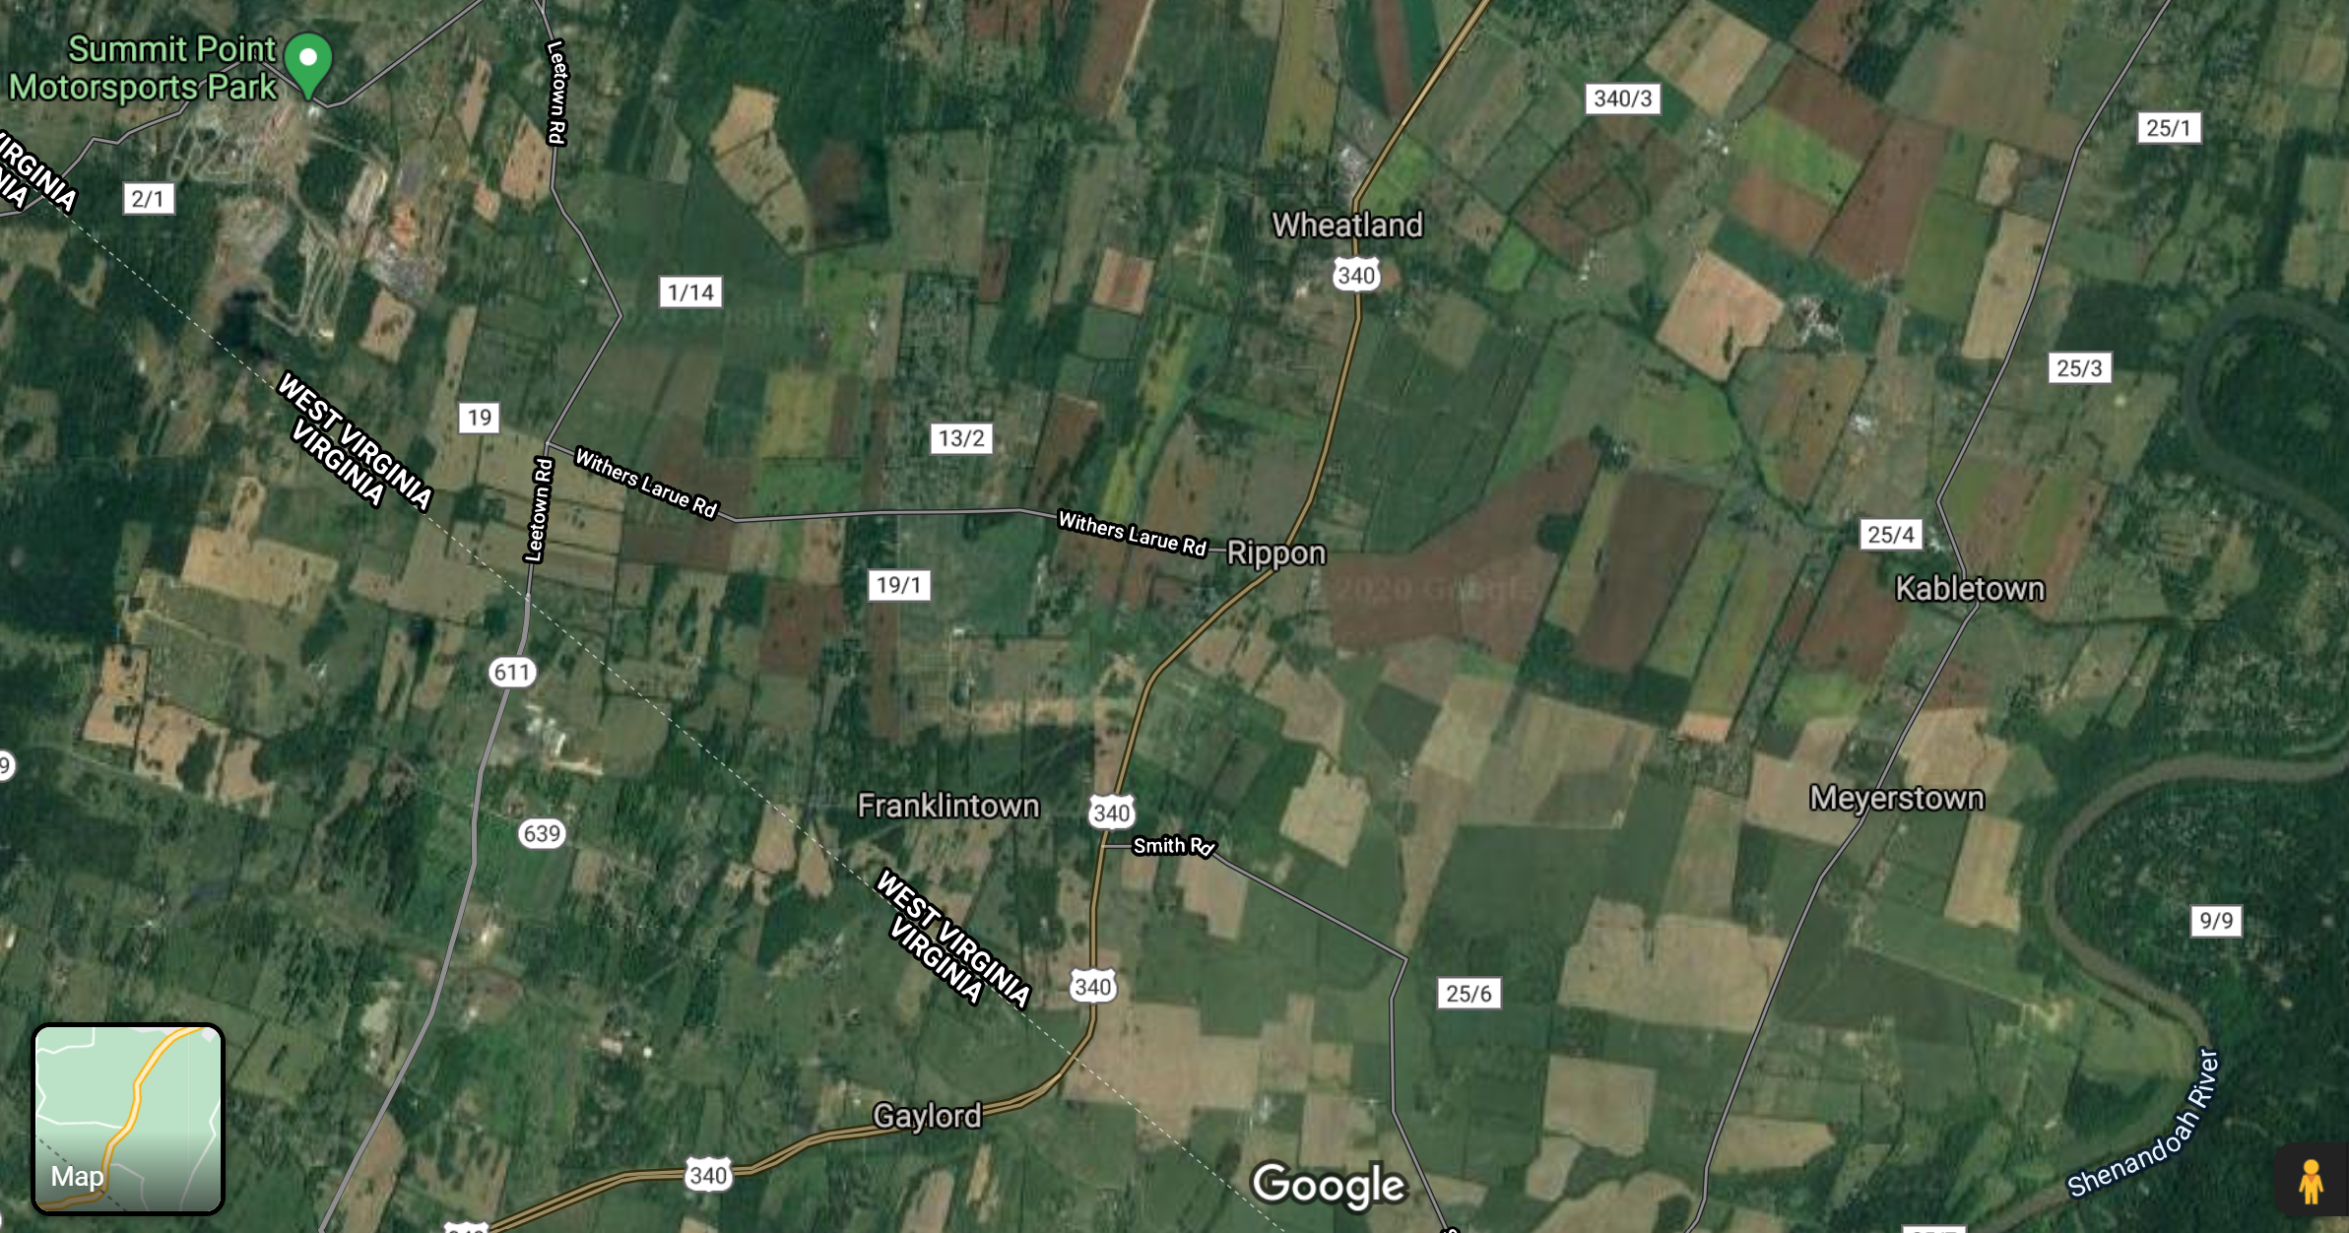

Slide 19
Hypothesis #2
In Jefferson County, wells are more likely to be contaminated in karst areas

Slide 20
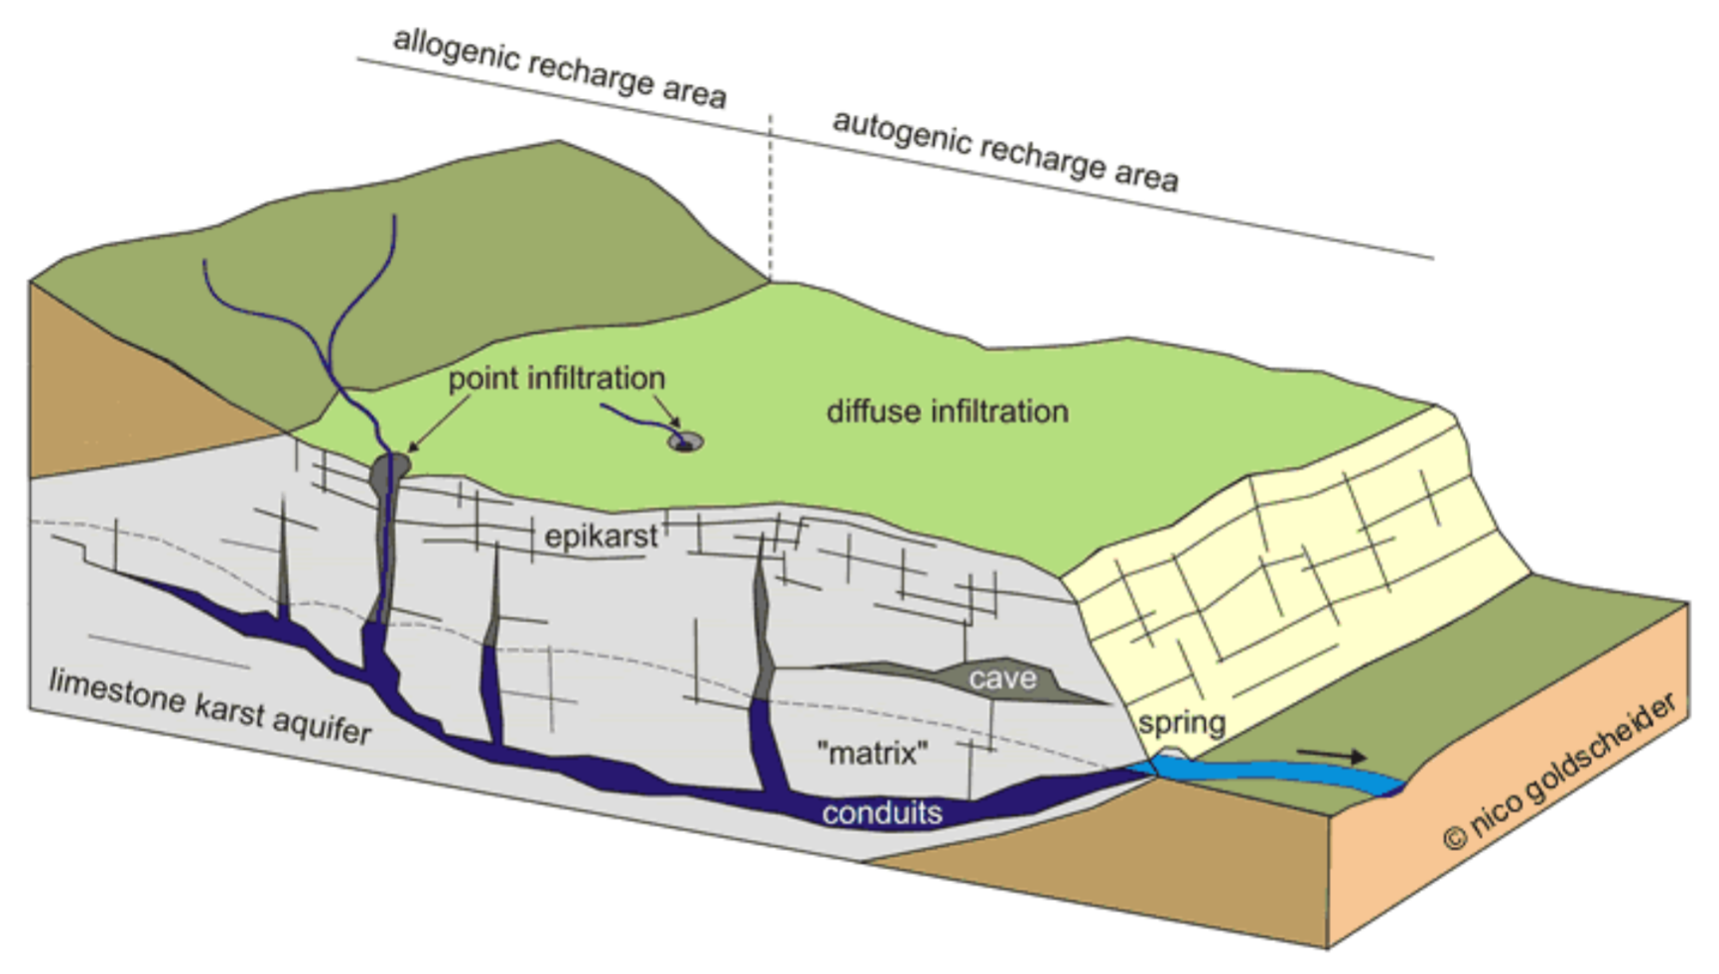
Karst is a topography formed from the dissolution of soluble rocks such as limestone or dolomite. It is characterized by underground drainage systems with sinkholes and caves. In karst areas contaminants can easily pollute groundwater and travel long distances quickly.
What is Karst?

Slide 21
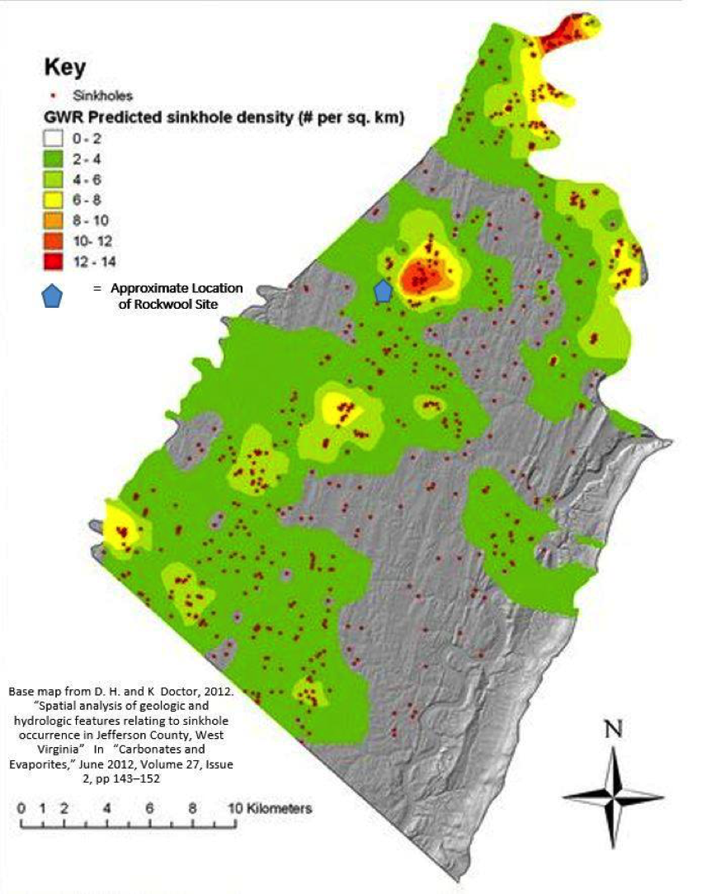


Slide 22
Hypothesis #3
In Jefferson County wells are more likely to be contaminated in areas with steep slopes

Slide 23
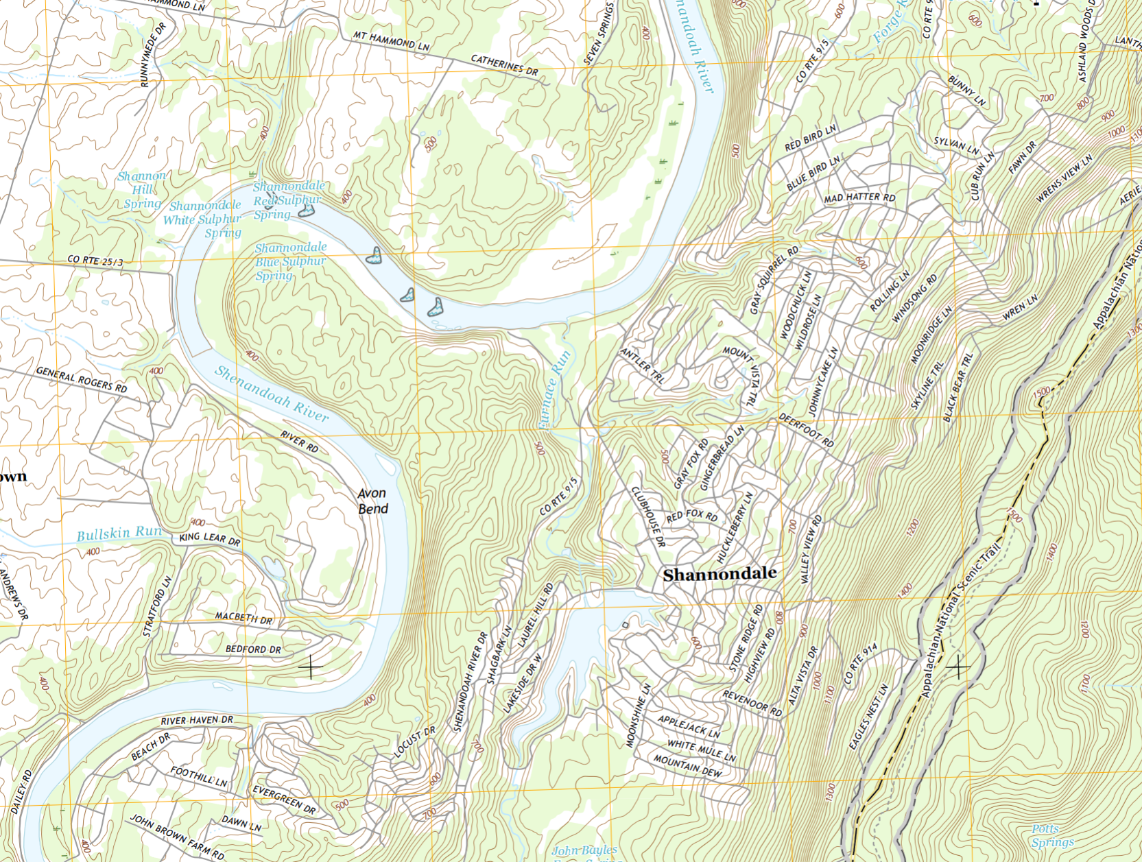
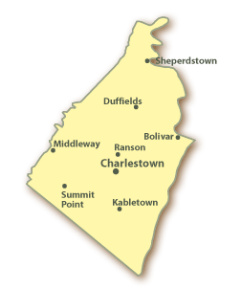
Shannondale

Slide 24
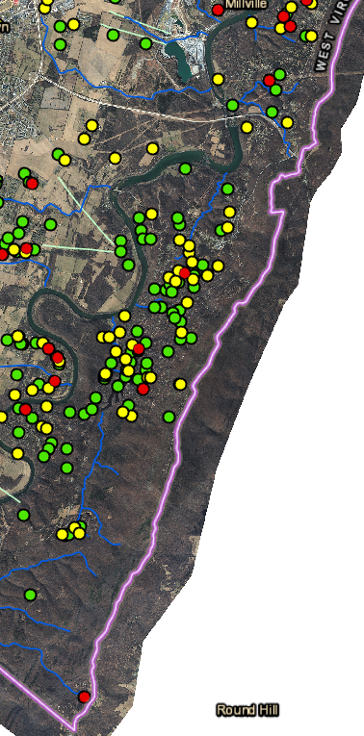
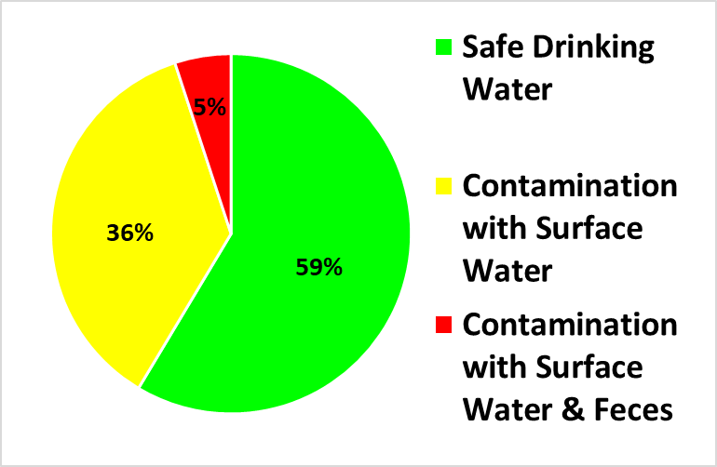
Shannondale
N = 112

Slide 25
Hypothesis #4
In Jefferson County wells are more likely to be contaminated in areas underlain by shale where the soils are most poorly suited for septic systems

Slide 26
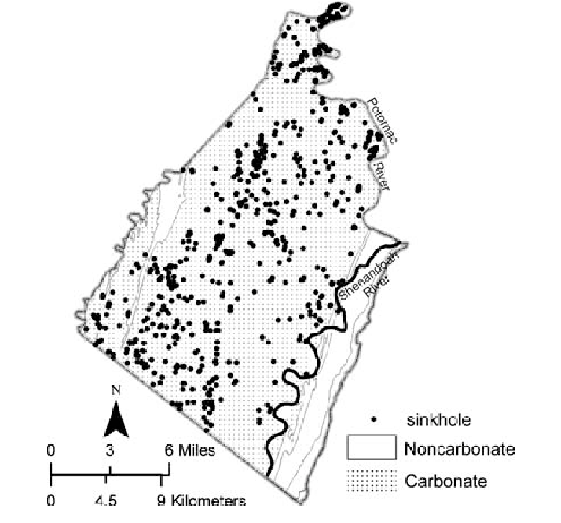
Area circled in red = area of shale bedrock

Slide 27
Hypothesis #5
In Jefferson County wells are more likely to be contaminated in areas that are more densely populated

Slide 28
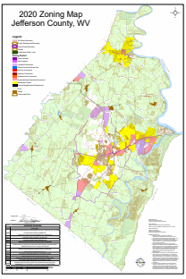
Green = Rural (agricultural) zoning

Slide 29
What Did We Learn?
Contamination was not concentrated in one area of Jefferson County, but several potential “hot spots” were identified

Slide 30
Areas Which May Have a Higher Incidence of Well Contamination
Middleway
Wide Horizon Blvd
Steamboat Run
Brown’s Corner
West Huyett Road
Avon Bend
Blue Ridge Acres

Slide 31
Study Conclusions
Wells in Jefferson County are more likely to have contamination from surface water and more likely to have fecal contamination than wells nationally
Over the last 7 years, there has been a significant increase in the percentage of wells that have tested positive for contamination

Slide 32
Study Conclusions
Based on FY19 data, which showed that 61.6% of the wells tested were positive for total coliform bacteria, as many 17,000 persons in Jefferson County may be drinking water from wells subject to contamination by surface water
Based on FY19 data, which showed that 18.2% of the wells tested were positive for E. coli bacteria, more than 5,000 persons in Jefferson County may be drinking water from wells contaminated with fecal material

Slide 33
How Will We Use This Data?
Targeted outreach to well owners in areas with a higher risk of groundwater contamination encouraging them to test their well water
General community education on protecting groundwater from contamination
Further study focused on identifying the sources of groundwater contamination

Slide 34
Opportunities for Further Research
Analysis of data by:
  Rainfall patterns
  Well depth
  Well age
  Proximity to failing septic systems
Concentrated sampling in specific high-risk neighborhoods
Sampling for other contaminants
  Nitrates
  Arsenic
  Pesticides
  Lead
  VOCs

Slide 35
Our Thanks To …
Kearneysville District Environmental Laboratory West Virginia Department of Health
  Brenda Hall, Lab Director
  Brad Kincheloe, Microbiologist II
  Julie McGhee, Microbiologist I
National Environmental Health Association
  Christine Ortiz Gumina, Project Coordinator
Environmental Health Services Branch, Centers for Disease Control & Prevention

Slide 36
Questions?

Slide 37
Speaker
Contact
Information:
Bob Custard, RS, CP-FS, CPO-I
Environmental Health Consultant
Robert.W.Custard@wv.gov
(304) 728-8416
Carissa Caruso-DiPaolo
NEHA / CDC Intern
ccarusod@syr.edu
Josh Griffin, CPO-I
Jefferson County Sanitarian
Joshua.W.Griffin@wv.gov
(304) 728-8416

