Slide 1
What’s SO Special About EH?
January 2024
Notes:
Ask audience for ideas.

Slide 2
Designing for Action:
How User-Focused Communications
Can Empower
EH Audiences
Eve Elliott
Communications Officer
Alexandria Health Department
January 2024

Slide 3
Today’s Discussion
EH and Communications
Solutions for EH Comms
Examples and guides
Questions
January 2024

Slide 4
What’s SO Special About EH?
January 2024
Notes:
Ask audience for ideas.

Slide 5
Notes:
Source: Jake May—The Flint Journal/AP Images

Slide 6
The Challenges of EH Communications
Abstract
Long-term
Individual AND communal
January 2024

Slide 7
Solutions
Materialize value -- “why”
Cater Content -- “what”
Amplify progress – “so what”
January 2024

Slide 8
Solution 1: Materialize Value
Identify your audience’s personal values
Align success collectively
Month 2023

Slide 9
Audience Values
Month 2023

Slide 10
Audience Values
Month 2023

Slide 11
How Do You Know? ASK!
Month 2023

Slide 12
Audience Values
$100 for bloodwork and testing
$150 for antibiotics
Hundreds more yearly
Lameness, swollen lymph nodes, loss of appetite, kidney complications, and chronic pain
“Rocky and his owner used to love to hike each weekend, but after lyme disease….”
January 2024
Notes:
https://www.forbes.com/advisor/pet-insurance/pet-care/lyme-disease-in-dogs/

Slide 13
Using “We”
Builds trust
Balances power
Note – be careful to share vs. give values
January 2024

Slide 14
Solution 2: Cater Content
Utilize Metaphors
Speak Your Audience’s Language
Convey information in digestible formats
January 2024

Slide 15
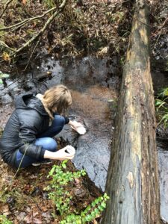
The Power of Metaphors
PFAS =
January 2024
Notes:
Source: University of North Carolina – Carolina Center for Public Service

Slide 16
Speak Your Audience’s Language
Ditch the Droves of Data
Use narrative imagery
Emphasize accessibility
Language
Reading level
Physical disabilities
January 2024

Slide 17
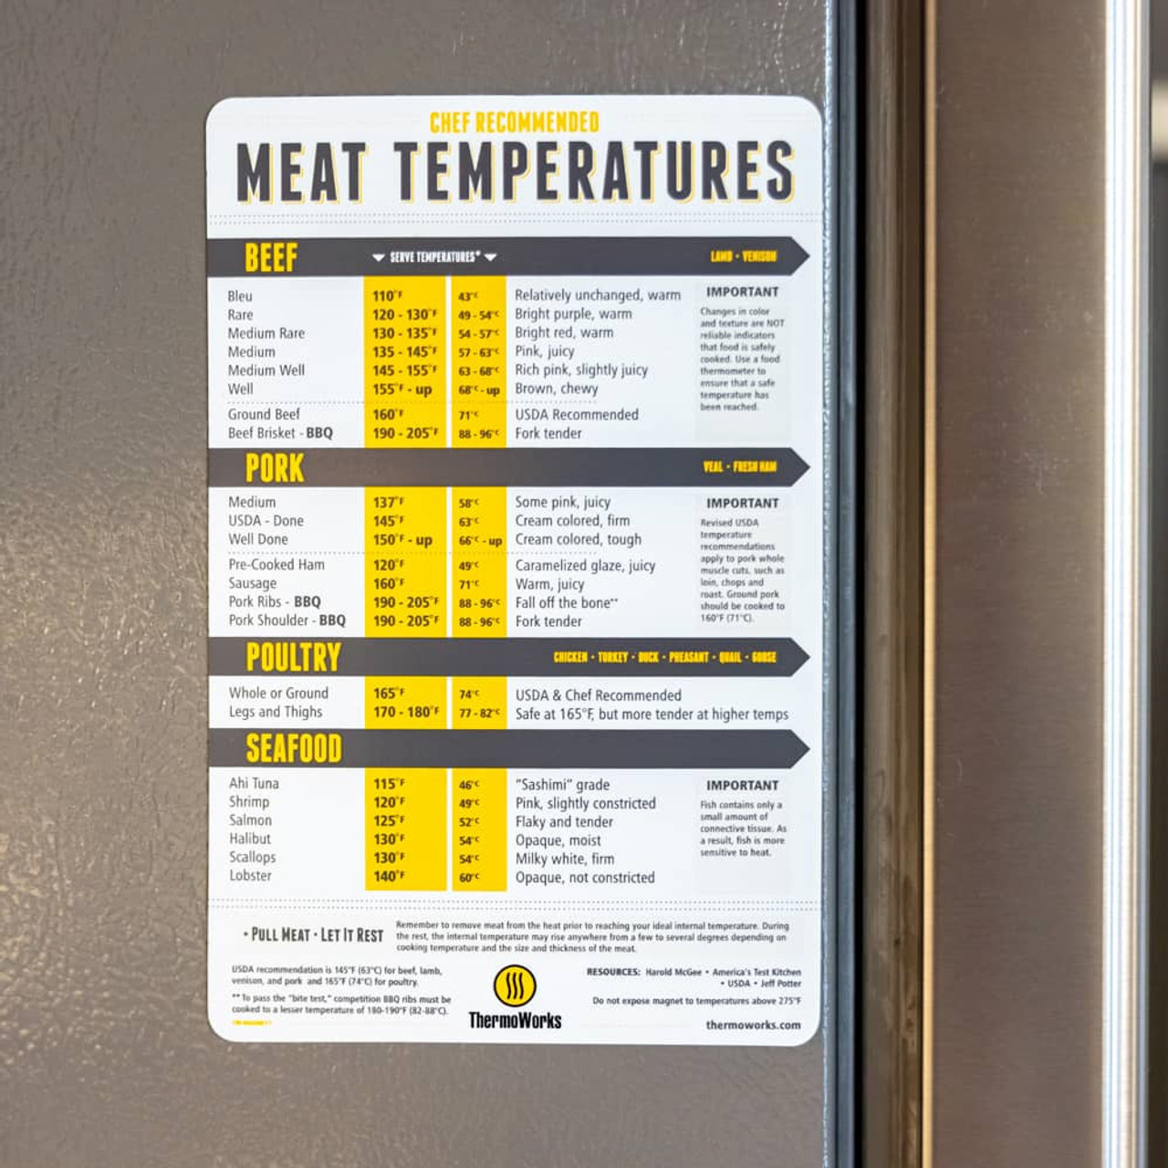
Consider Format
January 2024
Notes:
Source: https://z.umn.edu/8pmk
https://www.google.com/url?sa=i&url=https%3A%2F%2Fwww.thermoworks.com%2Fmeat-magnet%2F&psig=AOvVaw3QnQv6pO9gw1f3LTwGmcFq&ust=1706758396384000&source=images&cd=vfe&opi=89978449&ved=0CBEQjRxqFwoTCJDL_tHYhoQDFQAAAAAdAAAAABAE

Slide 18
Case Study: Home Trigger
Baseball Cards
January 2024

Slide 19
Public Health in Alexandria
Goal: Educate user on remediation of environmental triggers
Challenges:
High info volume
Visual needs
Challenge to existing behaviors
January 2024

Slide 20
Who
Alexandria resident
Could speak English or Spanish
Reading level unknown, but let’s build for 6th Grade
All ages
Experiences common Alexandria home triggers
January 2024

Slide 21
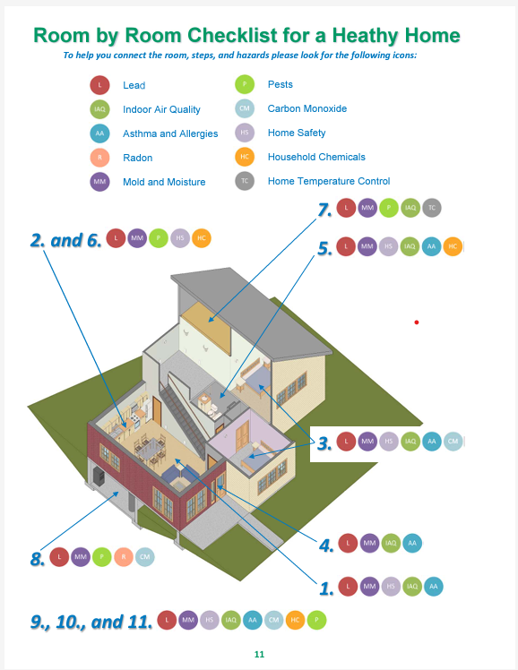
Before: HUD Consumer Action Guide
Month 2023
Notes:
Source; https://www.hud.gov/sites/documents/SAFEANDHEALTHYHOME.PDF
12-page booklet
Lots of text
Tries to include imagery, but not super representative of all homes
Lots of sources to read more
PAPER

Slide 22
Discussion: How can improve that resource for our who?
Alexandria resident
Could speak English or Spanish
Reading level unknown
All ages
Experiences common Alexandria home triggers
January 2024

Slide 23
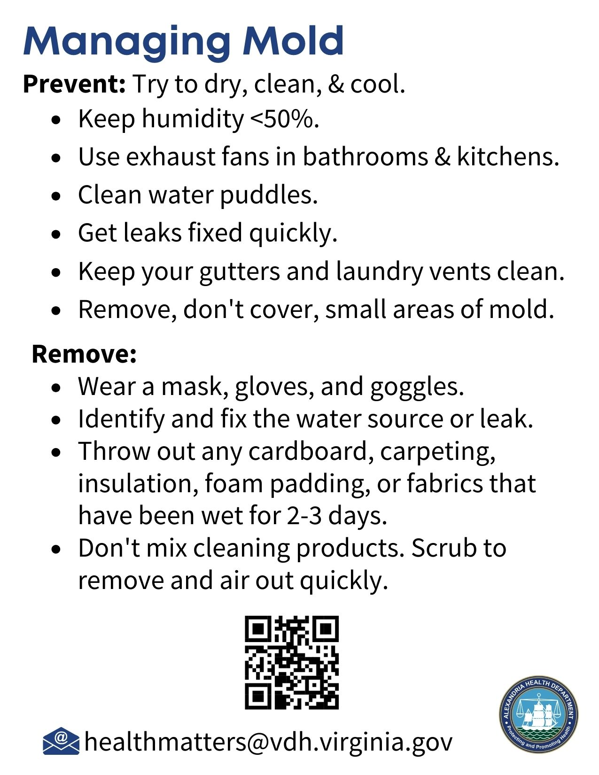
Public Health in Alexandria
Final Product: Baseball Cards
Month 2023
Notes:
Source; https://www.hud.gov/sites/documents/SAFEANDHEALTHYHOME.PDF
12-page booklet
Lots of text
Tries to include imagery, but not super representative of all homes
Lots of sources to read more
PAPER

Slide 24
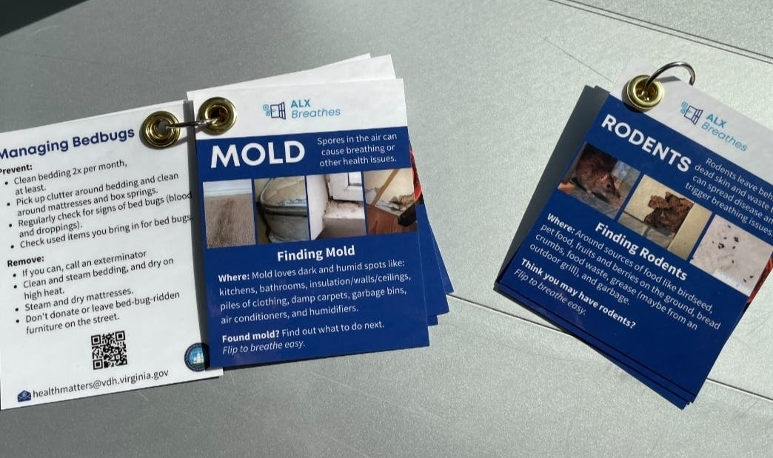
January 2024
Notes:
Source; https://www.hud.gov/sites/documents/SAFEANDHEALTHYHOME.PDF
12-page booklet
Lots of text
Tries to include imagery, but not super representative of all homes
Lots of sources to read more
PAPER

Slide 25
Solution 3: Amplify Progress--
Empowers audience
Sustains behavior changes
Opens the door for more action
Month 2023

Slide 26
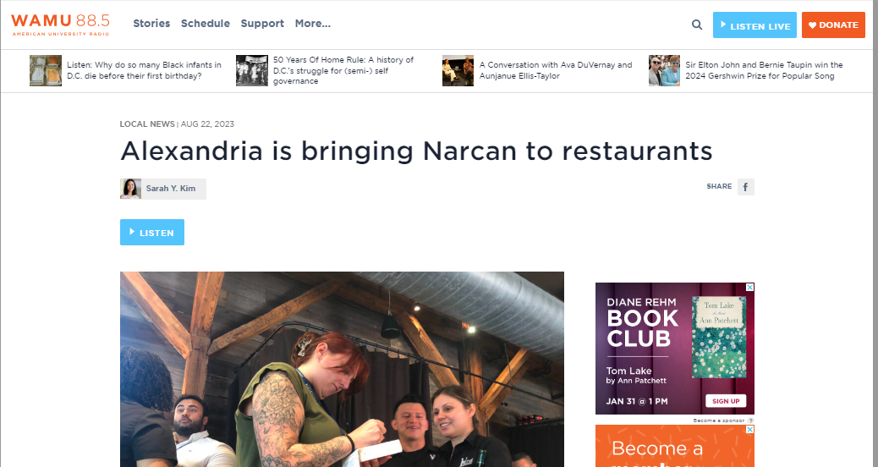
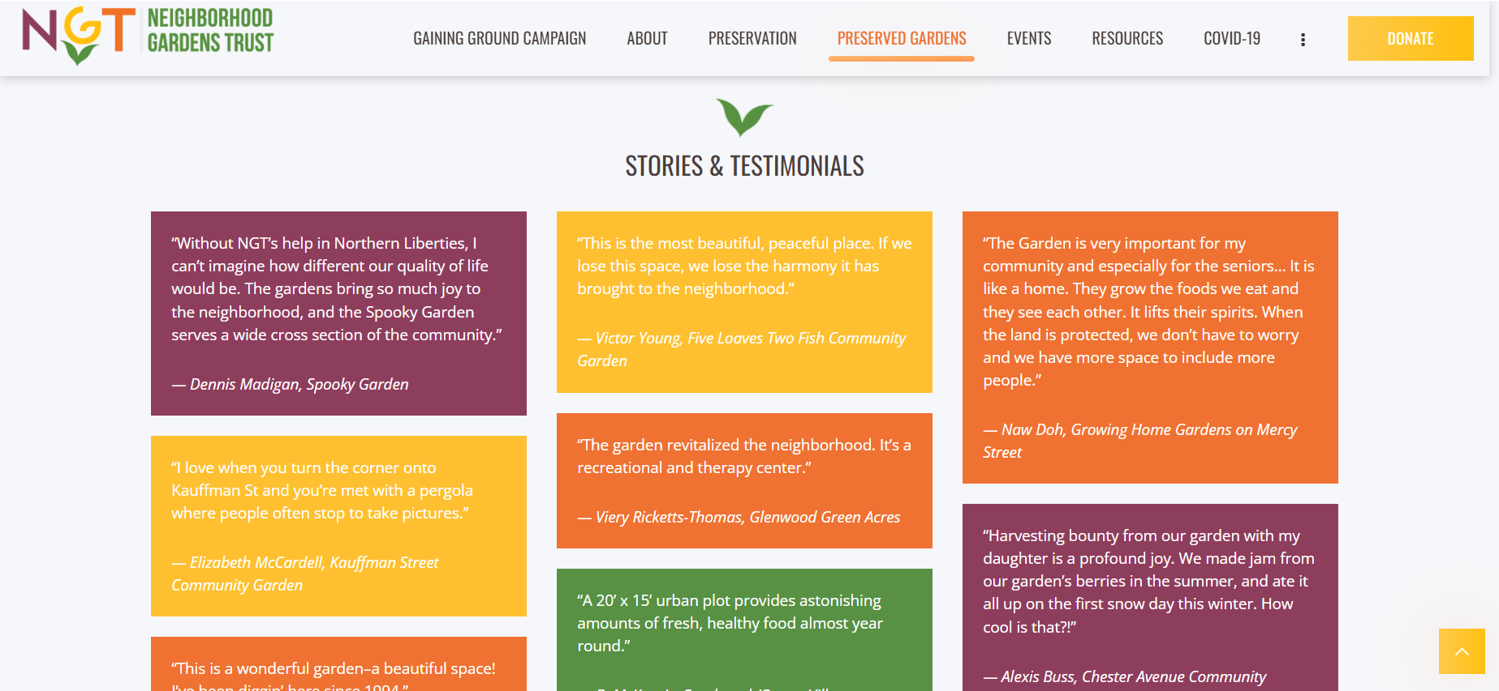
Month 2023
Notes:
Source:
https://www.ngtrust.org/stories-and-testimonials/
https://wamu.org/story/23/08/22/alexandria-is-bringing-narcan-to-restaurants/

Slide 27
Materialize Values
Cater
Content
Amplify Progress
Month 2023
Notes:
Source:
https://www.ngtrust.org/stories-and-testimonials/
https://wamu.org/story/23/08/22/alexandria-is-bringing-narcan-to-restaurants/

Slide 28
QUESTIONS?
Month 2023

Slide 29
Contact Me
Eve.Elliott@vdh.virginia.gov
804.467.5160
January 2024

Slide 30
Logos

