Slide 1
Before you Baechu
Kimchi Hazard Analysis of Critical Control Point Plan
Fairfax County Health Department HACCP Team

Slide 2
What is Kimchi?
Kimchi is a traditional Korean method originating over 3,000 years ago. It is a method to ferment and preserve vegetables using a salt brine to grow lactis bacillus (lower pH).
Notes:
Kimchi is a traditional Korean dish originating over 3,000 years ago. It is a method to ferment and preserve vegetables using a salt brine to promote the growth of lactic acid bacteria (lower pH).
-TRADITIONAL RECIPE?
Remove periods from bulleted list –done
Is kimchi the food or the method? - it's a method
Why are we interested?
Cut leafy greens are considered TCS food
To make Kimchi, cut leafy greens or whole head of cabbage and other cut vegetables are left at room temperature for >4hrs.
Fermented cabbage must reach a pH of 4.2 or less

Slide 3
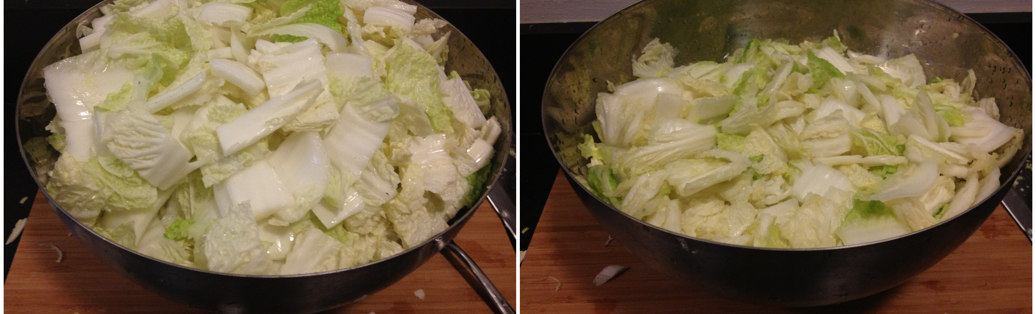
Why do we care?
2019 FDA Food Code revisions consider cut leafy greens are TCS foods
In process of making traditional Kimchi, cut vegetables are left at room temperature for >4hrs and kept for >7 days
Ensure the salt brine does indeed drop the pH of the item to 4.2 to prevent spoilage
pH of above 4.2 does not contain enough acid to prevent botulism
Notes:
defined as having a pH above 4.6—do not contain enough acid naturally to prevent the germination and growth of the botulinum spores found on most fruits and vegetables that come in contact with soil
-Based on the recipe alone, we would likely be citing violations for cold holding and date marking every time we inspect these establishments.

Slide 4
Seo Chon
Seo Chon is a Korean establishment which opened recently
Menu review found Kimchi
Do you make kimchi on site?
What is your process of making Kimchi?
How long do you keep your Kimchi for?

Slide 5
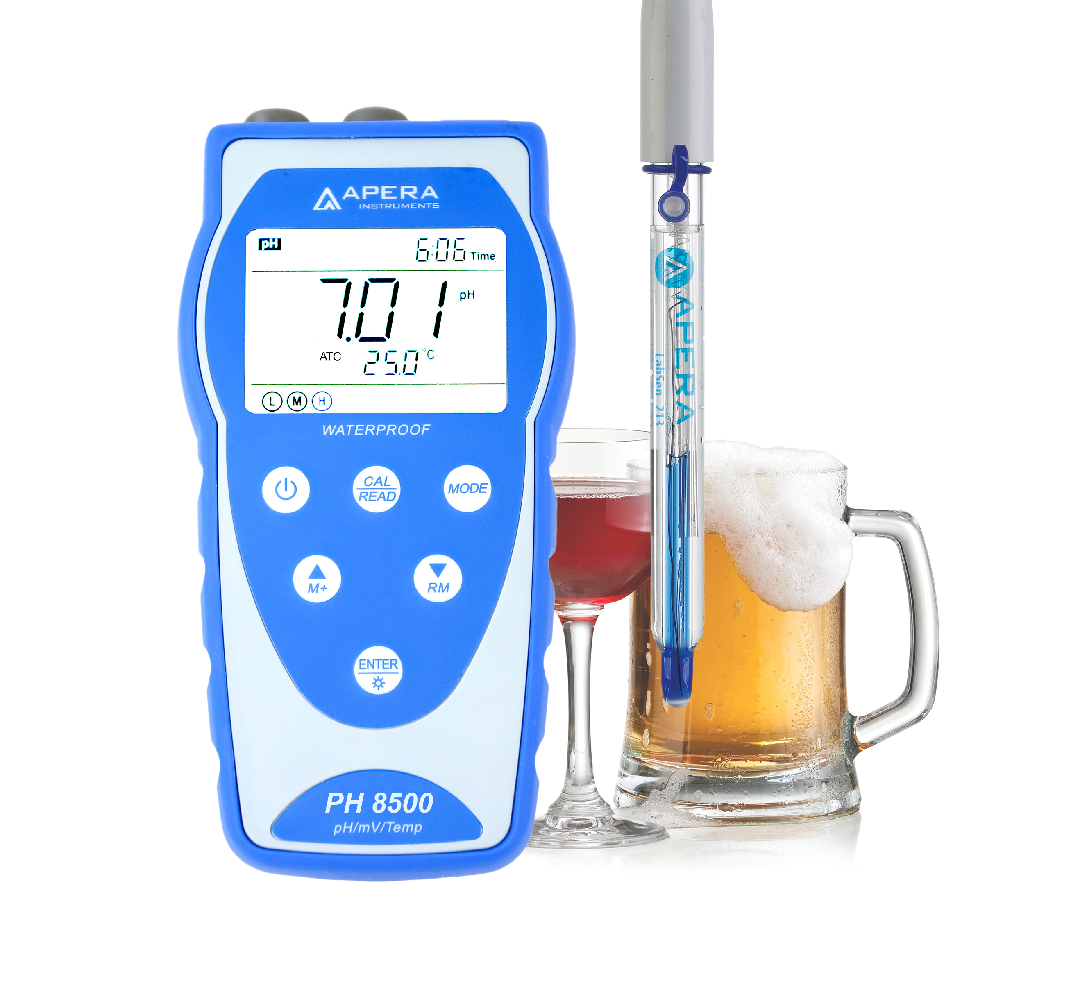
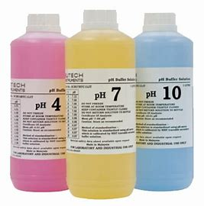
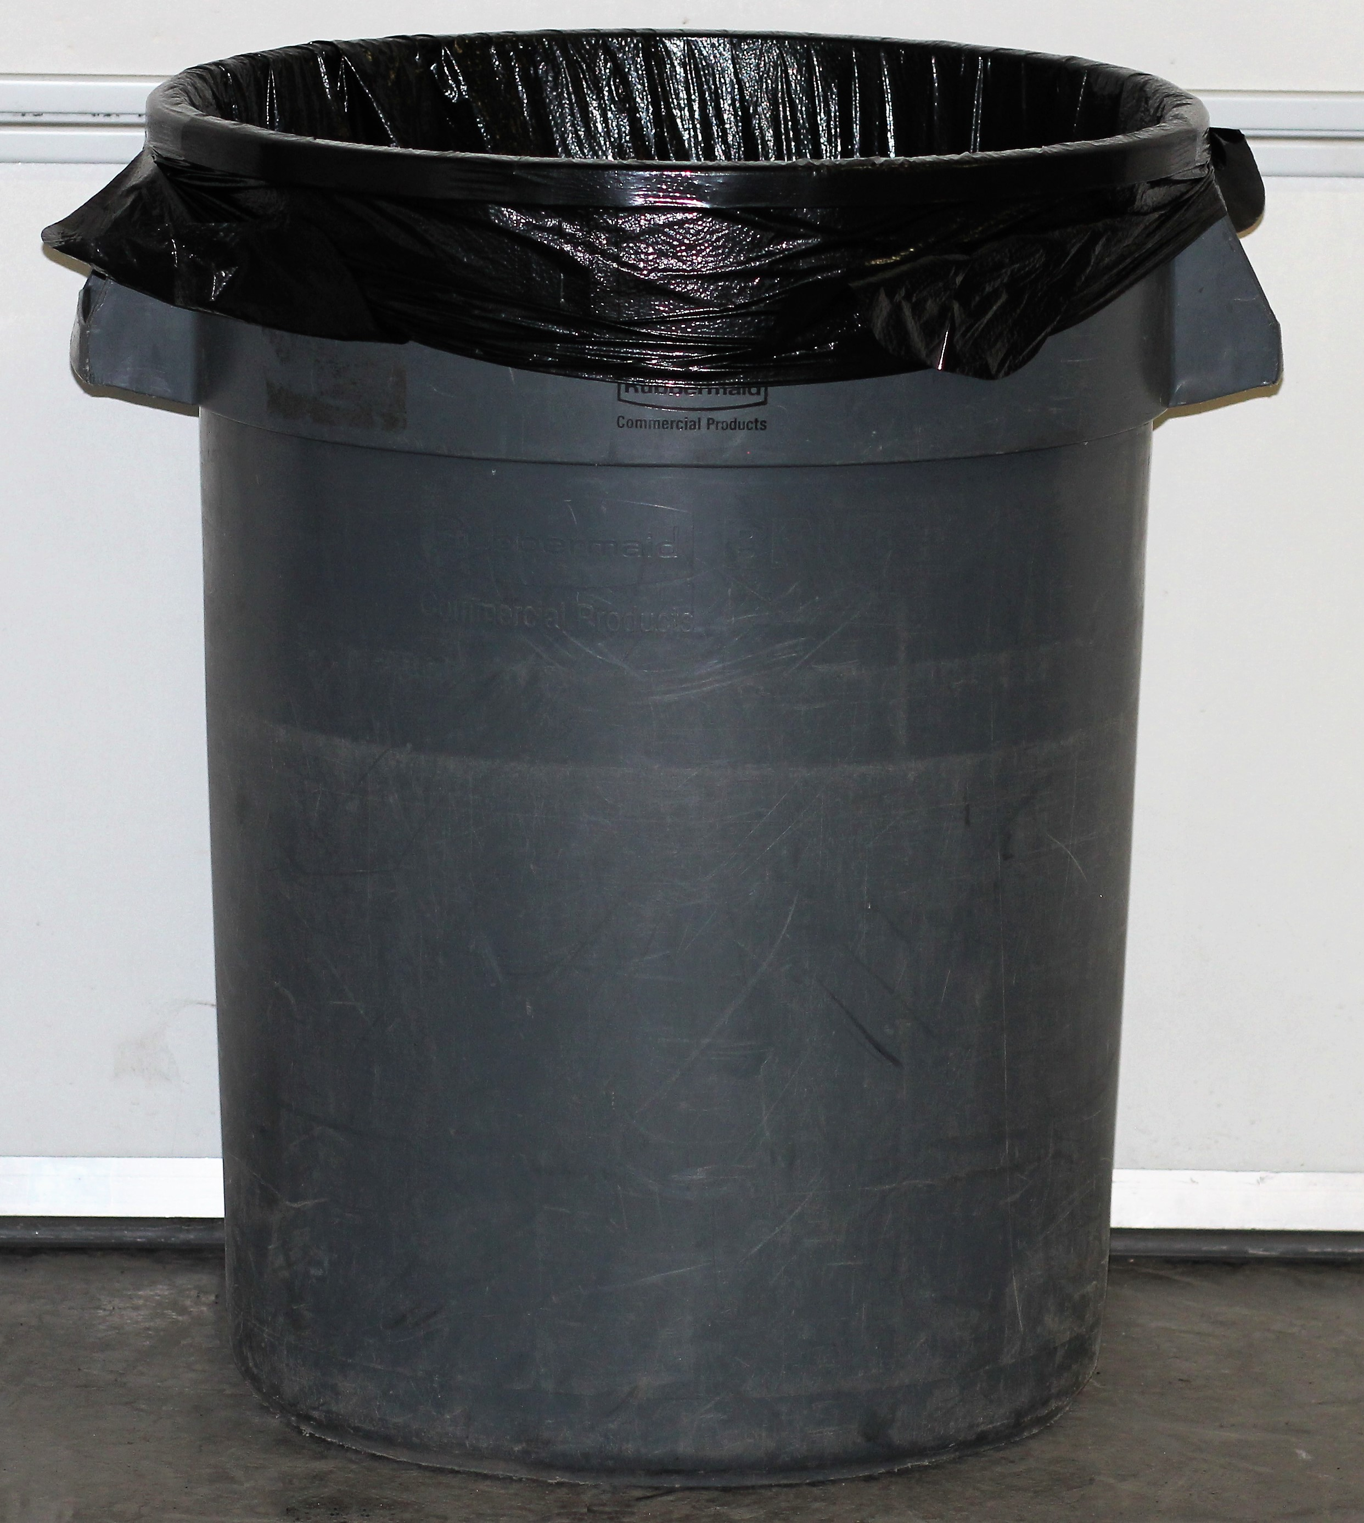
What documents/materials are required?
Approved equipment & approved pH meter with buffers
Variance request application
Hazard Analysis of Critical Control Point Plan
Notes:
Completed variance request application
HACCP Plan
Approved equipment/Utensils
Approved pH meter
Buffer solutions
Equiptment must be smooth and easily cleanable
Have a slide for each section of our Plan

Slide 6
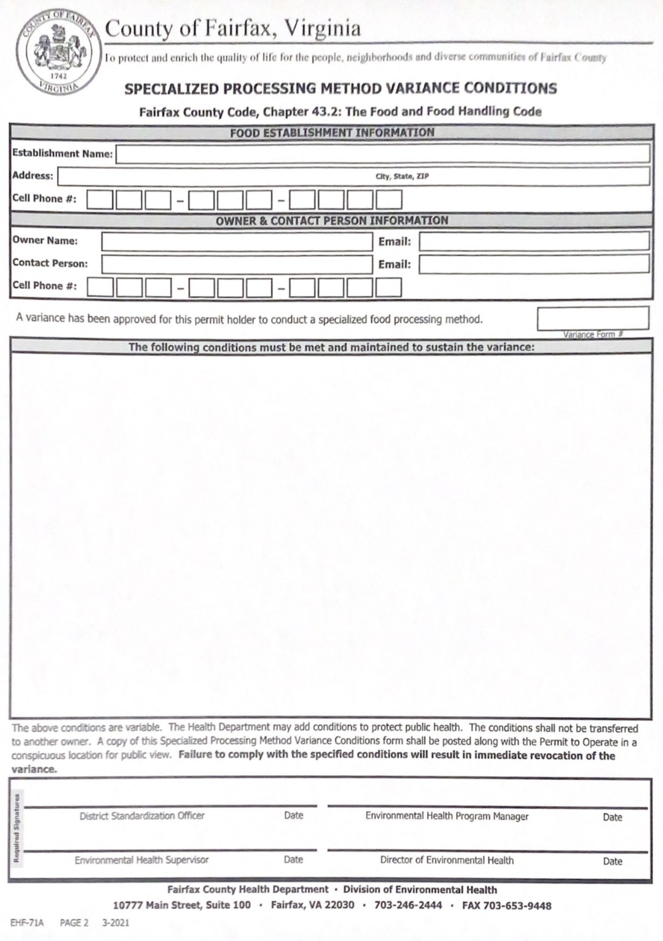
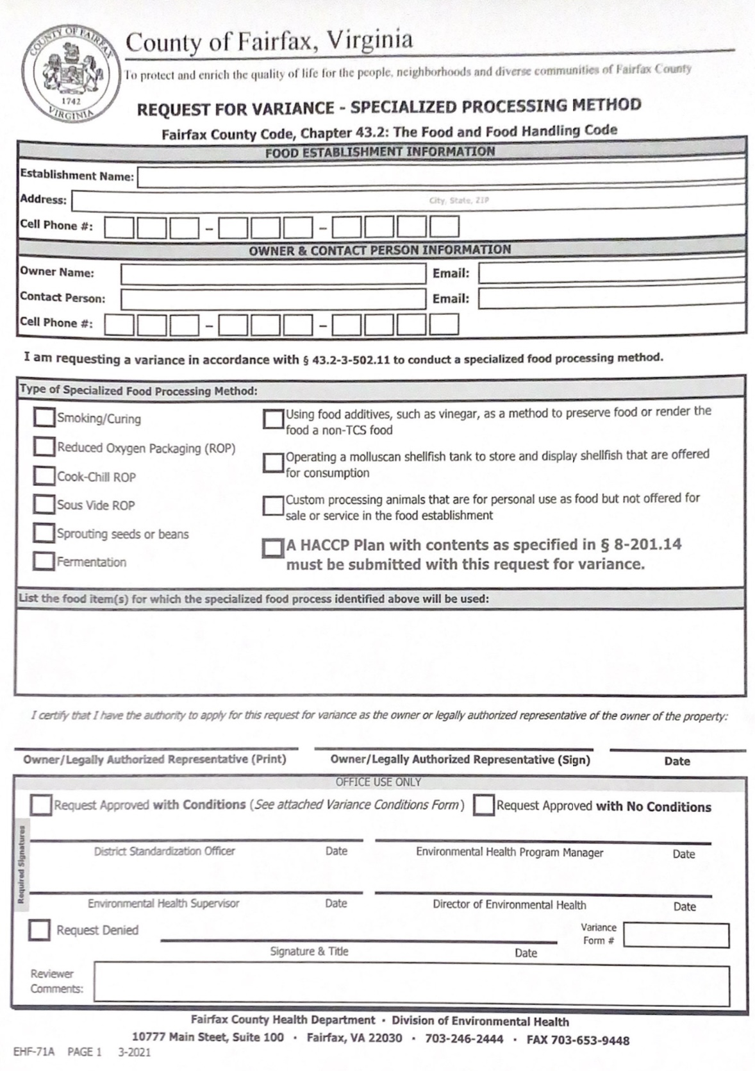
Variance Request Application
Notes:
-Fermentation or using additives?
-HACCP Plan with contents must be submitted!!
-Food items would be what items they make into kimchi (ex- cabbage)
-Depending on the plan they display, we can approve with pending conditions
-Page 2 is where conditions are given back to establishment.
+++ update to PLUS

Slide 7
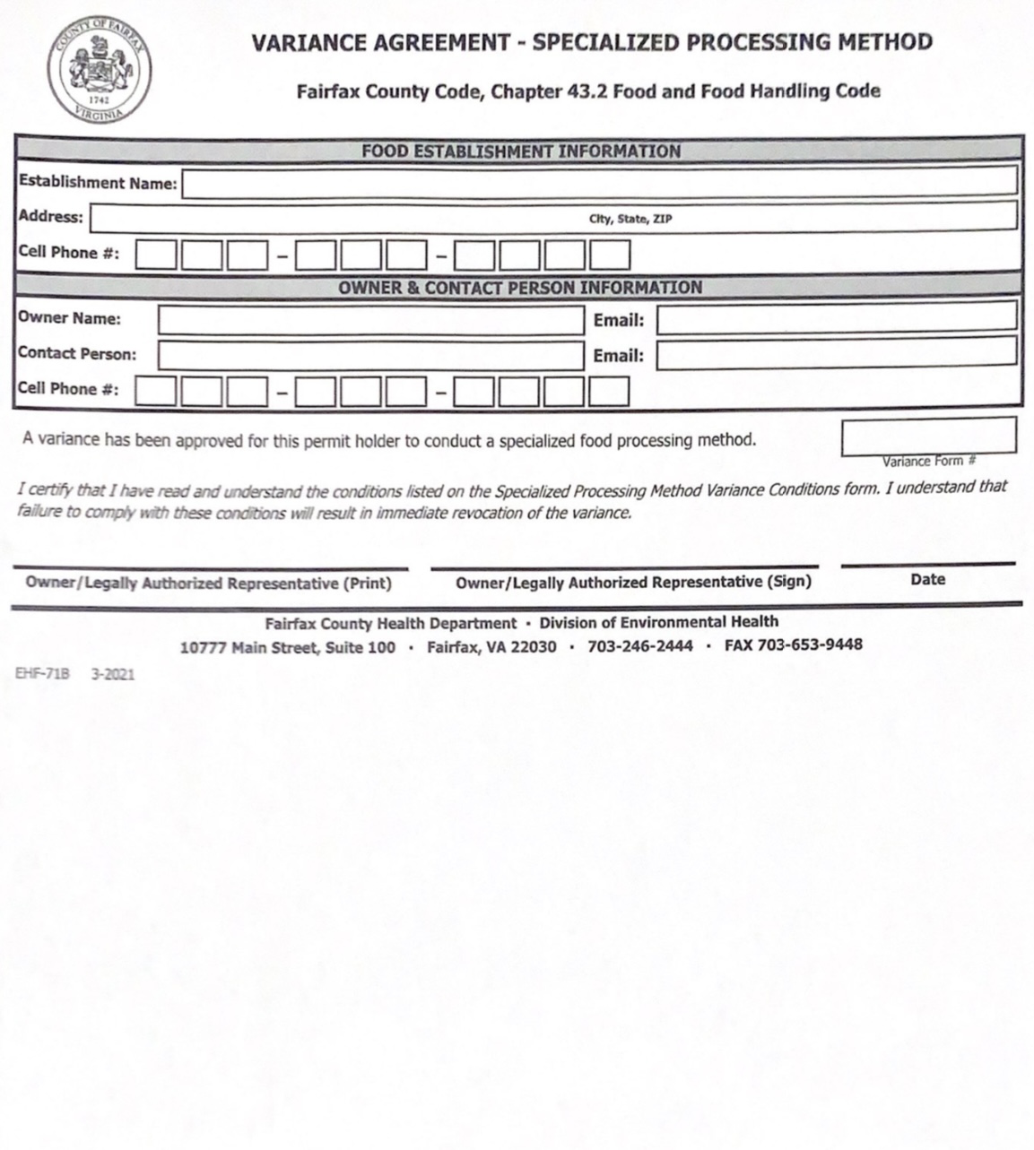
Variance Request Application
Notes:
Lastly there is an agreement form for the owner/representative to sign if they are in agreeance with the conditions of the variance and HACCP.

Slide 8
What is in a HACCP Plan?
Ingredients/Recipe
Standard Operating Procedures for product creation
Flow chart of product creation, storage, and service
Corrective Action Plan (Critical Control Points should be denoted in SOPs and Flow Chart)
Record logs
Notes:
Ingredients and recipe – are they from an approved source too? Are materials approved?
SOP
Flow Chart
Corrective Action Plan
Record logs (employee training, pH meter calibration, pH testing for product
-Sample guide has training agreements for employee hand washing, employee hygiene, glove use, cleaning and sanitizing, batch labeling and pH meter use. Managers are ultimately responsible for ensuring procedures are followed.
Employee training – only trained employees should be participating in the processes for items with HACCP
pH meter must be calibrated by measuring two buffer solutions before measuring the pH of the actual kimchi sample
pH of Kimchi should be tested at least 1/day and recorded until a pH of 4.2 is achieved

Slide 9
Ingredients
Napa cabbage
Salt
Rice flour
Sugar
Water
Garlic
​
Ginger​
Onion ​
Fish sauce ​
Pepper flakes​
Carrots, radish, cucumber, etc
Notes:
~ Make it into a story -
Seo Chon is a new establishment in Fairfax County

Slide 10
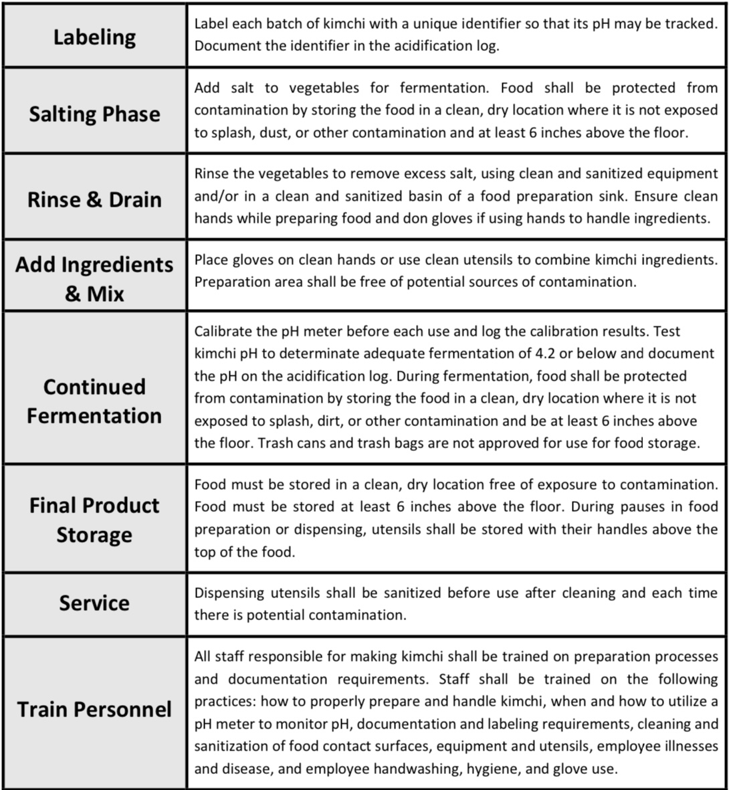
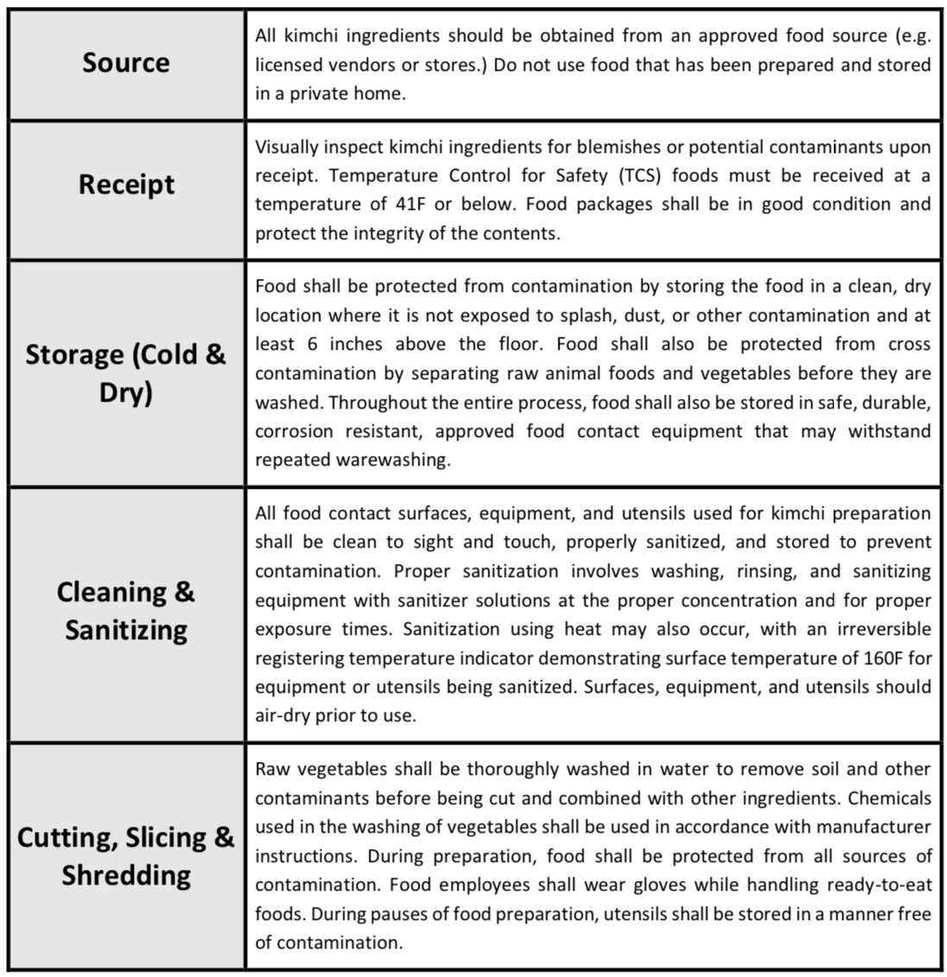
SOP - SAMPLE

Slide 11
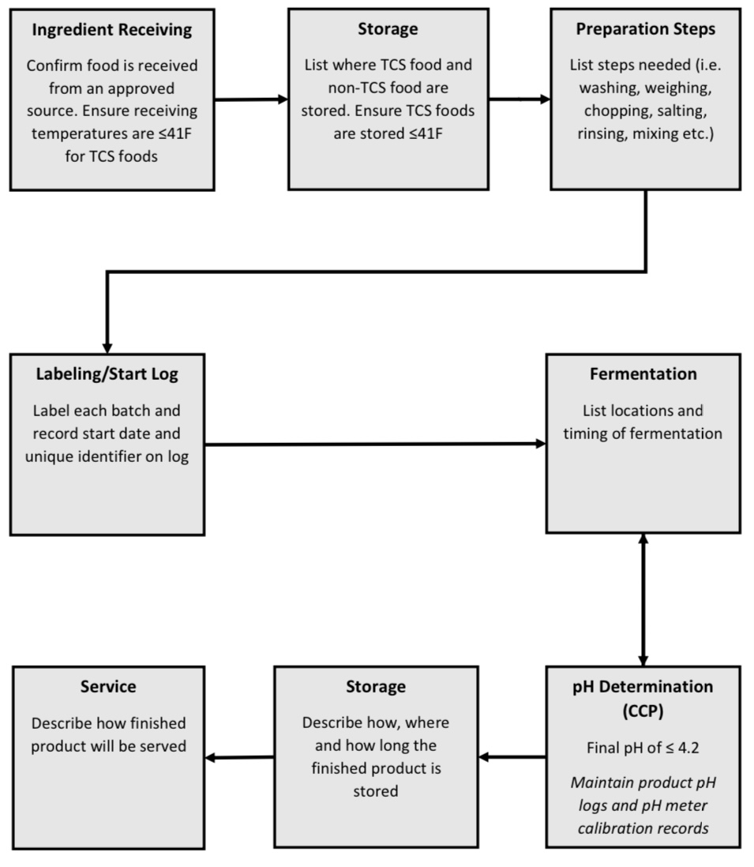
Flow Chart – SAMPLE

Slide 12
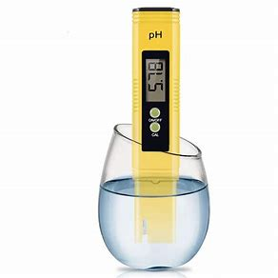
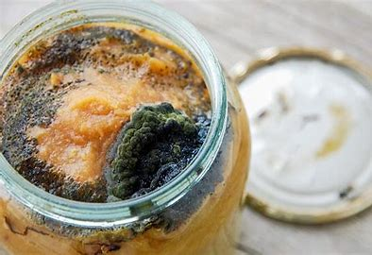
Corrective Actions
What to do if procedures are incorrectly followed or intended outcome is not achieved:
Contaminated foods must be discarded.
If pH is tested above 4.2, continue the fermentation process.
Notes:
What to do if flow or SOP is not followed~~~ CCP – corrective actions
Contaminated food must be discarded
If pH is tested below 4.2, continue the fermentation process

Slide 13
Logs - SAMPLE
pH meter is used to measure the hydrogen ion activity levels of a given solution. It is required to confirm that the correct level of acidity is achieved when fermenting.
To ensure the pH meter is accurately measuring, buffer solutions are initially measured.

Slide 14
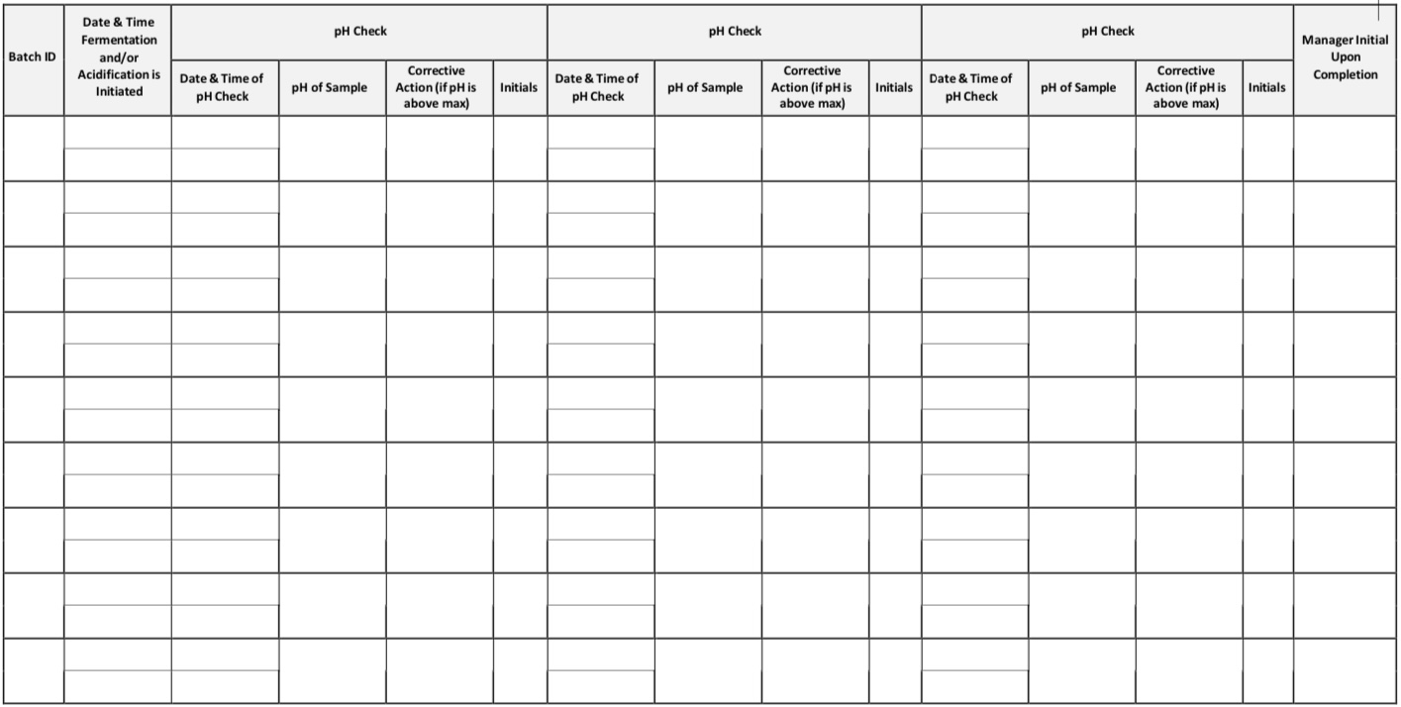
Logs - SAMPLE

Slide 15
How to implement as the Inspector
If approved, there should be a Variance record attached to the file
Check the logs
Are they calibrating the pH meter before use?
Are the batches of kimchi consistently reaching a pH of 4.2 or below?
If a batch of kimchi is 'ready to serve' they should test at a pH of 4.2 during the inspection.
Notes:
What should we look for?
Variance Approval/HACCP Plan on site
Following the HACCP Plan
Logs:
calibration: Are they calibrating the pH meter before use?
pH: Are they documenting the pH of each batch? Are batches of kimchi consistently reaching a pH of 4.2 or less.
Corrective Actions documented?

Slide 16
Challenges in Implementation
Tradition & Culture
Anti-oxidant
Probiotic
Cultural Competence
Public risk
Botulism
E. Coli
Salmonella
Notes:
As forementioned, this is a dish that has been created for thousands of years, and now a regulatory agency is telling them they have documentation and to purchase new supplies.
Cultural competence – Understanding, communicating, and interaction

Slide 17
If you see a facility fermenting kimchi without a variance and/or non-approved HACCP plan:
3-502.11(C)/12VAC5-421-860 - Variance Requirement (Priority Foundation)
Corrective Action: Submit a Variance Request AND
8-201.13(A)/12VAC5-421-3620 - When a HACCP Plan is Required (CORE)
Corrective Action: Submit a HACCP Plan
Notes:
A slide per scenario (Have code and corrective actions fly in second.
If you see a facility fermenting kimchi without a variance and/or non-approved HACCP plan:
3-502.11C- Variance Requirement (PF)
Corrective Action: Submit Variance request
and
8-201.13(A) When a HACCP Plan is Required (Core)
Corrective Action: Submit HACCP Plan
If you find a facility fermenting kimchi with an approved variance and not following HACCP plan:
8-103.12(A) Conformance with Approved Procedures - Comply with HACCP Plans and Procedures that are submitted and approved (P)
Corrective Action: Follow HACCP plan as submitted and approved by the Health Department
and/or
8-103.12(B) Conformance with Approved Procedures – Maintain and provide to RA records (PF)
Corrective Action: Maintain the required record as per your approved HACCP plan. Maintain on site for Health Department review.
If facility has submitted a HACCP Plan/Variance Request but it has not been approved and you see the process of kimchi fermentation occurring:
3-502.11C- Variance Requirement (PF)
Corrective Action: Discontinue process until approval is received
and
8-201.13(A) When a HACCP Plan is Required (Core)
Corrective Action: Discontinue process until approval is received

Slide 18
If you find a facility fermenting kimchi with an approved variance and not following the HACCP plan:
8-103.12(A)/12VAC5-421-3595 - Conformance with Approved Procedures – Comply with HACCP Plan and Procedures that are submitted and approved (Priority)
Corrective Action: Follow HACCP plan as submitted and approved by the Health Department AND/OR
8-103.12(B)/12VAC5-421-3595 - Conformance with Approved Procedures – Maintain and provide risk assessment records (Priority Foundation)
Corrective Action: Maintain the required record as per your approved HACCP plan. Maintain on site for Health Department review.

Slide 19
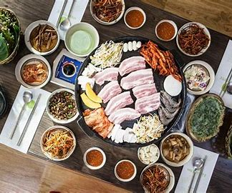
Questions????????
Thank you!!!!!

