Slide 1
Moving Towards a Values-Driven Practice of Environmental Health
Bob Custard, REHS, CP-FS
NEHA Past-President (2015-16)
EH Leadership Partners, LLC

Slide 2
Defining Your Core Values
“Values aren't buses... They're not supposed to get you anywhere. They're supposed to define who you are.”
― Jennifer Crusie
This Photo by Unknown Author is licensed under CC BY-SA

Slide 3
What Are Your Core Values?
____________
____________
____________
____________
This Photo by Unknown Author is licensed under CC BY
Think About It

Slide 4
Respect
Excellence
Service
Professionalism
Education
Commitment
Teamwork
This Photo by Unknown Author is licensed under CC BY-ND
Common Core Values

Slide 5
This Photo by Unknown Author is licensed under CC BY-SA
Identified Using a Collaborative Process

Slide 6
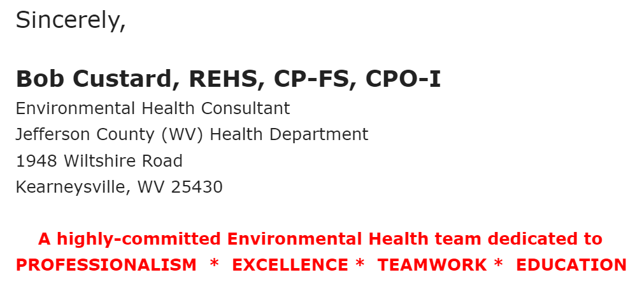
Make Your Values Visible
Internally & Externally
Email

Slide 7
Always Visible
Web Site

Slide 8
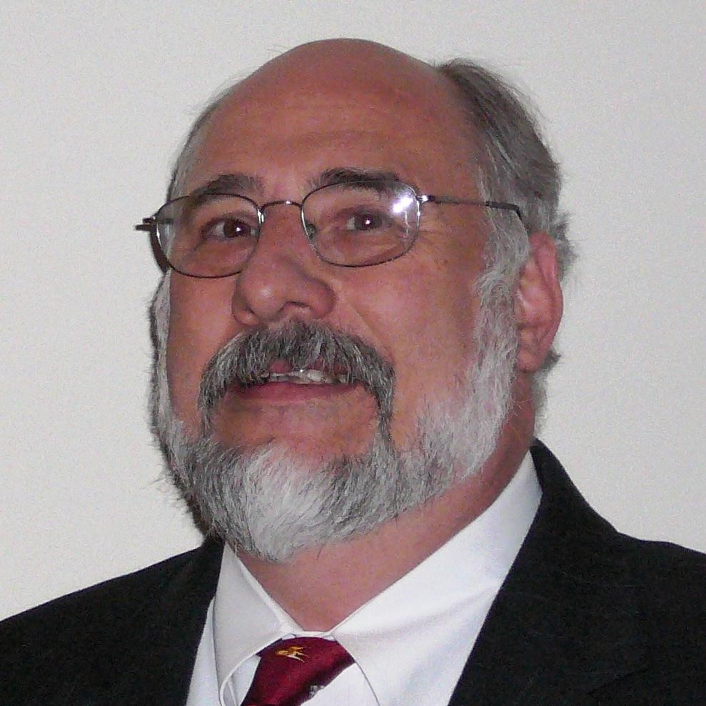
Zoom
Bob Custard, RS, CP-FS
Environmental Health
Leadership Partners, LLC
Highly-committed to:
LEADERSHIP
PROFESSIONALISM
EXCELLENCE
SERVICE
EDUCATION
Developing the next generation of Environmental Health leaders
BobCustard@comcast.net

Slide 9
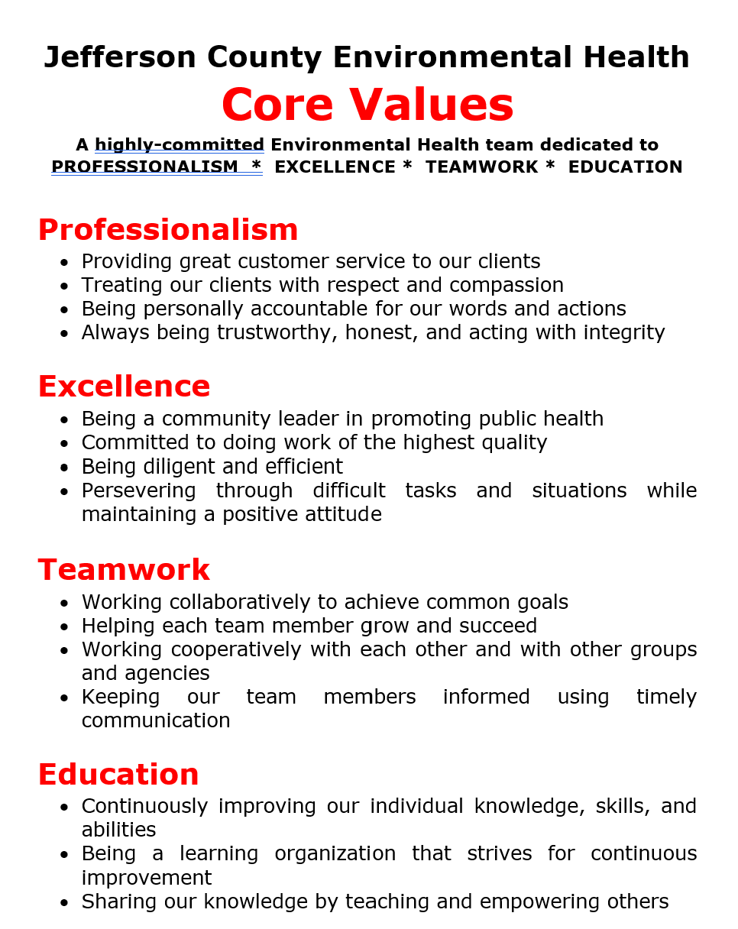
Always Visible
Posters

Slide 10
Model Your Core Values
“Values
are caught,
not taught.”
How do you model the core values of your work unit?
This Photo by Unknown Author is licensed under CC BY-NC-ND

Slide 11
Values-Based Decision Making
“It's not hard to make decisions when you know what your values are.”
― Roy Disney
This Photo by Unknown Author is licensed under CC BY-SA

Slide 12
Model Values-Based Decision Making
ASK:
“In light of
our core values, what is the best course of action in this situation?”
This Photo by Unknown Author is licensed under CC BY-NC
Show How Decisions Are Made Based On Core Values

Slide 13
Values-Based Hiring
“Good values are like a magnet – they attract good people.”
- John Wooden
This Photo by Unknown Author is licensed under CC BY-NC-ND

Slide 14
Interview Questions That Reveal Attitudes & Values
Describe any volunteer experience you have had working with community or service organizations?
If we ever got into a bind with a client, would you be willing to tell a little white lie to help your supervisor out?
In general, would you prefer to work independently or as part of a team?

Slide 15
Values-Based Training
“People can’t live up to the expectations that they don’t know have been set for them.”
- Rory Vaden
This Photo by Unknown Author is licensed under CC BY-SA

Slide 16
Values-Based Training
Set clear expectations
Explain why it is important
Illustrate your core values with stories
Celebrate public health heroes
This Photo by Unknown Author is licensed under CC BY-SA-NC

Slide 17
Integrating Values Into Training
“One of our core values here at the Jefferson County Health Dept is education.
When we begin each food safety inspection, we ALWAYS wash our hands because:
As an EH professional we should model desired food safety behaviors
We use it as an opportunity to teach proper handwashing to the restaurant staff
Most restaurant staff are oral learners who learn better by hearing and observing rather than by reading”

Slide 18
Values-Based Performance Standards
“You can only improve
what you measure.”
- Tom Peters
This Photo by Unknown Author is licensed under CC BY-SA

Slide 19
Values-Based Performance Standards
How do you incorporate core values into performance standards?
This Photo by Unknown Author is licensed under CC BY-SA-NC

Slide 20
Values-Based Performance Standards
Customer Service
Quality
Standards should be:
Specific
Measurable
Attainable
Relevant
Time-Limited
Timeliness
Quantity
Standard

Slide 21
Example Performance Standards
In keeping with our core value of professionalism, the EHS will respond appropriately to foodborne illness complaints within 24 hours of receipt at least 95% of the time
In keeping with our core value of excellence, the EHS will score at least 75% in conformance with at least 18 of the 20 elements in Retail Food Program Standard 4 during the four annual joint on-site inspections with their supervisor

Slide 22
Example Performance Standards
In keeping with our core value of educating and empowering our clients, the EHS will help teach at least two Certified Pool Operator classes annually
In keeping with our core value of customer service, the EHS will be rated as “Usually” or “Always” treating clients fairly and with respect at least 90% of the time on the annual client customer service survey

Slide 24
Values-Based Coaching & Mentoring
Reinforce importance of core values
Frame difficult conversations in terms of how performance did not conform with core values of organization
Praise performance exemplifying core values
This Photo by Unknown Author is licensed under CC BY

Slide 25
Values-Based Coaching & Mentoring
“As you know, one of our core values is education. That includes continuously working to improve our knowledge and abilities. Now that you have been with us two years and have completed your basic training, I would like to encourage you to take it to the next level and earn your REHS credential.”
This Photo by Unknown Author is licensed under CC BY-SA

Slide 26
Values-Based Coaching & Mentoring
“As you know, two of our core values are customer service and professionalism. That includes responding quickly to consumer foodborne illness complaints. Rapid investigation of these complaints is critical in stopping foodborne illness outbreaks and protecting public health. Let’s talk about why you have not investigated the two complaints I assigned to you five days ago.”
This Photo by Unknown Author is licensed under CC BY-ND

Slide 27
Values-Based Coaching & Mentoring
“As you know, two of our core values here are teamwork and customer service. Thank you for covering Janet’s septic inspections today when she called in sick. I know it meant rearranging your schedule. We all really appreciate your willingness to support your teammates and help us meet our commitments to our clients.” ”
This Photo by Unknown Author is licensed under CC BY-NC

Slide 28
Celebrate Those Exemplifying Core Values
“Appreciation is a wonderful thing: It makes what is excellent in others belong to us as well.”
- Voltaire
This Photo by Unknown Author is licensed under CC BY

Slide 29
Core Values Will Cause Pain
When Rigorously Applied
“If you’re not willing
to accept the pain
real values incur,
don’t bother going to
the trouble of formulating a values statement.
― Patrick M. Lencioni
This Photo by Unknown Author is licensed under CC BY-SA

Slide 30
In Summary
Identify your core values using a collaborative process
Make your core values constantly visible both internally and externally
Use values-based decision making to model your core values
Incorporate core values into your hiring process
Incorporate core values into staff performance standards
Incorporate core values into coaching and mentoring
Celebrate those exemplifying your team’s core values

Slide 31
Speaker Contact Information:
Bob Custard, REHS, CP-FS
NEHA Past-President (2015-16)
BobCustard@comcast.net
Environmental Health Leadership Partners, LLC

