Slide 1
Southeast Rural Community Assistance Project, Inc. (SERCAP): An Overview
Southeast Rural Community Assistance Project (SERCAP)
Delaware and Maryland Office
5 Main Street
Frankford DE 19945
302-387-1619
www.sercap.org
Notes:
Thank you for the invitation to speak with you all today. My name is Vikki Prettyman and I am the Delaware and Maryland State Manager for Southeast Rurral Community Assistance Project, SERCAP. Our office is in Frankford Delaware and we serve Maryland and Delaware. Our home office in Roanoke, VA serves the entire state of Virginia. I will take this opportunity to share with you about RCAP, SERCAP, what PFAS is and a Lessons from the Field: A case study on a small rural town that experienced a PFAS contamination crisis.

Slide 2
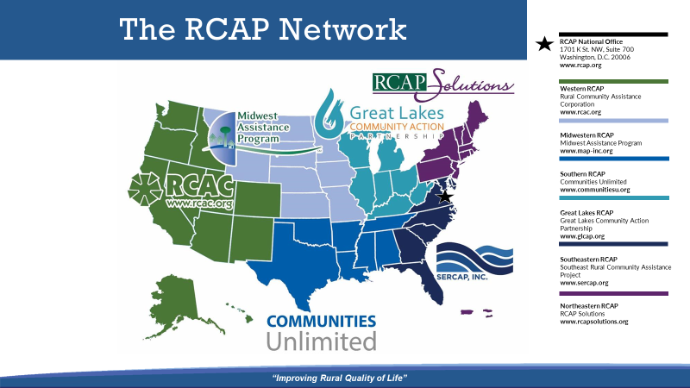
Notes:
The Rural Community Assistance Partnership (RCAP) is a national network of nonprofit partners with over 300 technical assistance providers across the country. RCAP works to improve the quality of life in rural America starting at the tap. In 2020, RCAP served more than 3.4 million rural and tribal residents and over 2,000 communities in all 50 states, Puerto Rico, and the U.S. Virgin Islands. Visit www.rcap.org to learn about our work this past year. Southeast Rural Community Assistance Project, or SERCAP is one of 6 regions that make up the RCAP network.

Slide 3
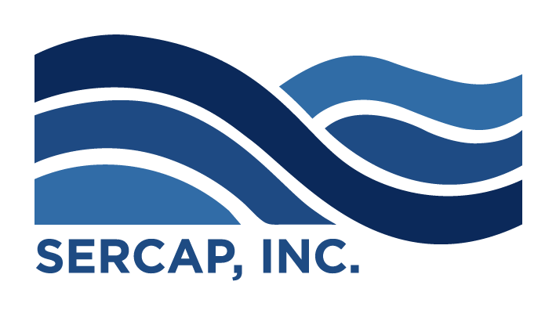
Our Mission:
SERCAP’s mission is to improve the quality of life for low income individuals by promoting affordable water and wastewater facilities, community development, environmental health and economic self-sufficiency.
Notes:
SERCAP’s mission is to improve the quality of life for low income individuals by promoting affordable water and wastewater facilities, community development, environmental health and economic self-sufficiency.

Slide 4
Our Story:
Southeast Rural Community Assistance Project, Inc. (SERCAP) is a 501(c)3 Nonprofit Organization which assists small rural towns and communities with their community utilities and economic sustainability.
Created in the 1970’s and with its central office in Roanoke, Virginia, SERCAP serves the seven states of Delaware, Maryland, Virginia, North Carolina, South Carolina, Georgia and Florida.
To date, SERCAP has brought clean water and wastewater facilities to more than 450,000 residents in our seven state network.

Slide 5
USDA, EPA and HHS programs:
Training – both general classroom style and one-on-one training custom designed for you
Technical Assistance – advice and guidance re:
  Compliance issues
  Financial Management & Budgeting
  Contract or Project management
  Asset inventory and/or management
  Capacity building
  Record-keeping
  Grant/funding opportunities, application &compliance
  Solid Waste/Recycling/Compost programming/education
  Economic Development
  Community Development/Organization

Slide 6
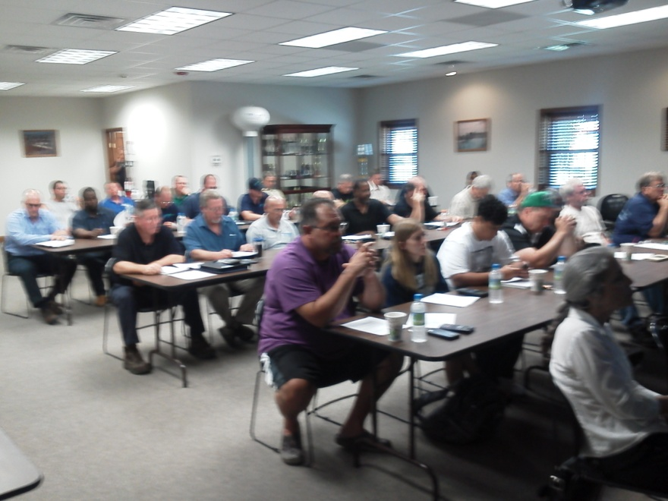
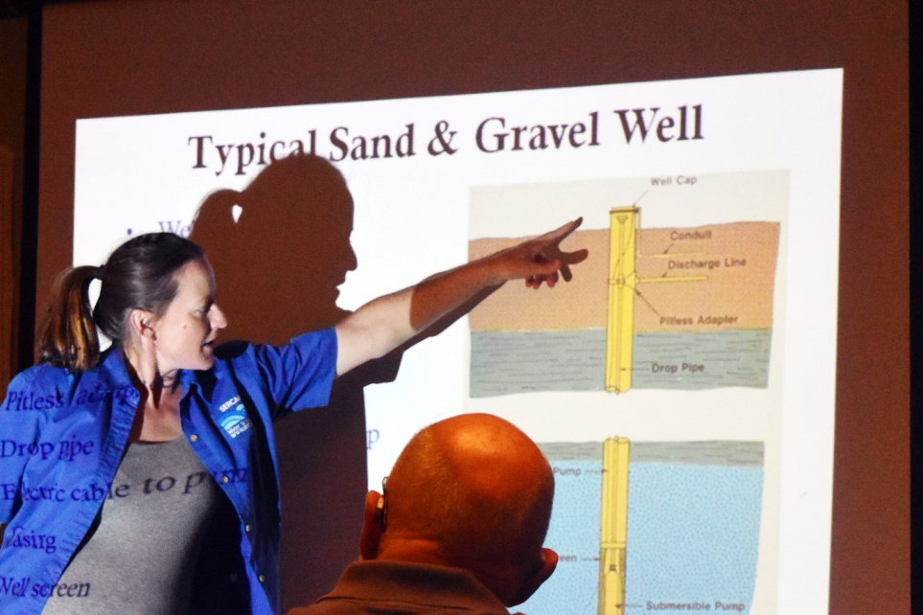
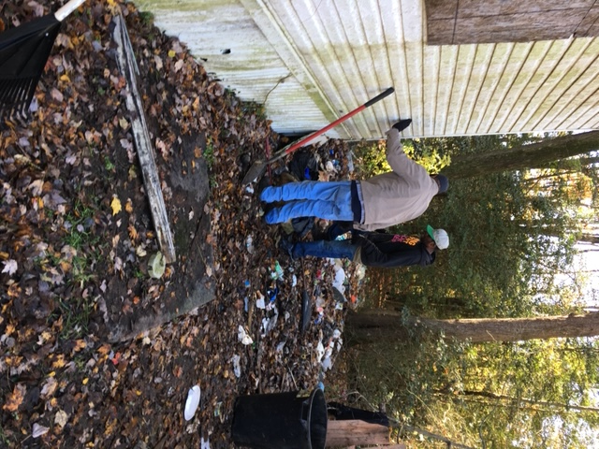
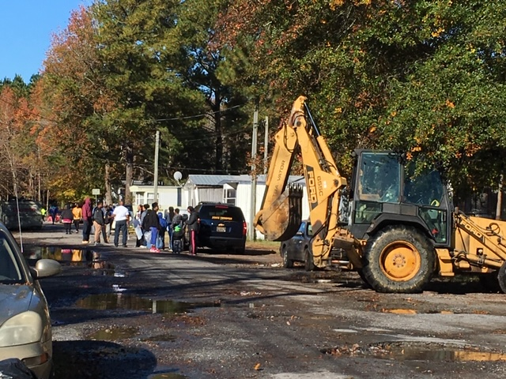
Training and Assistance
Notes:
SERCAP offers trainings for water and wastewater operators, utility staff, private well and septic owners. Sessions are available in person and virtually and even one on one at the utility.

Slide 7
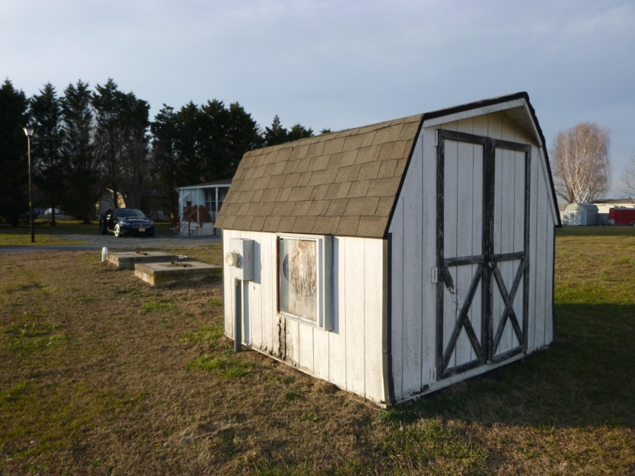
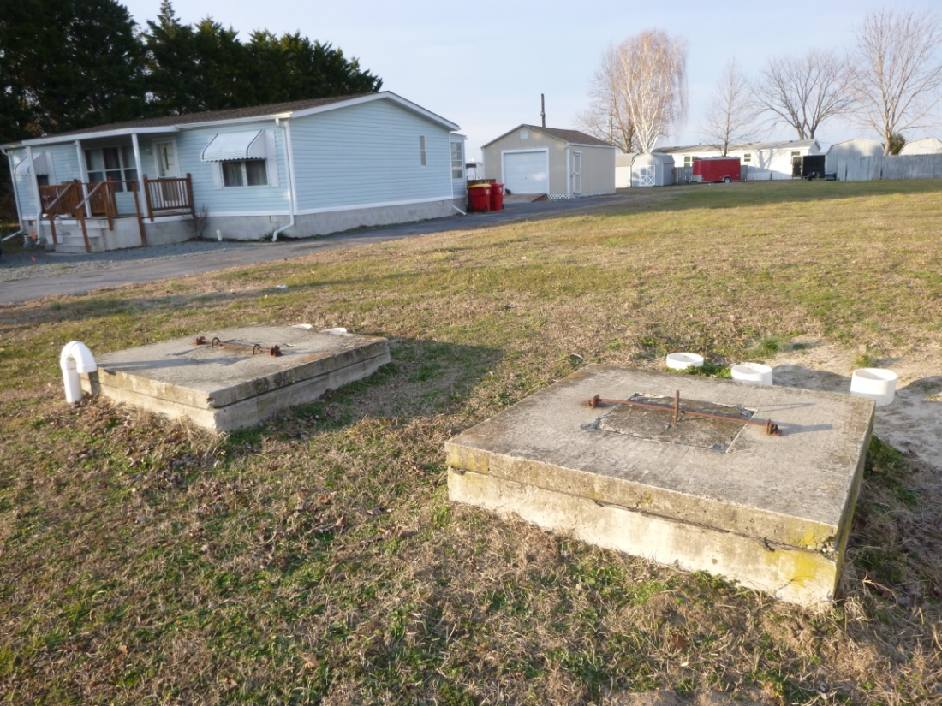
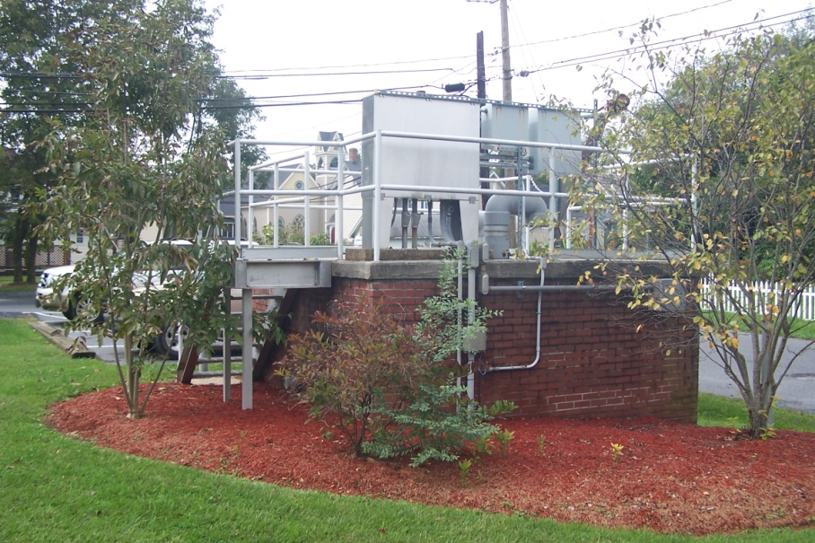
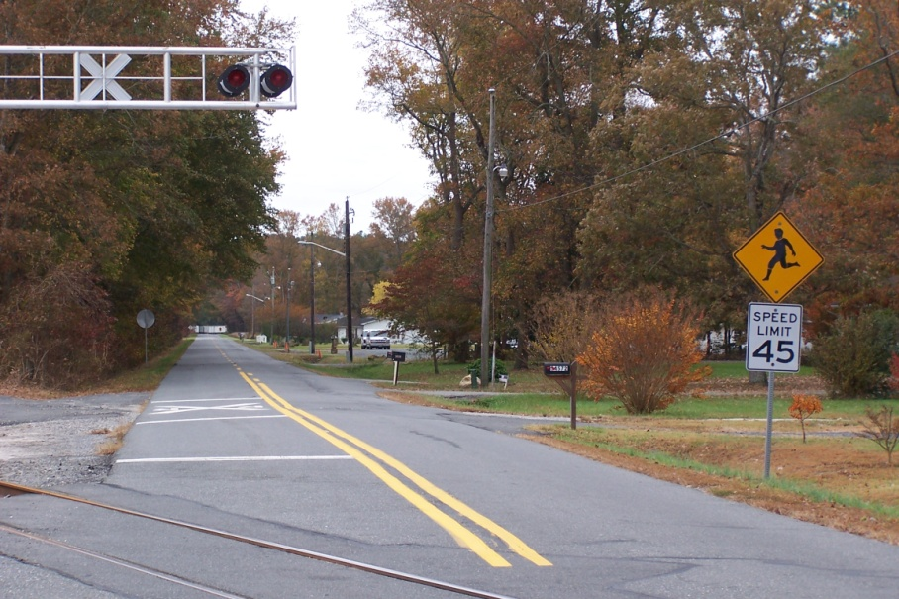
Communities and Community Systems
Notes:
SERCAP offers community support to HOA’s who have shared septic systems and shared wells. We can assist with updating and wrting by-laws and assisting with RFP’s and Q’s for services such as testing and maintenance on wells and septic systems.

Slide 8
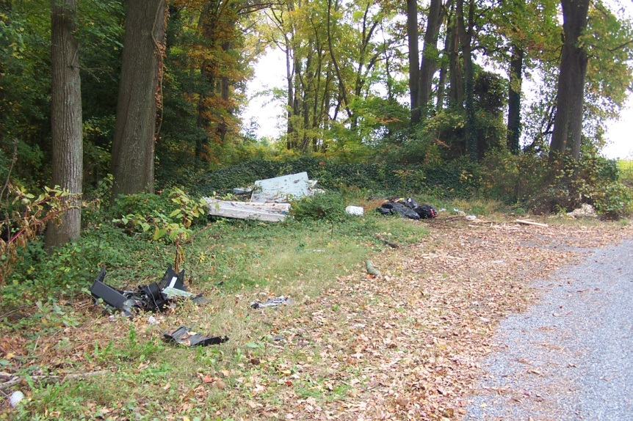
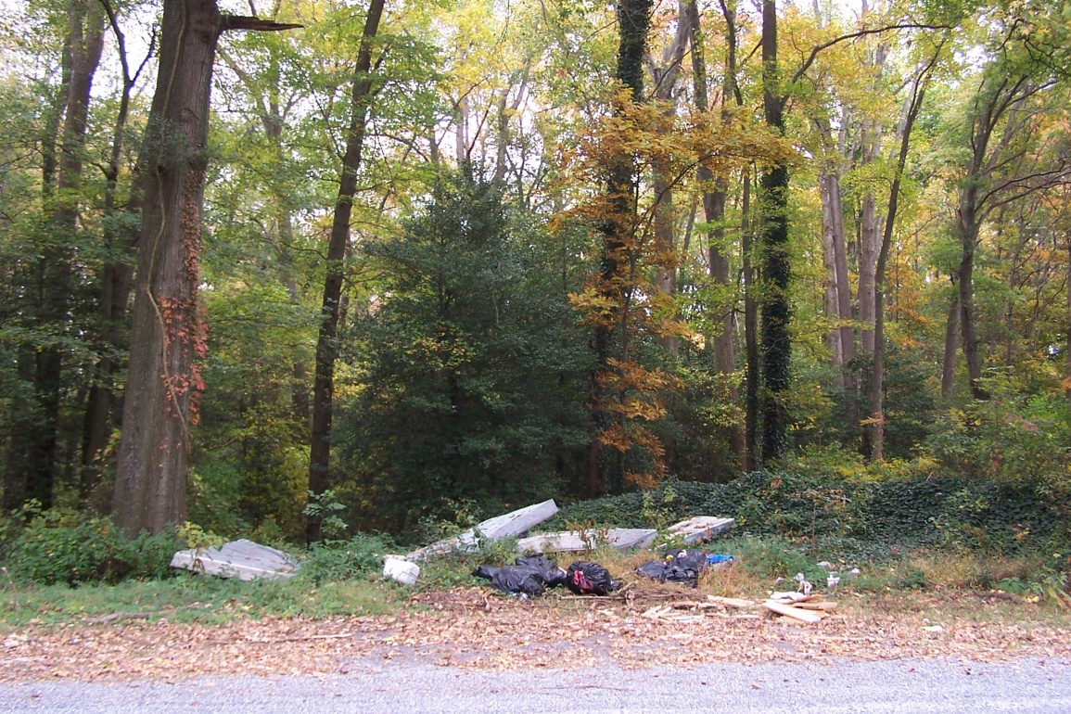
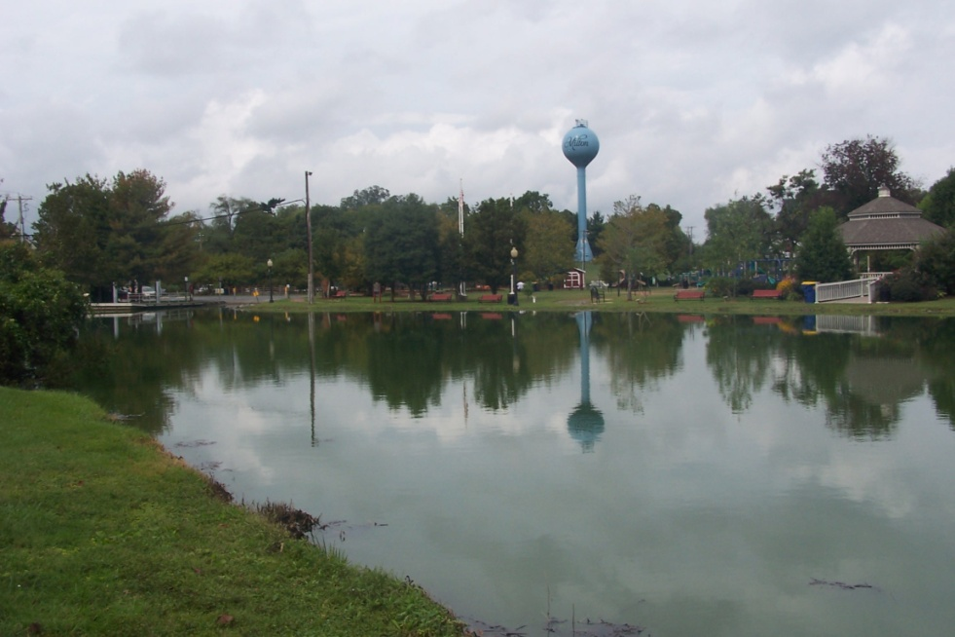
Community Issues –
Collaborative Solutions
Road in Coverdale Community
Bridgeville, DE
Milton, Delaware
Coverdale Community
Bridgeville, DE
Notes:
SERCAP collaborates with communities to hold community clean up events and teach the importance of recycling. SERCAP can also assist communities with drafting sustainability plans.

Slide 9
Individual Programs
Private Well owners assistance
  Up to $11,000 to replace/improve qualified homeowners’ well
  1% interest
  Up to 10 year term, depending on eligibility
  $30.00 application fee for credit check
Notes:
SERCAP Technical Assistance Providers’ or TAP’s can also conduct well assessments and training to private well owners and advice on well testing to ensure safe drinking water. If a pump goes bad or the well dries up we offer special low interest loans to help the homeowner replace or make improvements.

Slide 10
Individual Programs
Septic System Loan Programs
Up to $15,000 to eligible homeowners to replace Septic System
  Up to 10 year term
  Interest rate dependent on credit score
  Minimum Credit Score of 600
  $30 application fee for credit check
Notes:
Loan programs are also available to make repairs or replace septic systems. TAP’s can assist the homeowner with advice and application assistance along with training on proper septic system basics.

Slide 11
Individual Programs
$15,000 loans for home improvements (VA & DE)
  Improvements must be to provide safety in or around the home, or provide a vital need for quality of life.
  Interest rate dependent upon credit score
  Terms may be up to 10 years
  Requires minimum credit score of 600
  $30 application fee for credit check
Notes:
Our Virginia office has a dedicated housing team to assist Virginia homeowners with a variety of needs.

Slide 12
USDA 502 and 504 Loan Program
SERCAP is an authorized “packager” for USDA loans
The program assists low- and very-low-income applicants by providing payment assistance to increase an applicant’s repayment ability.
Payment assistance is a type of subsidy that reduces the mortgage payment for a short time.
The amount of assistance is determined by the adjusted family income.

Slide 13
eligible Area?
Visit the USDA Income and Property eligibility website for complete details.
https://www.rd.usda.gov/programs-services/single-family-housing-programs/single-family-housing-direct-home-loans

Slide 14
RESIDENTIAL LEAD SERVICE LINE REPLACEMENT PROGRAM
PROGRAM GUIDELINES
SERCAP’s Residential Lead Service-line Replacement Program provides up to $2,500.00 toward the costs of replacing the lead service-lines coming into the home. All payments will be made directly to the contracted plumber upon completion of the work, and the submission of all required documentation.
ELIGIBILITY REQUIREMENTS
- Low-to-Moderate Income (LMI) Homeowners
- Existing Lead Service Line
- Owner Occupied Residence
- Home under going Active Renovation
Notes:
EPA is currently working on guidance and funding to water utilities to replace lead goosenecks and other components. SERCAP received a special grant from Spring Point Partners to assist low income homeowners replace the service lines that is on the homeowners side of the service. This is a very hot topic and we should be doing all we can to assist homeowners in understanding the impact that lead has on our health.

Slide 15
RESIDENTIAL LEAD SERVICE LINE REPLACEMENT PROGRAM
SERCAP’s new Residential Lead Service-Line Replacement Program assists homeowners with replacement of the private side of lead water service-lines. Financial assistance up to $2,500 is provided for low-to-moderate income (LMI) homeowners to have their water lines replaced. In most cases, the adjoining public side will be replaced simultaneously to ensure the best results in fully removing lead from all water services being supplied to the home. Lead Service Line Replacement must be completed by a licensed plumber.
WHY REPLACE LEAD SERVICE LINES?
While lead solder has been banned in the U.S. since the 1950's, it might still be present in some older homes. The corrosion of lead-based materials can add lead to tap water, particularly if water sits for a long time in the pipes. Replacing lead service lines helps protect the health of residents in the home.
Notes:
The graphic is fuzzy but basically, the teal area is the homeowners responsibility of the service lines and the orange is the utilities responsibility. The EPA and the state revolving fund will have funding available to the utilities to replace the lines but the homeowners side will be up to the homeowner. Working together with environment health advocates like you all, we can spread the work about funding and options for the homeowners and push for additional grant funding.

Slide 16
RESIDENTIAL LEAD SERVICE LINE REPLACEMENT PROGRAM
For more information or to apply for the program, contact Andy Crocker at 540-345-1184, or visit the agency on-line at www.sercap.org.
*SERCAP’s Lead Service-line Replacement Program is made possible by Funding from Spring Point Partners.

Slide 17
So, in summary…
SERCAP can help communities solve problems
  Community projects are handled locally from the Delaware/Maryland office in Frankford
SERCAP can help individuals
  Individual applications are handled by the central office in Roanoke VA
The local office staff can help with individual applications for those who need assistance

Slide 18
SERCAP
Southeast Rural Community Assistance Project
Vikki Prettyman – DE/MD State Manager
Jean Holloway – Technical Assistance Provider
Juel Gibbons - Technical Assistance Provider
DL Wilson – Technical Assistance Provider
5 Main Street
Frankford DE 19945
302-387-1619 vprettyman@sercap.org www.sercap.org

Slide 20

Acknowledgement
This project has been funded wholly or in part by the United States Environmental Protection Agency under an assistance agreement to Rural Community Assistance Partnership. The contents of this document do not necessarily reflect the views and policies of the Environmental Protection Agency, nor does the EPA endorse trade names or recommend the use of commercial products mentioned in this document.
This content does not necessarily reflect the views and policies of State Primacy, RCAP, or RCAP Regions.
Notes:
Disclaimer. As we move into the PFAS portion of our presentation I need to acknowledge that This project has been funded wholly or in part by the United States Environmental Protection Agency under an assistance agreement to Rural Community Assistance Partnership. The contents of this document do not necessarily reflect the views and policies of the Environmental Protection Agency, nor does the EPA endorse trade names or recommend the use of commercial products mentioned in this document. This content does not necessarily reflect the views and policies of State Primacy, RCAP, or RCAP Regions.

Slide 21
Naming / Terms
PFAS – Per and polyfuoroalkyl substances
PFOS – Perfluorooctoanesulfonic acid
PFOA – Perflurooctoanoic acid
Notes:
I will briefly go over the PFAS basics. I am no scientist or chemist but we can bring in PFAS specialists if anyone on this conference wishes to have a more in depth session on PFAS.

Slide 22

PFAS
A group of over 5,000 chemicals
Man-made do not occur naturally
Developed in the 1940s
Used to make products that resist heat, oils, grease, stains and water
Notes:
While we will be talking mostly on PFOA and PFOS there are over 5000 compounds of PFAS and we are learning about them more and more. They are called forever chemicals because they do not breakdown over time.

Slide 23
PFAS are widely used, long lasting chemicals, components of which break down very slowly over time.
Because of their widespread use and their persistence in the environment, many PFAS are found in the blood of people and animals all over the world and are present at low levels in a variety of food products and in the environment.
PFAS are found in water, air, fish, and soil at locations across the nation and the globe.
Scientific studies have shown that exposure to some PFAS in the environment may be linked to harmful health effects in humans and animals.
There are thousands of PFAS chemicals, and they are found in many different consumer, commercial, and industrial products. This makes it challenging to study and assess the potential human health and environmental risks.

Slide 24
Environmental impacts of PFAS
Various forms of cancer, including testicular and kidney cancer
Pregnancy-induced hypertension/pre-eclampsia
Liver damage
Increases in cholesterol levels
Increased risk of thyroid disease
Decreased antibody response to vaccines
Increased risk of asthma diagnosis
Increased risk of decreased fertility
Small decreases in birth weight

Slide 25

Environmental impacts of PFAS
Exposure to PFAS is widespread. PFAS have been found in 95 to 100% of blood samples in the general population.

Slide 26
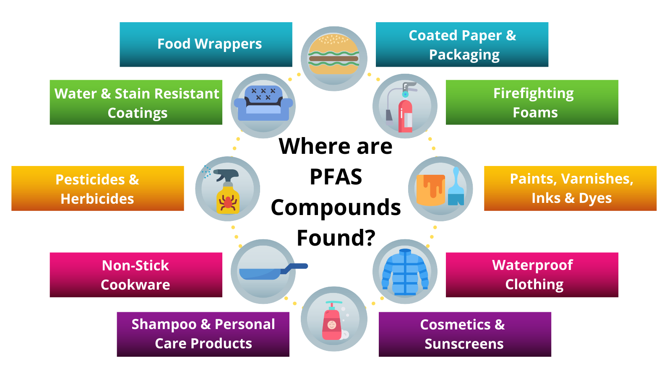

Slide 27
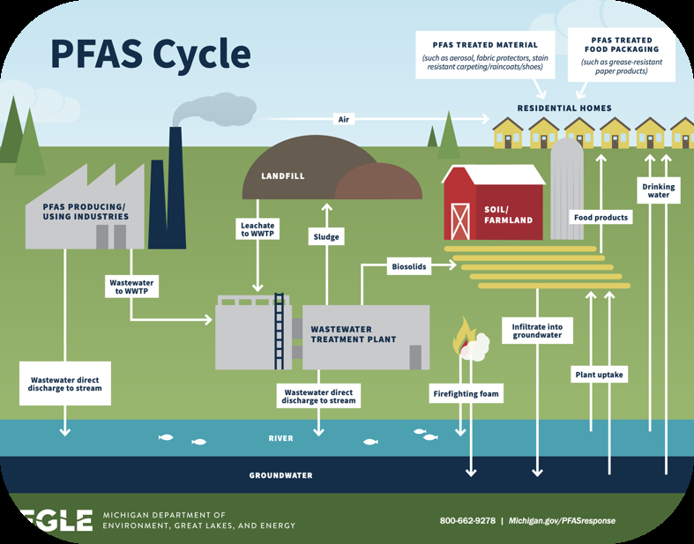
Notes:
As I mentioned these are called forever chemicals and they will just continue to cycle around.

Slide 28
Lessons from the Field: Navigating PFAS
Vikki Prettyman
DE/MD State Manager for SERCAP
Notes:
This is my account of the PFAS experience in a small rural town in Delaware that experienced a PFAS contamination crisis in 2018.

Slide 29
Lessons from the Field: Navigating PFAS
Case Study: Blades, Delaware
Three sites of PFAS contamination in the state of Delaware
City of New Castle
Dover Air Force Base
Town of Blades
Source
Firefighting Foam at the airport and the air base
Plating businesses in Blades
Notes:
Before coming to work for SERCAP in January of 2019, I served Blades, Delaware for 11 years as the Town Administrator. Today I will share the experience of navigating through a PFAS contamination situation from the small rural town perspective. Blades was the third confirmed site of PFAS contamination in the state. The two other site’s contamination is due to firefighting foam during training exercises of the air national guard at the airport in New Castle and the air force at the air base in Dover. Blades was a chosen test site due to historical plating businesses.

Slide 30
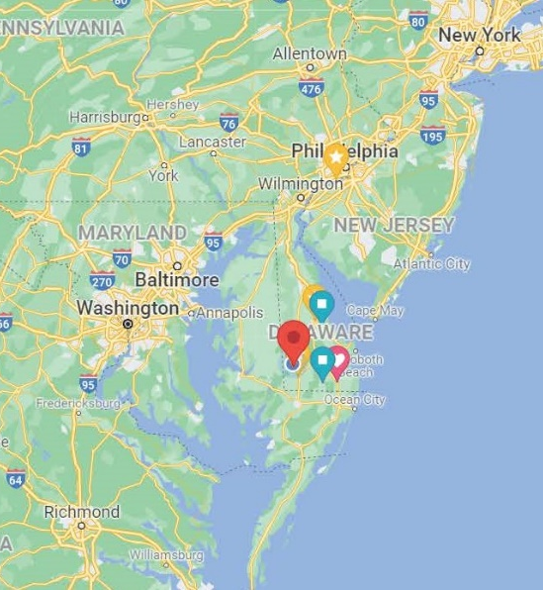
Lessons from the Field: Navigating PFAS
Case Study: Blades, Delaware
February 8th, 2018 DNREC and DPH informed the town that the PFAS contaminates PFOA and PFOS were detected in all 3 drinking water wells over and above the HAL of 70ppt
Ranging from 96.2ppt to 187.1ppt
Wells were tested at the request of the EPA due to proximity of wells to historical plating businesses
Notes:
Blades (red mark) sits in the middle of the Delmarva Peninsula. Blades was notified by the Delaware Department of Natural Resources and Environmental Control (DNREC) and the Division of Public Health (DPH) on February 8th, 2018 that all three of the town’s drinking water wells were contaminated with perfluorinated compounds of PFOA and PFOS over and above the HAL of 70ppt. The EPA requested testing of the wells due to a history of plating businesses in close proximity of the existing wells. Also, an active plating business several blocks from the well site has monitoring wells for hexavalent chromium, chromium, copper, nickel, and zinc plumes due to known soil contamination and past releases from the plating tanks. PFAS as an emerging contaminate has not been tested on these monitoring wells.

Slide 31
Lessons from the Field: Navigating PFAS
Case Study: Blades, Delaware
What is PFAS?
HAL versus MCL?
“Abundance of Caution” Advisement to not drink or cook with the water
Public Notice and Press Releases
Temporary Water
Notes:
At the time this happened, I had never heard of perfluorinated compounds. I may not of known what they were at the time but if I am on a call with the DNREC Secretary, the acting division chief of DPH, Office of Drinking Water, the state hazardous response team, and someone from the Governor’s office, it doesn’t take a genius to know that this was serious. Because it was an HAL and not an MCL what were we even required to do. To me it was our responsibility to ensure the health and safety of our citizens so we immediately made the decision to advise that our residents not drink or cook with the water. I requested assistance from DNREC’s public information team to draft the press release. Use the resources available to you and don’t try to do this all alone. Our water operator reached out to all the town councilman to bring them in for an emergency meeting. The hazard response team was making arrangements for the school to have bottled water delivered on the 9th and I was notified that the Governor would then declare Blades in a state of emergency to activate the national guard to assist us with water buffalos and emergency water distribution. A lot happened within that hour phone call.

Slide 32
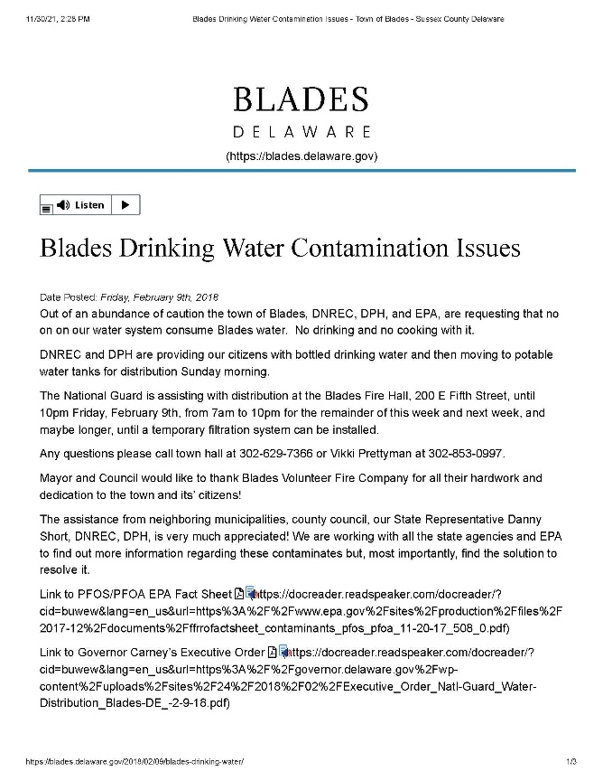
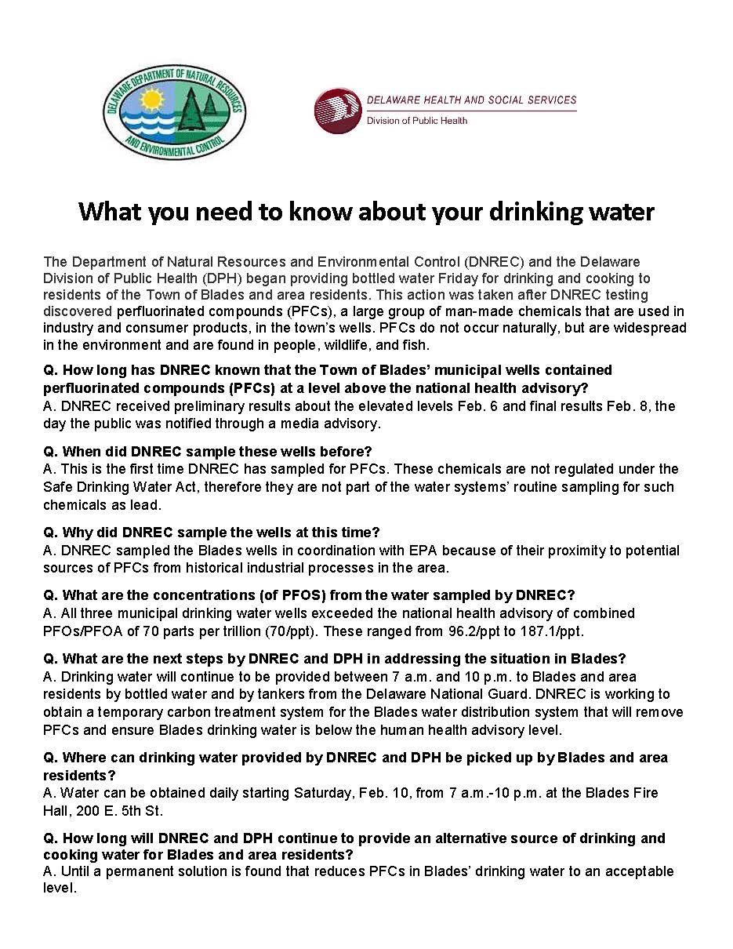
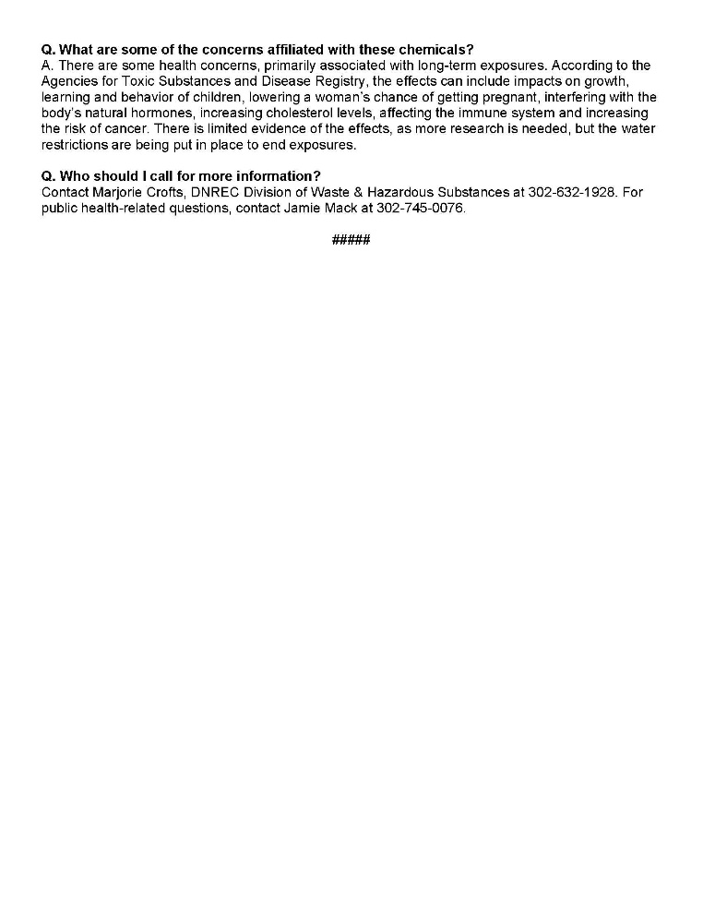
Lessons from the Field: Navigating PFAS
Case Study: Blades, Delaware
Notes:
Press releases were sent to all the local media outlets and posts made on the town’s website and Facebook pages. We notified all the large users and restaurants in person. Being a small rural town afforded us that ability. The school superintendent made the decision to not have students in school that Friday. With cooking meals they wanted to be better prepared. The school requested water in 5 gallon jugs so arrangements were made.

Slide 33
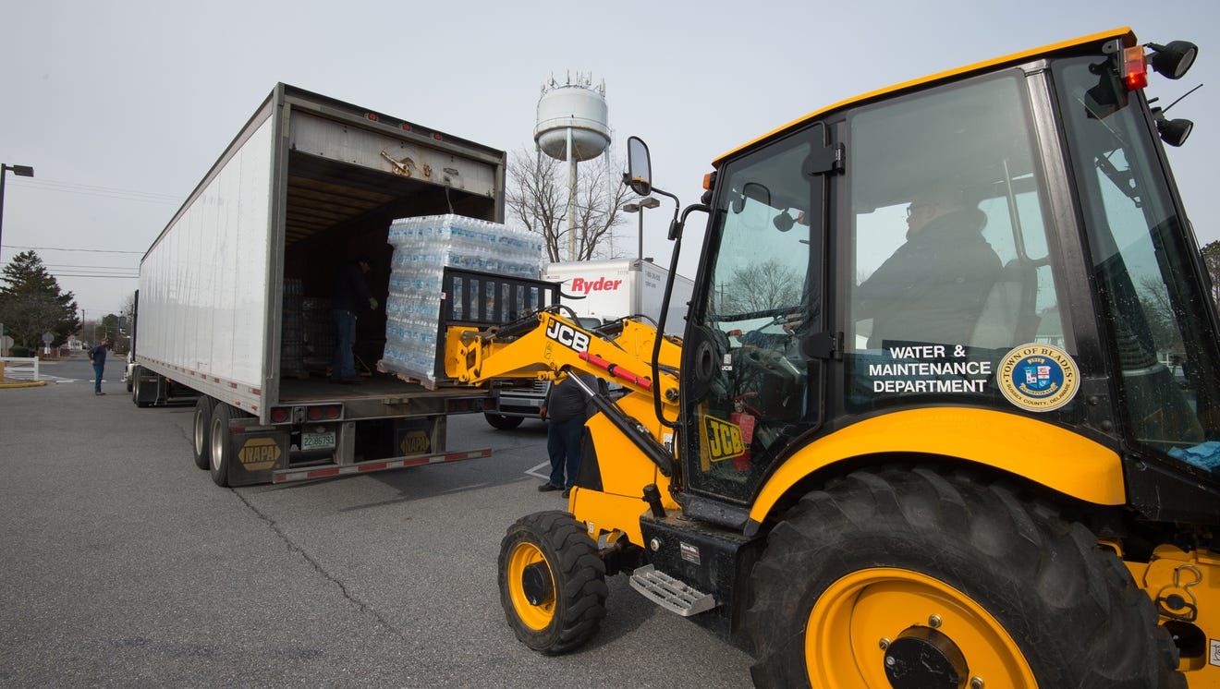
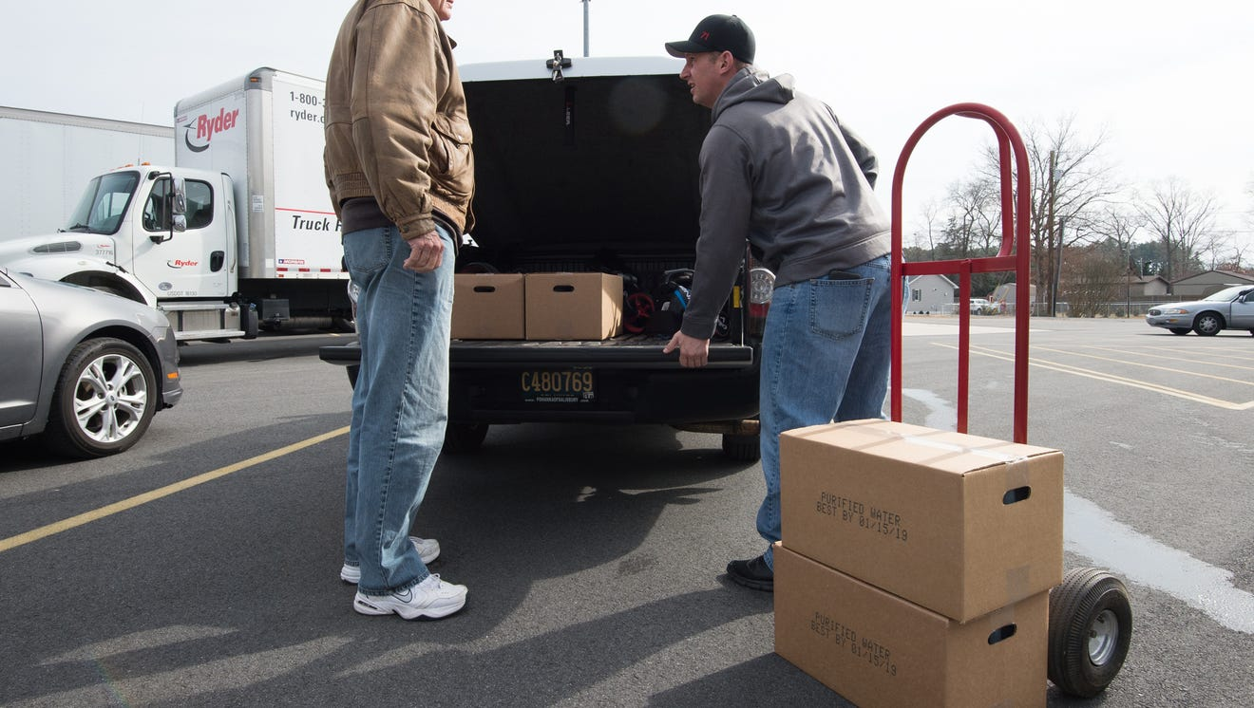
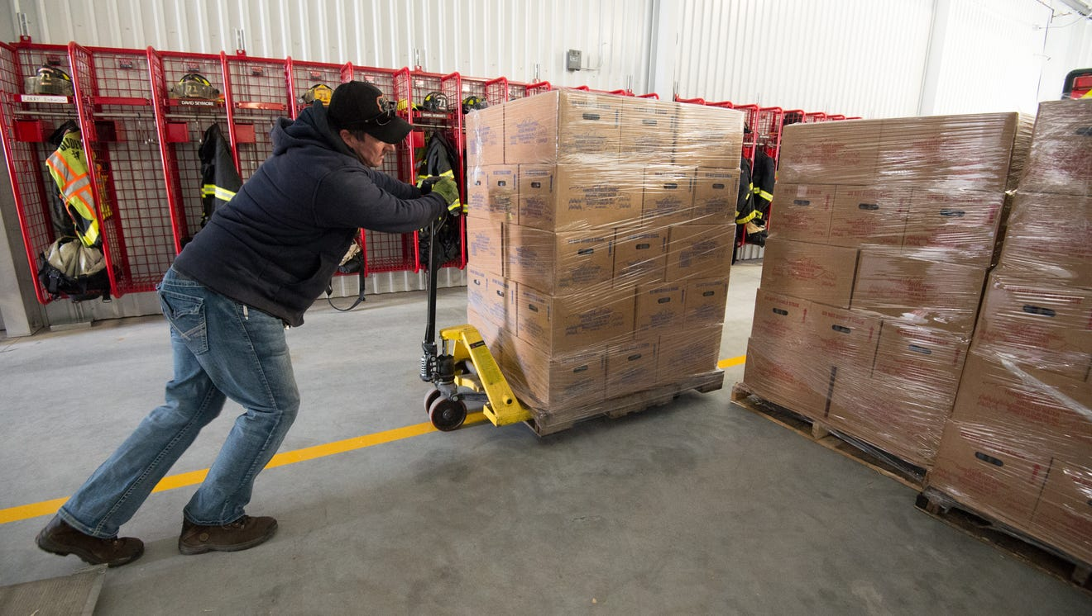
Lessons from the Field: Navigating PFAS
Case Study: Blades, Delaware
Notes:
The Blades Volunteer Fire Company served as our base of distribution. The support they gave us was incredible. The volunteer firefighters were checking names against tax records, loading the cases of water into citizens vehicles, and handing out information sheets. The water was also being distributed to residents that live outside of town limits south-west of the contamination site based on hydrological studies. Additional testing of properties on private wells was being conducted.

Slide 34
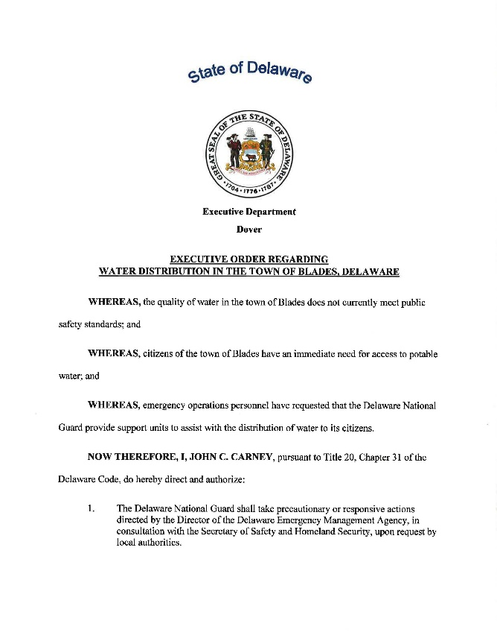
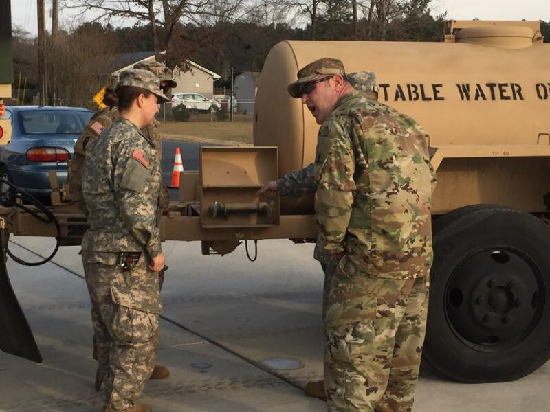
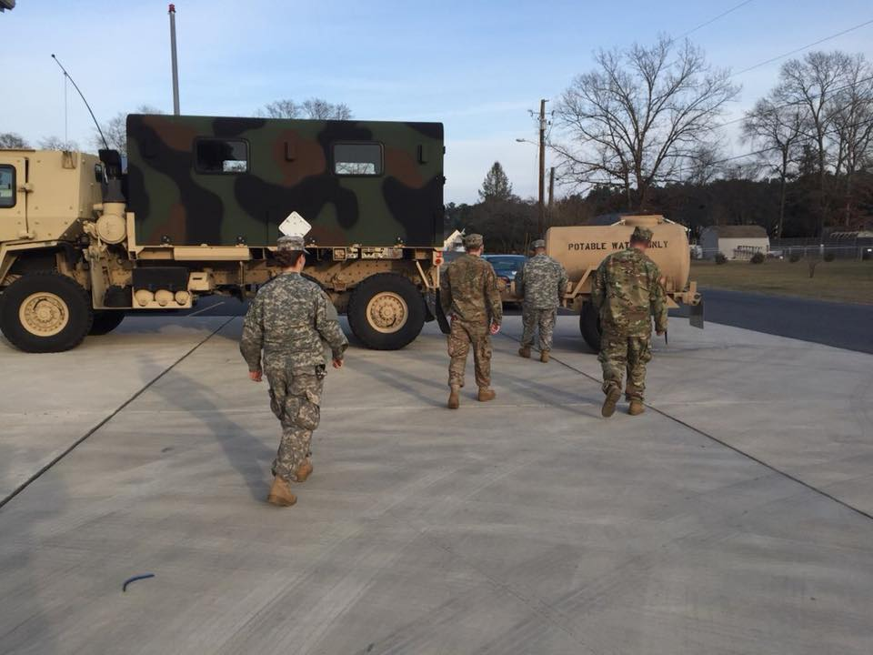
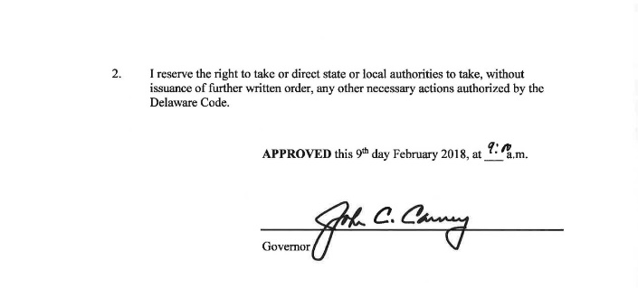
Lessons from the Field: Navigating PFAS
Case Study: Blades, Delaware
Notes:
The Governor’s declaration was signed early morning on the 9th of February, 2018 and the guard showed up later that evening. They filled their water buffalos with water from the town just to the north of Blades. I asked if that source had been tested for the perfluorinated compounds and DPH and DNREC said no. I requested testing of any source before water from the buffalos were able to be distributed. Until then water would continue to be distributed in bottles and gallon jugs. Once test results came back confirming no PFAS we would then use the water buffalos to fill the citizens gallon jugs up. Once the guard was on site they handled all the water distribution. The fire company got them all set up upstairs in the meeting rooms for their sleeping quarters.

Slide 35
Lessons from the Field: Navigating PFAS
Case Study: Blades, Delaware
Notes:
Source water is groundwater and here is the breakdown of the wells in town and current treatment at the time.

Slide 36
Lessons from the Field: Navigating PFAS
Case Study: Blades, Delaware
Water Treatment Considerations
Granular Activated Carbon
Ion Exchange
Reverse Osmosis
Maintenance Costs
Backwash
Media Replacement
Notes:
We considered many different options to get safe drinking water to our town quickly. We discussed interconnecting to our sister town just across the river from town by laying hoses down over the drawbridge and then what it would take to permanently interconnect. We discussed the treatment options GAC, Ion Exchange, Reverse Osmosis, all known treatment systems that is effective for capturing PFOA and PFOS. The first utility in Delaware where PFAS was found is the City of New Castle. Their water operator was only a phone call away and giving us all the advice he could on contacts and reasons why they chose Granular Activated Carbon and Calgon Carbon’s system. We talked to other manufacturers of GAC systems and Calgon was able to work with us and this emergency need we had. When considering treatment options, you must take into consideration the future maintenance costs, backwash filtration, disposal, and media replacement and disposal. The town felt that GAC was the best option and the state agreed with our decision. The GAC was ordered on February 9th, 2018.

Slide 37
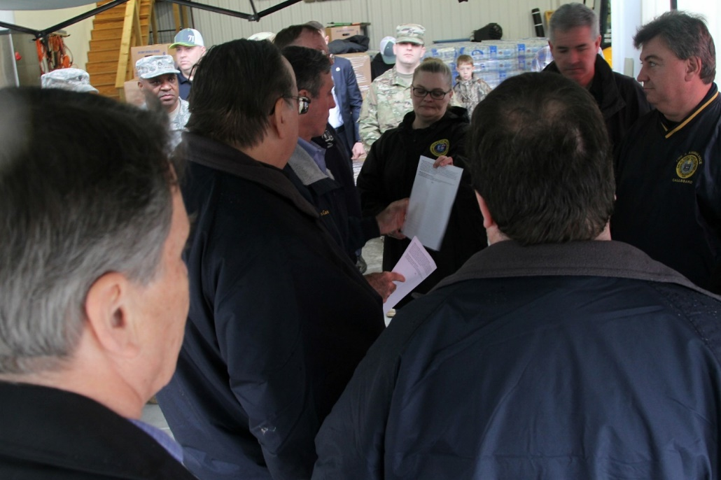
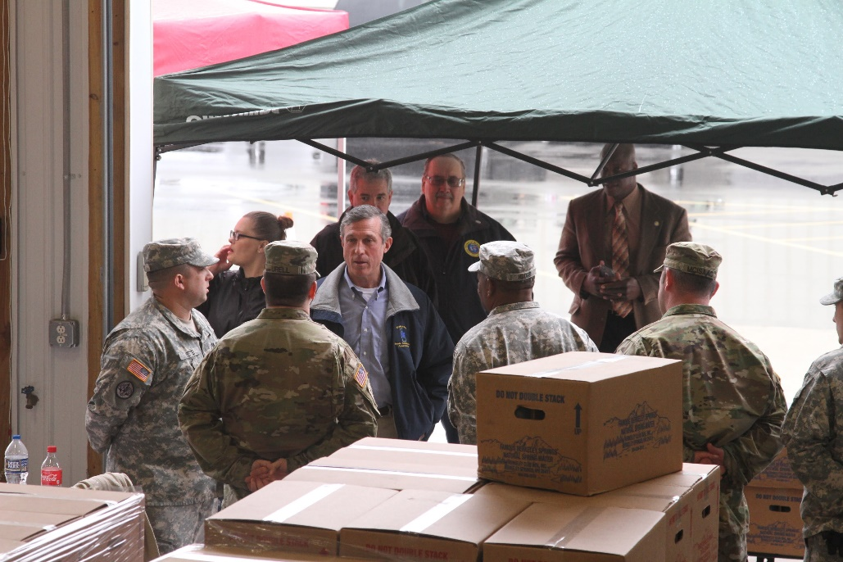
Lessons from the Field: Navigating PFAS
Case Study: Blades, Delaware
Saturday, February 10th, 2018
Briefing the Governor
Notes:
With some much information going around it is extremely hard to keep it all together. Don’t try to remember it all. Especially if you are meeting with federal, state, and local officials. You want everyone on the same page with the exact same information. Have data sheets handy and always updated, date and time stamped at the bottom so you can ensure everyone is working off the most recent data. We limited who could talk to the press and talking points were updated before either the Mayor or I spoke to the media. It was important to us to be very transparent. We worked with the county emergency operations center and their reverse 911 system to spread the word and the national guard also was able to deliver water and fact sheets to our elderly and shut ins. We needed to ensure that no one could come back to the town saying they were never told about the crisis.

Slide 38
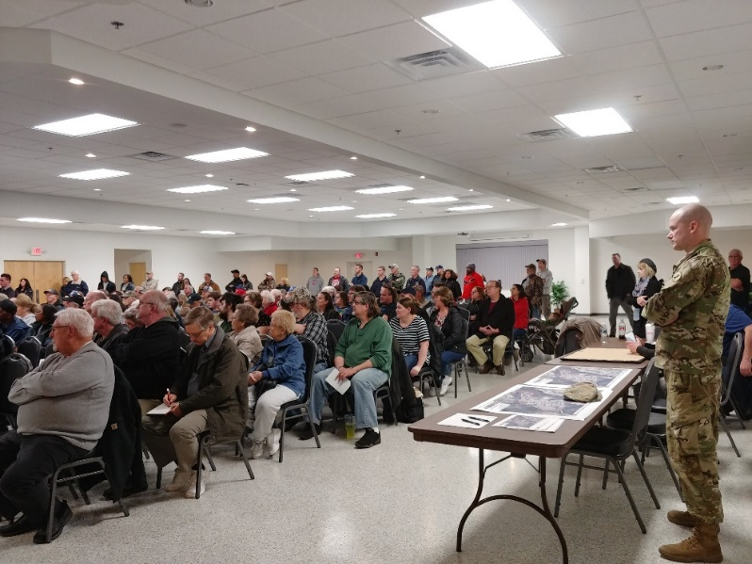
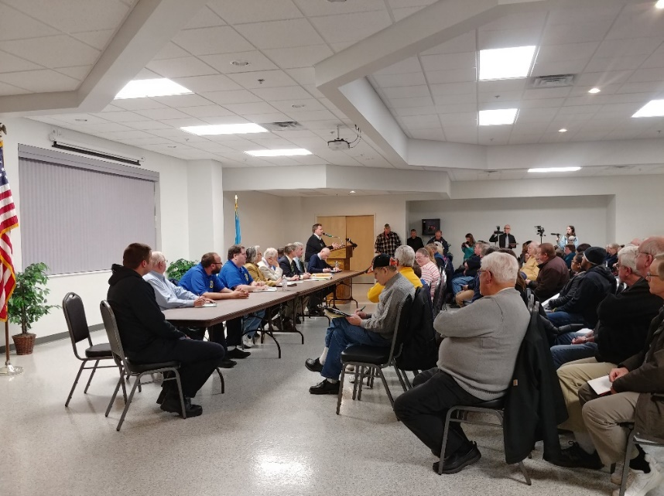
Lessons from the Field: Navigating PFAS
Case Study: Blades, Delaware
February 13th, 2018
Public Meeting
EPA
DNREC
DPH
State/County/Local Officials
Notes:
Again, transparency is best! A public hearing was held to get all the most recent and updated information out to the public. We allowed for public comment and questions and as you can see it was a very full house with standing room only towards the back of the fire hall. We had a lot more comments thanking us for the work we were doing then complaints, and that felt good. There were a few people that stated they didn’t feel it fair they were still receiving a water bill and wanted credits. The majority of the comments were concerns from parents of the children that attended the elementary school in town, pregnant women, and parents with young children. DPH was able to answer a lot of their questions but we agreed after the meeting, that the next meeting we would have someone with the CDC present to talk about the health effects, at least what was known at the time.

Slide 39
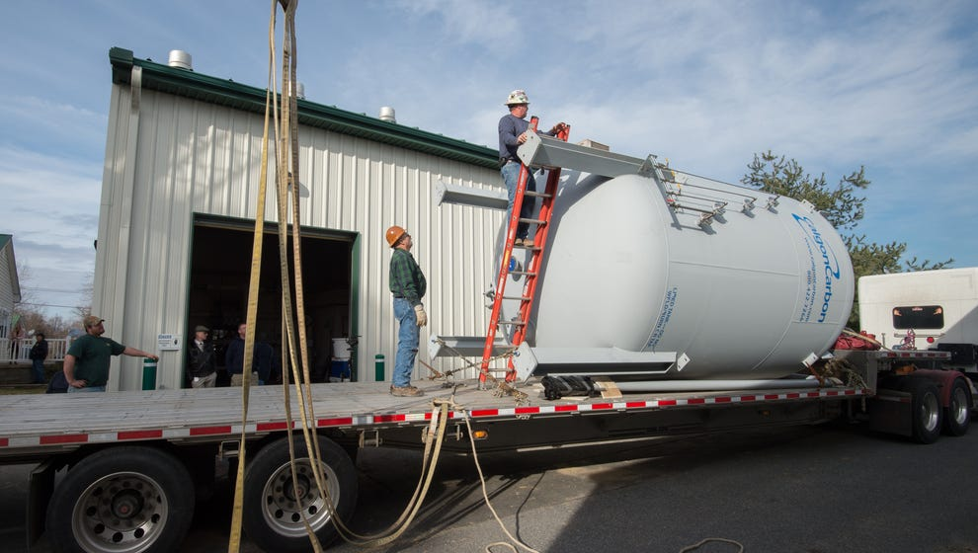
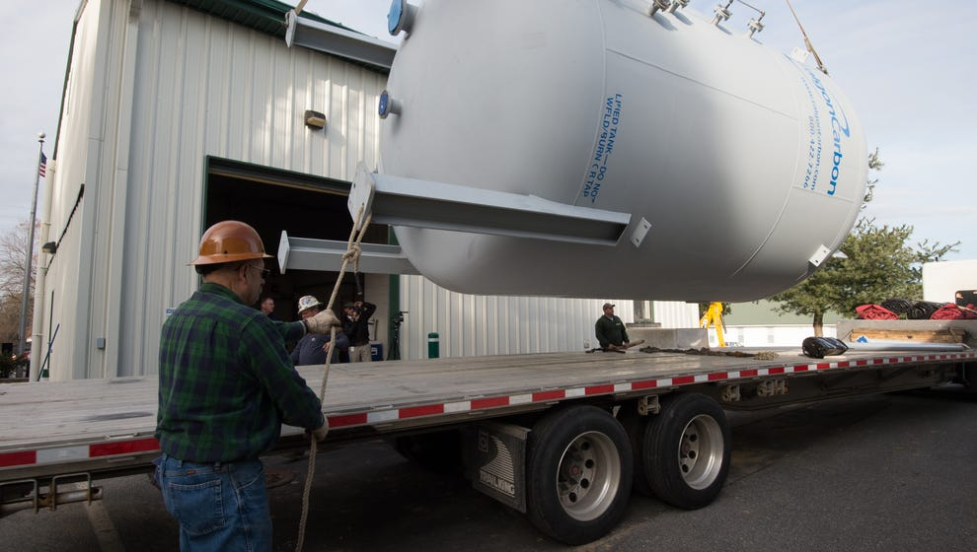
Lessons from the Field: Navigating PFAS
Case Study: Blades, Delaware
February 14th, 2018
Notes:
The GAC was ordered on Friday, February 9th, 2018 and here it is 5 days later being delivered on February 14th, 2018. Pretty awesome Valentine’s Day gift, huh? ☺
At first Calgon was going to send a used tank but they talked to their team and each employee agreed to work overtime manufacturing a new tank. Within 3 days they had it built and loaded on a flatbed from middle Pennsylvania to us. They even called us with updates on where they were in route. We then had to arrange for a crane company to lift and assist with placing the tank.

Slide 40
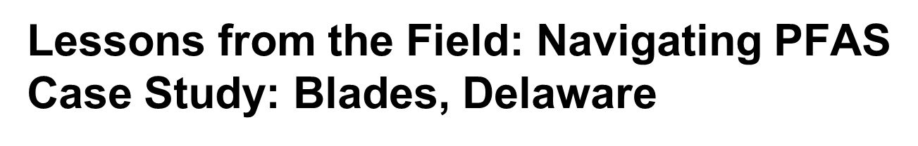
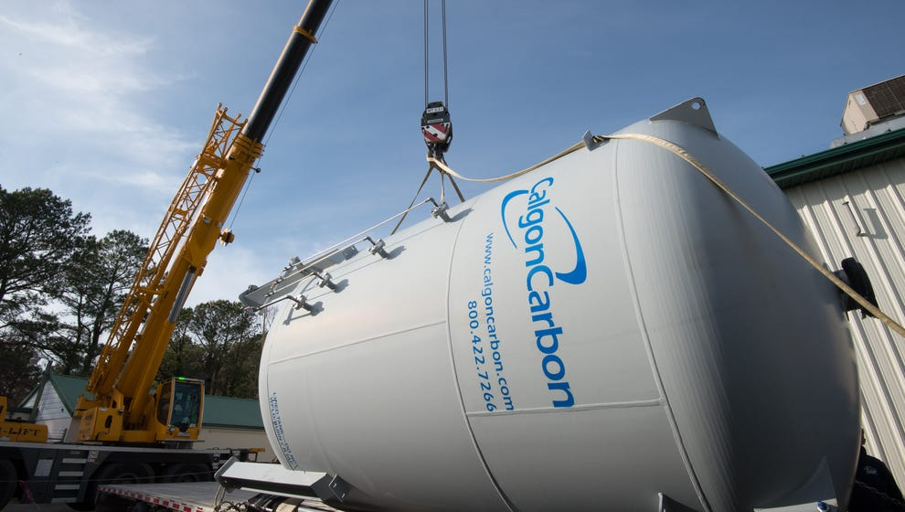
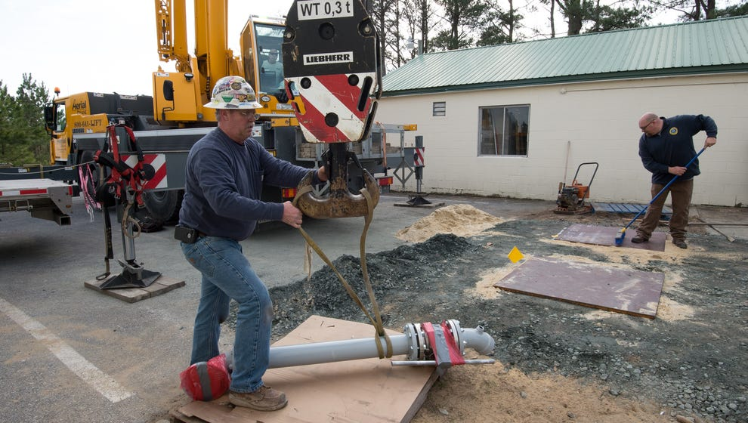
Notes:
Prepare for the unexpected. I love small rural towns! When you’ve pretty much grown up in and around where you work, you probably know a lot of people who have varying talents and skill sets. Thank goodness for small town water operators, cause they know EVERYONE! We needed a bracket and a tool manufactured for the installation. Sketches and dimensions were sent and in a short time parts were delivered.

Slide 41
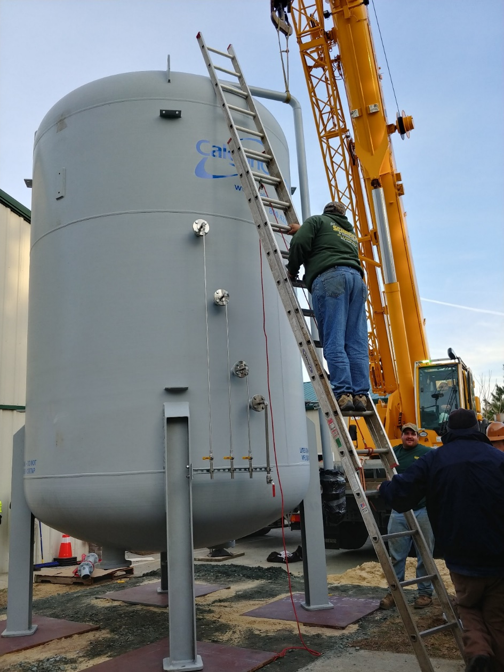
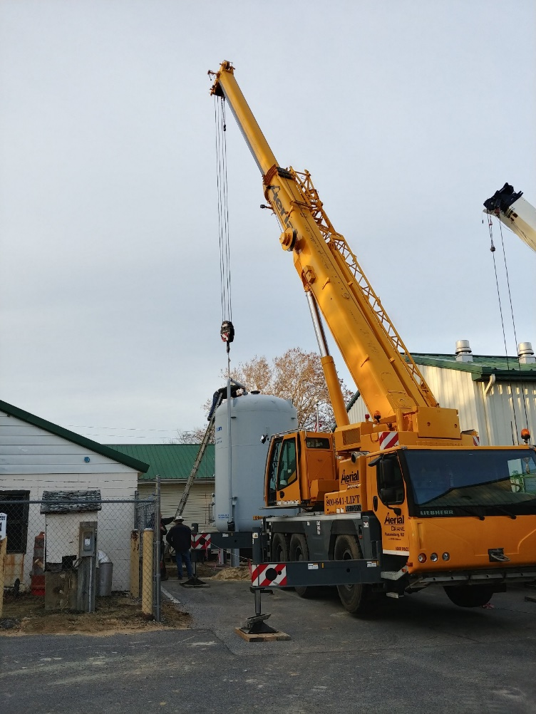
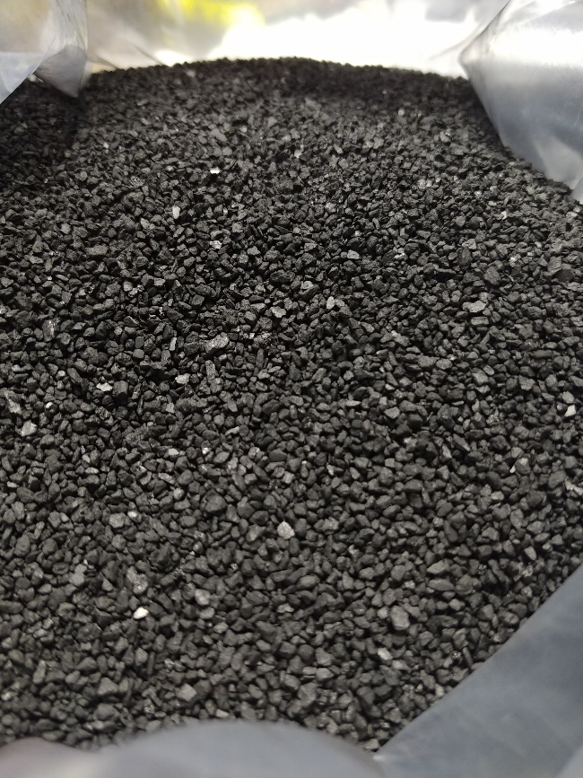
Notes:
Installation of the 21 foot tall tank was not easy and add to it, the very tight spot it had to be maneuvered in to. The picture on the right is the carbon. Imagine 20,000 lbs. of this. I still keep a small vile of this on my desk to remind me of this experience. Our hazardous response team member called the tank the minion. Think if we painted it yellow with blue bib-overalls and goggles it would look like a minion from despicable me movie. ☺

Slide 42
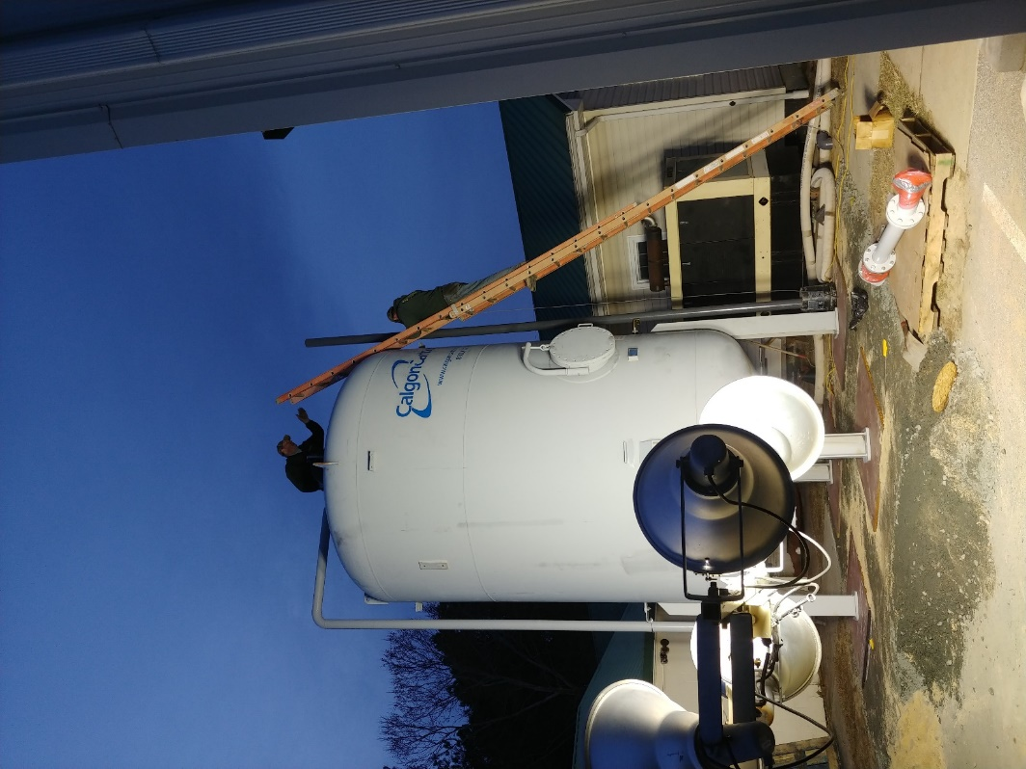
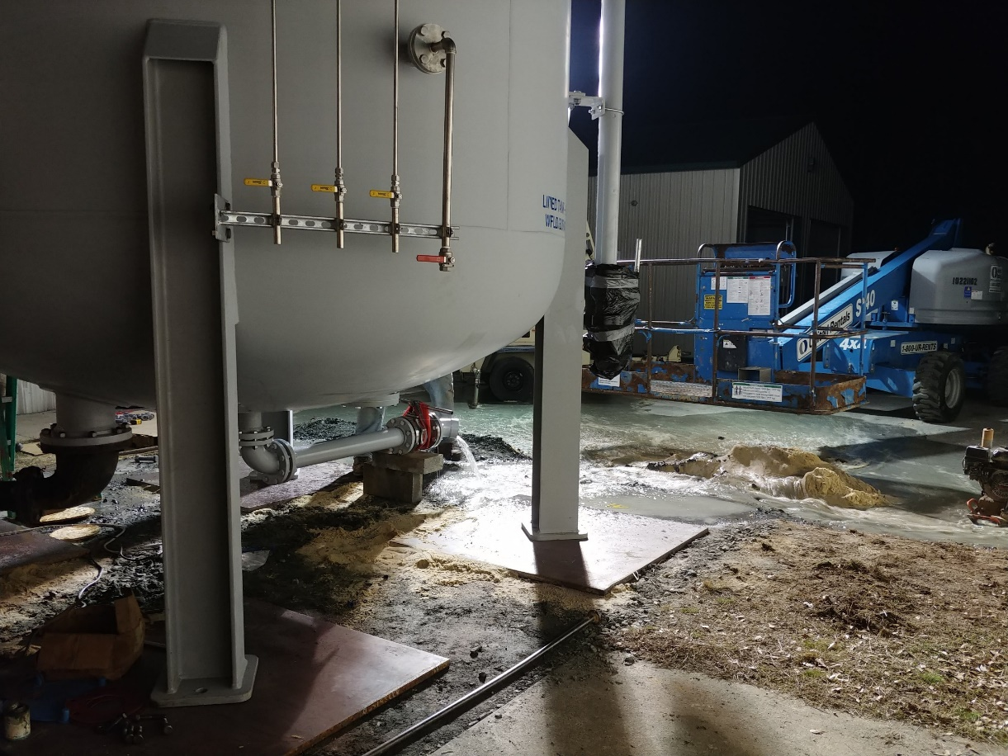
Filter installation and connection to the plant
Notes:
The team worked through the whole night connecting all the parts getting the filter ready to connect to the plant. The City of New Castle brought down the large connector hoses the town needed to connect the filter to the plant. By the morning on the 15th the filter was online. EPA and DPH came in to collect water samples. The first round of PFAS testing detected less than 4ppt of combined PFOA and PFOS. The next day samples were taken again and those results were a complete non detect for PFOA and PFOS.

Slide 43
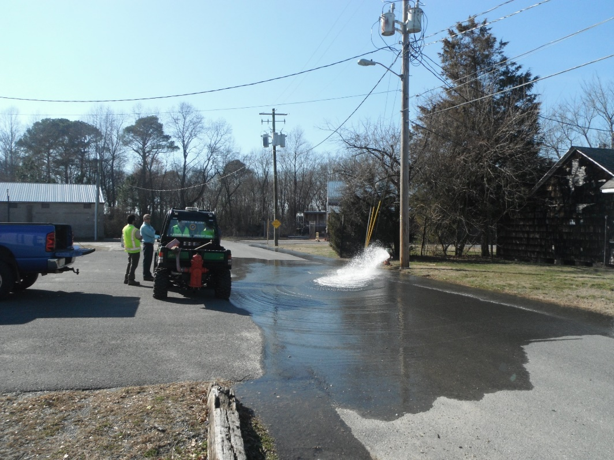
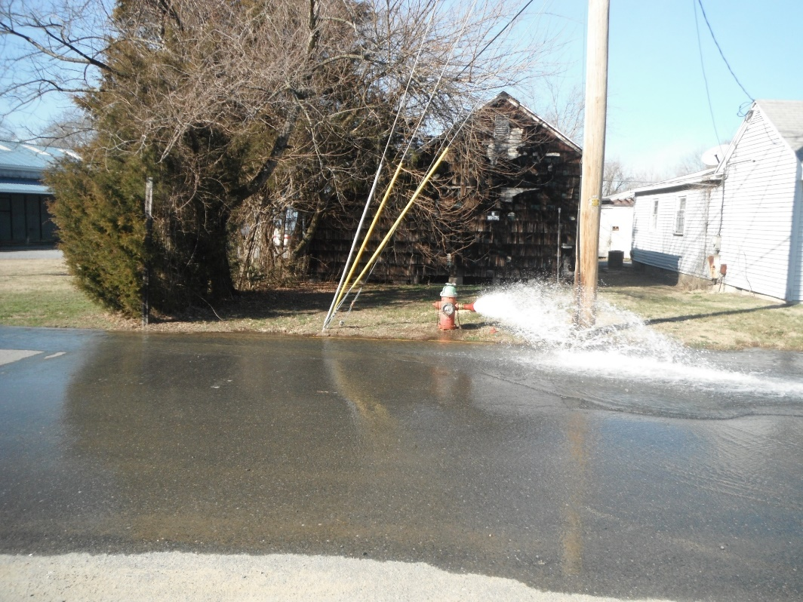
Flushing Plan
Notes:
During the waiting period for the test results the town engineers drafted a flushing plan. The team also worked on how long each home would also have to run water from their faucets to assist in the clearing of the “old” water. By the 20th of February, the town was given the all clear to begin flushing the system. At the time this happened, the town did not have a written directional flushing plan. Most small rural utilities are reactive to emergencies and breakdowns. It can take major events as this one to make them realize how important a written plan for emergencies is. Stress to your communities that regardless of how small they are, anything can happen. RCAP has such great resources. I use this crisis to explain to my project towns the importance of being proactive instead of reactive. I will admit that the town did not have an emergency response plan, no continuum of services plan, no list of vendors in a central document. This crisis showed the council how important written plans are and I did take all the lessons learned from this crisis to write up the plan.

Slide 44
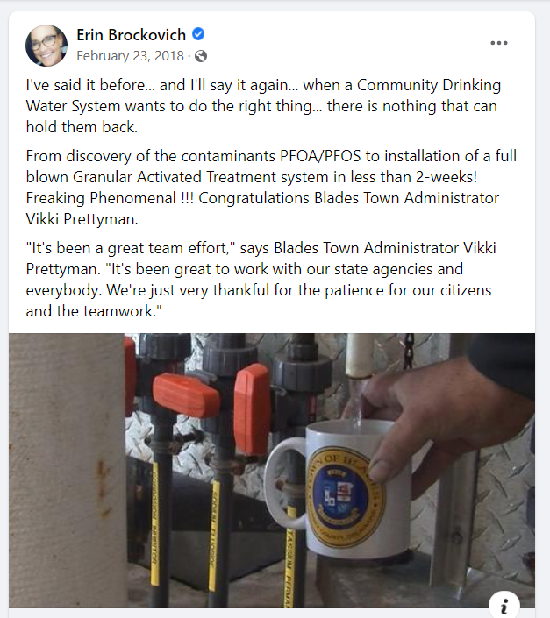
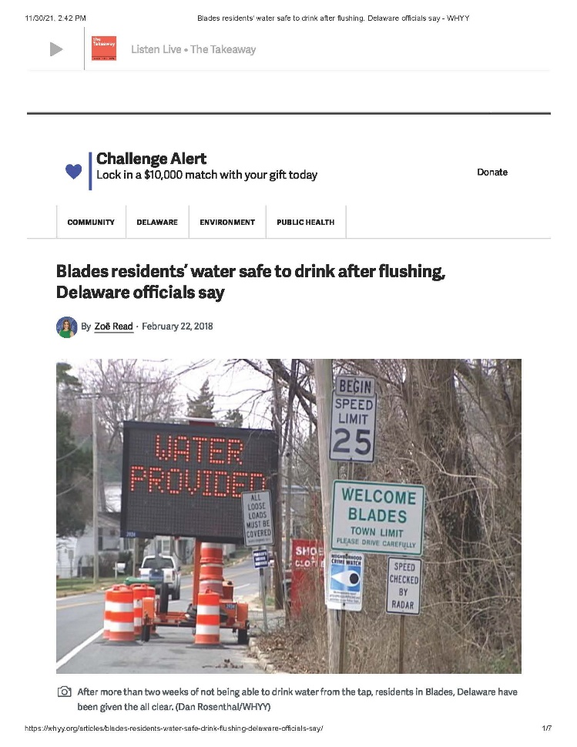
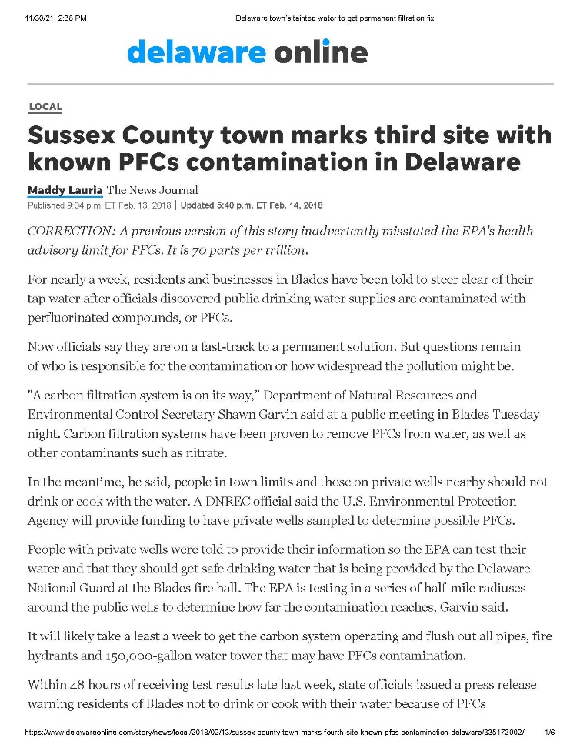
Media: Good vs. Bad
Notes:
Media: Drinking water crisis's, we’ve heard the bad stories of how officials weren’t transparent, closed sessions, false information, speculation because of lack of communication, decisions made not based on sound technical advise or past experience, silo decision makers. The fear I had about the stories I heard had a huge affect on how we managed this crisis, not going to lie. Don’t get me wrong, we didn’t change who we were to manage the crisis, we just made the conscience decision to be completely open even with our faults and failures. The mayor and council basically grew up in this small town. We had all been drinking the water, everyday, for years and years. We needed our citizens to know that we had their best interest at heart because our families were also impacted by this crisis. We were out to take care of our citizens and the future of the town. I encourage you to suggest communities have a media strategy as a part of your ERP.

Slide 45
Community Support:
National Guard
Blades Volunteer Fire Company
Neighboring Cities/Towns
SERCAP
Rural Water
DE WARN
School District
Community Groups
Notes:
Relationships: Not only were our primacy agencies right there with us every step of the way, our community was also supporting us. The community also supported our volunteer fire fighters and our national guards men and women. I don’t think anyone paid for a meal for the duration of this crisis. Citizens were cooking homemade meals and dropping off, business owners were delivering pizzas, subs, Panera Bread soups, salads, sandwiches, specials treats like chocolate covered strawberries, candies, all sorts of goodies.

Slide 46
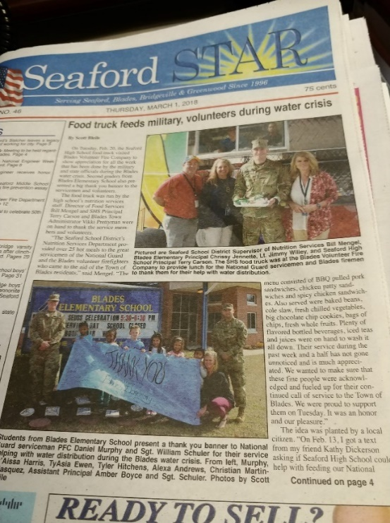
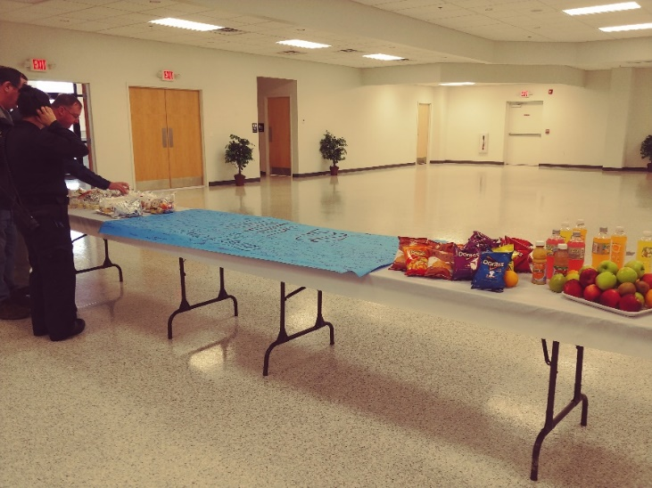
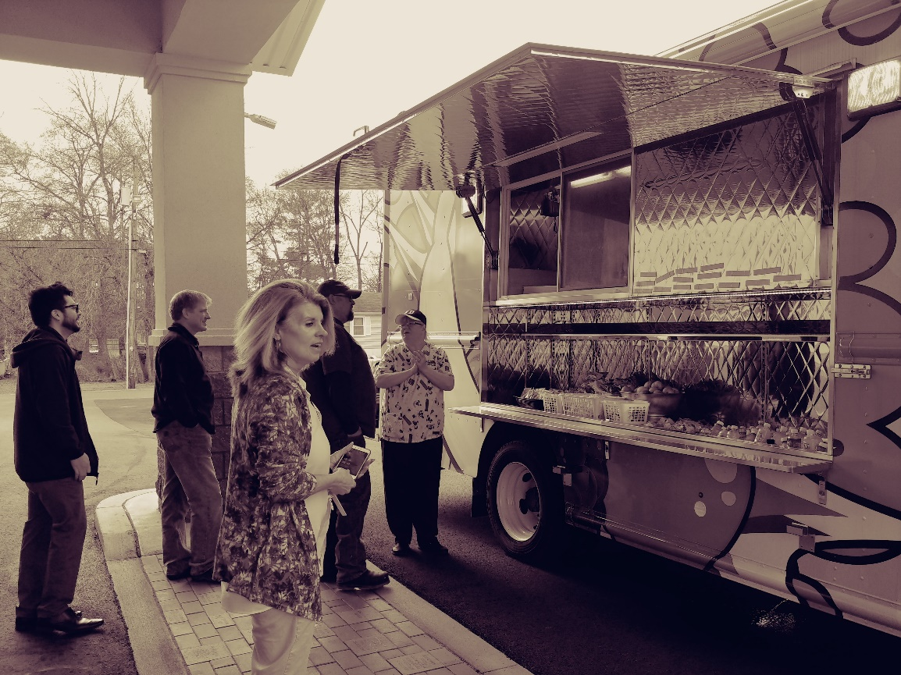
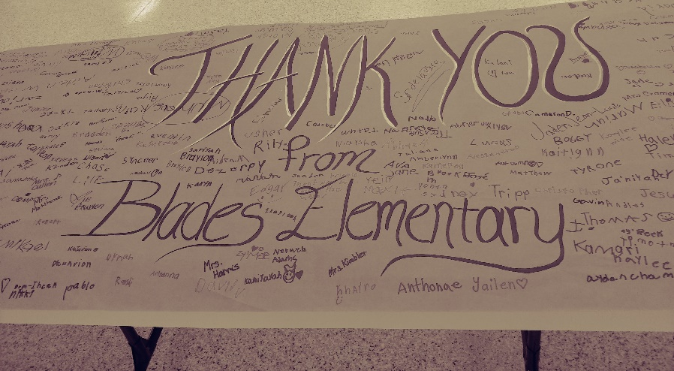
Notes:
The Seaford School district sent their summer feeding program food truck over to feed the volunteers. Culinary Arts program at the high school helped In preparing the food. It was really good food too!
Get the community engaged and make them a part of the solution so that you have community buy in. The kids felt so proud to have the national guard come to their school so they could say thank you and get pictures. Not all superhero’s wear caps… some are in their water operator uniforms, fire fighting uniforms, every day clothes, and military fatigues.

Slide 47
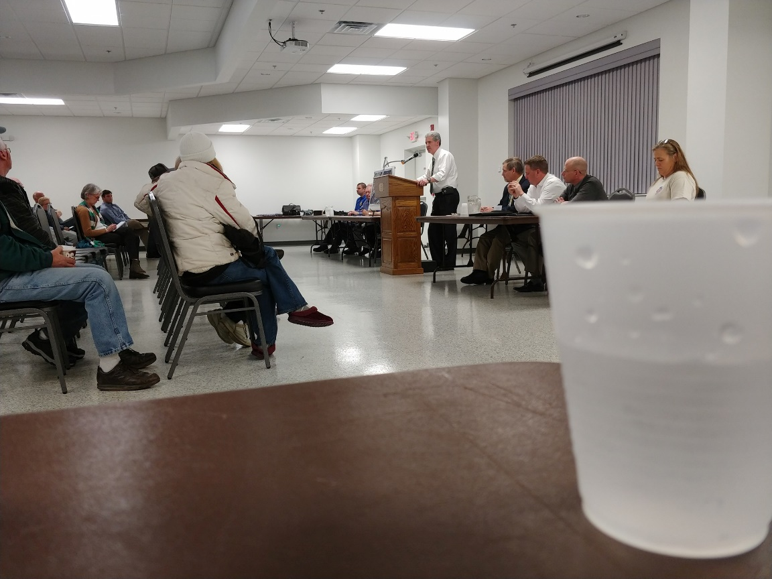

Public Meeting March 1st, 2018
Notes:
Thanks to the advice from a great friend, colleague, and RCAP Outstanding Mentor of the Year for 2019, Jean Holloway, we filled water pitchers with Blades Tap water for all the presenters and panelist. We wanted to show that Blades Tap water was safe to drink. This meeting, as you can tell, was no where near the capacity of the first hearing and mostly filled with the residents that were just south west of town on private wells. DNREC purchased 2 point of use filtration systems for all property owners that tested positive for PFAS. Also one year of replacement cartridges. The EPA is continuing to monitor this area with over 20 monitoring wells and sampling in the shallow creeks in the area.

Slide 48
Additional Concerns
Media Disposal
Media Replacement
Backwashing – approval to send down the sewer
Notes:
As mentioned earlier, Media disposal and replacement must be topics of discussion when planning what filtration system to use. How will the municipality pay for the disposal and replacement. At the time of this crisis, we posed that question and entered into an MOU with the state that the state would be providing funding so this expense was not one the taxpayer had to bear. Blades does not operate its own wastewater plant. The town has an agreement with the county who then contracts with the town just north for all its sewage collection. Approvals had to be obtained to send the backwash to the sewer system.

Slide 49
Additional Water Treatment Plant Upgrades Needed
Plant expansion
Treatment train
Advice:
Are you currently working on a new plant or plant upgrades?
Notes:
To meet the immediate need, Blades only installed one GAC with plans to add an additional GAC and also to expand the plant to enclose both filters. They just broke ground on the plant expansion last month with state and federal grant funding.
Advise: current plant upgrades or a new plant?
Consider recommending some valves and connectors for possible “future” treatment connections . May cost the utility a little extra now but save a lot if an event were to happen where additional treatment/filtration were needed!

Slide 50
RECAP:
February 8th, 2018 –
  Notification by DNREC for PFAS contamination
  Do Not Drink or cook with town water
  Notification to large users and businesses
February 9th, 2018 –
  Governor issued State of Emergency
  Temporary water distribution started
  National Guard arrived in town
  GAC was ordered
Notes:
RECAP:

Slide 51
RECAP continued:
February 10th, 2018 –
  Governor visit and briefing
  National Guard distributing water to shut-ins and elderly
February 13th, 2018 –
  Public Meeting with EPA, DNREC, DPH, ODW, State/County/Local officials
February 14th, 2018 –
  GAC delivered and installation begins
Notes:
RECAP:

Slide 52
RECAP continued:
February 15th, 2018 –
  GAC connected to water plant
  EPA takes sampling (raw and filtered)
February 17t^{h}, 2018 –
  PFAS test results come back less than 4ppt and is sampled again (raw and filtered)
February 19th, 2018 –
  PFAS test results come back non-detect after filtration
February 20th, 2018 –
  Flushing plan enacted and all clear to cook and drink with town water notifications made!
Notes:
RECAP: 12 days from notification to solution.

Slide 53
THANK YOU!
Vikki Prettyman
DE/MD State Manager for SERCAP
302-853-0997
vprettyman@sercap.org
Notes:
I tried to cover as much as I could in the short time we had today. I am available for more in depth questions and discussion just reach out to me. I will hand this back over to Lisa for questions.

