Slide 1
Conducting an Environmental Assessment
Julia Balsley, REHS/RS
Environmental Health Program
Community Health & Protection Bureau
Public Health Division
Arlington County Department of Health & Human Services
January 31, 2024
Notes:
Hi I’m Julia Balsley an Environmental Health Specialist with Arlington County since 2001. For those who don’t know me. I majored in Environmental Health from Salisbury University with minors in Biology & Dance. So, I do love both the Environment and Dancing.

Slide 2
What is an Environmental Assessment?
Systematic, detailed evaluation of environmental factors
Help identify underlying causes
Recommend steps to stop outbreaks and prevent future ones
Environmental Assessment Training Series: www.cdc.gov/nceh/ehs/elearn/eats/index.html
Notes:
Today I am going to tell you about how I initiated an environmental assessment at Restaurant A
An environmental assessment is a systematic and detailed evaluation of environmental factors that contributed to disease transmission in an outbreak
Environmental assessments help identify the underlying environmental causes of foodborne illness outbreaks and recommend steps to stop outbreaks and prevent future ones
If you haven’t taken the environmental assessment training series from CDC, I recommend it, it is a great tool for how to do these types of investigations

Slide 3
What takes place during an Environmental Assessment?
Activities, but are not limited to;
Review/records (invoices from food suppliers, equipment temperature logs, cooling logs)
Interviews of food service staff and operators
Developing food flows based on Farm-to-Fork Food Continuum
Notes:
An Environmental Assessment may encompass a range of activities based on the type of outbreak under investigation, how the outbreak was identified, and the suspected route of transmission involved. The assessment evaluates every point along the farm to fork food continuum and the activities include, but are not limited to;
Reviewing and/or collecting records related to the growth, harvest, processing, distribution, and/or handling of foods at the point of final service.
Interviewing people who have direct knowledge of how food was grown, harvested, processed, distributed, and/or handled at point of final service.
Developing food flows to determine points of contamination; proliferation and/or amplification; and survival of pathogens, toxins, or other agents involved in the outbreak.

Slide 4
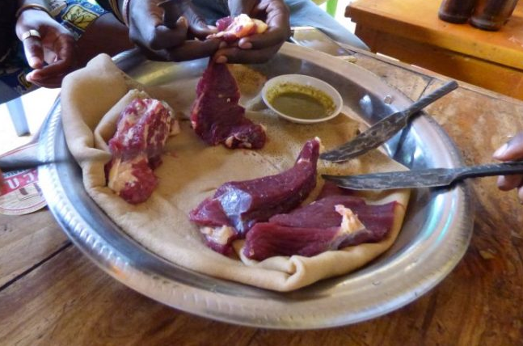
Initiating the Environmental Assessment
Initiated 8/1 after reports of foodborne illness
Staff: Senior EHS, EHS, and Public Health Nurse
No ill employees, but patron complaints
Ill patrons ate shared raw meat dishes with hands
Confirmed suppliers
Unapproved source for raw beef (Vendor X paid in cash)
Assessed kitchen and food handling processes
Notes:
Since I had just performed a Risk Factor Inspection at Restaurant A on July 27, 2023, we initiated an environmental assessment on August 1, 2023, after receiving reports of foodborne illness from two neighboring health departments.
Staff who participated included my Senior EHS, Candice Wooden, myself since this establishment is assigned to me, and a Public Health Nurse who spoke the same language as Restaurant A’s owners
Before we ever stepped foot into the kitchen, we sat down with the chef, who is also one of the owners, to discuss employee health, complaints received, review the menu, and to review their food sources.
The owner confirmed no ill employees, but indicated the restaurant received some complaints from patrons.
The patrons had consumed raw meat dishes from 7/27-7/31, eaten communally with their hands
Because the owner did not notify us about the ill patrons, we reminded the owner to always contact us when they receive reports of foodborne illness to assist in finding the cause
We reviewed their different food supplier facility names and addresses and collected invoice information
After about 30 minutes, the owner, stated he had one guy he got meat from, “Vendor X” who provided meat for the raw beef served in the restaurant called “kurt”. The owner paid Vendor X in cash, received no invoice and could only provide us a first name and phone number for this vendor. We informed the owner that if Vendor X could not provide information that the beef came from an approved source that is licensed and/or inspected, Restaurant A can't serve it because it is considered an “unapproved source”.
The owner at that time claimed they only received product from Vendor X on Thursdays and that they didn’t have any remaining meat from them during our assessment.
At that time, my Senior EHS and myself thought this was source of the outbreak, as we headed into the kitchen to inspect, and we left a handwritten report of our findings with the owner.

Slide 5
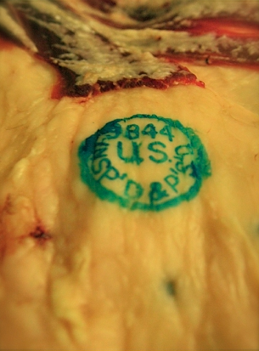
Environmental Assessment Continued
Restaurant A voluntarily closed for deep clean on 8/2
Restaurant A volunteered to stop serving under-cooked or raw meats until ACPHD confirmed safe food practices and approved sources
Owner contacted ACPHD upon securing new meat vendor
ACPHD verified new source was USDA licensed and inspected
ACPHD performed multiple inspections to ensure facility operating safely and in compliance
Notes:
On August 2, we hand delivered our typed inspection along with “A Notice of Alleged Violation” to the owner
The owner informed us at that time he hired a cleaning service to do a deep clean that evening in which they voluntarily closed the facility during that time
With our recommendation the owner also volunteered to stop serving under-cooked or raw meats until the cases of new illnesses stopped and we confirmed safe food practices and approved sources
We allowed the owner to start serving kitfo again after a week since the meat used for that dish was from an approved served
It was another week or two before the owner contacted us with a new vendor for the kurt meat, which we then had to verify that it was USDA licensed and inspected
EHS’s performed multiple inspections throughout several weeks to ensure that this facility was operating safely and in compliance our code (Arlington County Code Chapter 9.2, references current FDA Food Code 2022)

Slide 6
Assessing Similar Establishments
ACPHD compiled list of similar establishments
EHS confirmed:
Do you serve raw or undercooked meats? What types?
Supplier information, including pictures of invoices and labels
None of the facilities were using unapproved sources
Notes:
In addition to investigating Restaurant A, we compiled a list of similar establishments in the County, including markets and restaurants, that we suspected might also serve or sell raw beef
EHS’s contacted these facilities to confirm:
Do you serve raw or undercooked meats? What types?
Can you provide all your supplier’s information for the meat served raw or undercooked?
EHS’s were instructed to take pictures of invoices and labels

Slide 7
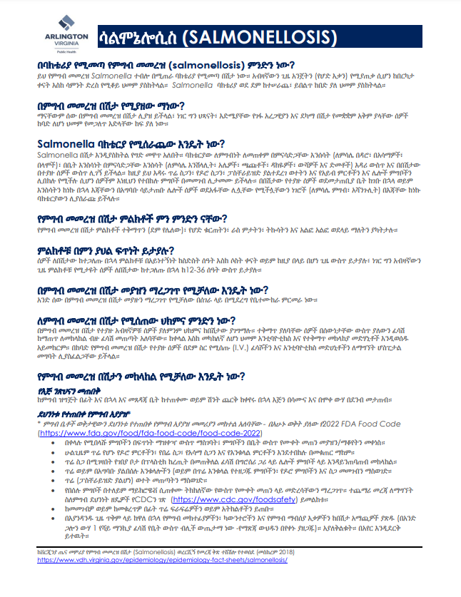
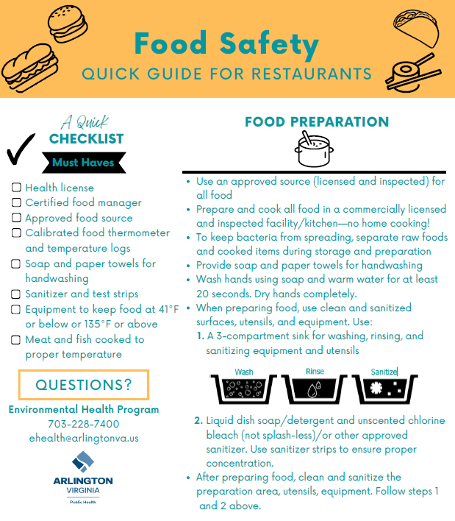
Education
Educated owner about risk factors
Modified and translated VDH fact sheets on Salmonellosis and STEC
Modified and translated ACPHD food safety handout
Created foodborne illness website for the public
Sent blast email to all licensed establishments
Notes:
We also provided education to Restaurant A, licensed establishments, and the public.
Educated Restaurant A’s owners about risk factors including contaminated equipment, food from unsafe sources, poor personal hygiene, inadequate cooking, and improper holding temperatures (also receiving food at or below 41⁰F and holding it at or below 41 F)
We modified fact sheets from VDH on Salmonellosis and STEC, translated them into the owner’s language, and shared them with the owner
We also modified an existing handout we had on food safety to add information about preparing and serving raw meat and fish
We shared materials from Colorado Department of Health on preparing this particular raw meat dish safely, which was already translated.
We created a foodborne illness webpage for the public
& a blast email was sent to all licensed foodservice establishments to notify them of our new resources

Slide 8
Collaboration
Close collaboration between EH and Epi
Shared findings from Environmental Assessment
Supported Food History Interviews
Requested list of raw dishes sold
Requested patron and employee contact information
Notes:
EH worked closely with our Epidemiology staff before and throughout the Environmental Assessment, as well as numerous state and federal partners
Collaboration with Epis
Met frequently to discuss ill patrons and the suspected food sources
Shared findings with Epi team about the facility
To support the Food History Interviews,
On multiple occasions we requested that the owner provide a list of the raw dishes sold from 7/27-8/1 that we suspected were making patrons sick
We also attempted to get patron and employee contact information
Collaboration with state and federal
As the investigation progressed, we met with RRT and VDH, VDACS, USDA FSIS partners on-line

Slide 9
Findings
Meat sources from unapproved vendor
Lab testing indicated meat from unapproved vendor was:
Contaminated with salmonella
Consumed by ill patrons at Restaurant A
Connected to cases at an out-of-state market
No other Arlington establishments connected
Notes:
The environmental assessment and traceback investigation revealed Restaurant A had sourced meat from an unapproved vendor who was from another state
Lab testing indicated meat from unapproved vendor was:
Contaminated with salmonella
Consumed by ill patrons at Restaurant A, eaten communally and with their hands
Connected to cases at an out-of-state market
At this time, we have not confirmed that any other Arlington restaurants are connected to the outbreak

Slide 10
Questions?
Julia Balsley, REHS/RS
2110 Washington Blvd. Ste. 350
Arlington, VA 22204
703-350-5573 | jbalsley@arlingtonva.us

