Slide 1
The Intersection of Art & Science:
The path to food safety excellence for the artisan meal delivery chef

Slide 2
Our Passion: Intentional Eaters

Slide 3
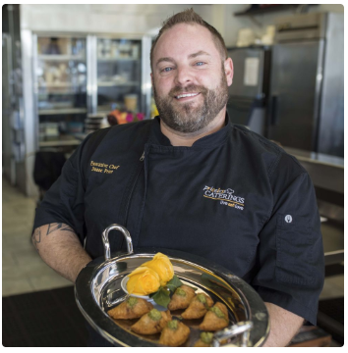
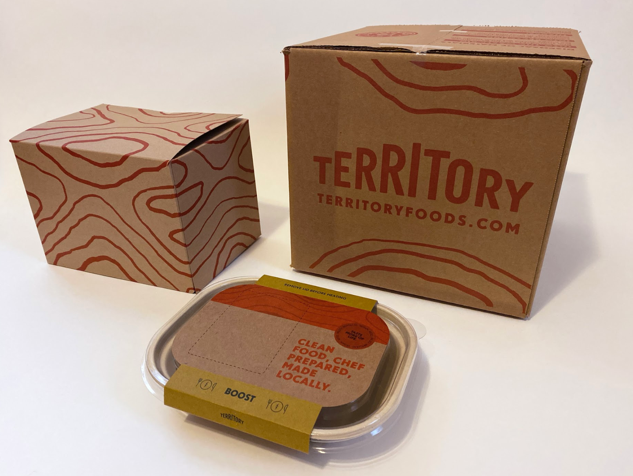
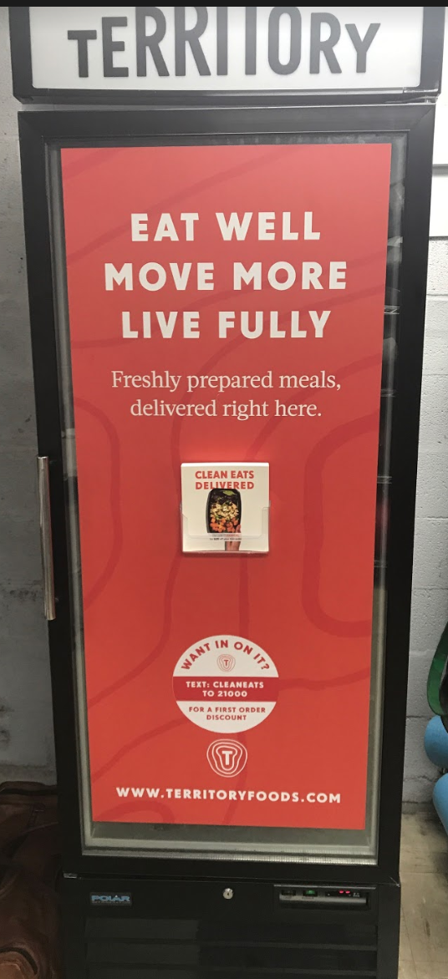
Our Model: Fresh & Local

Slide 4
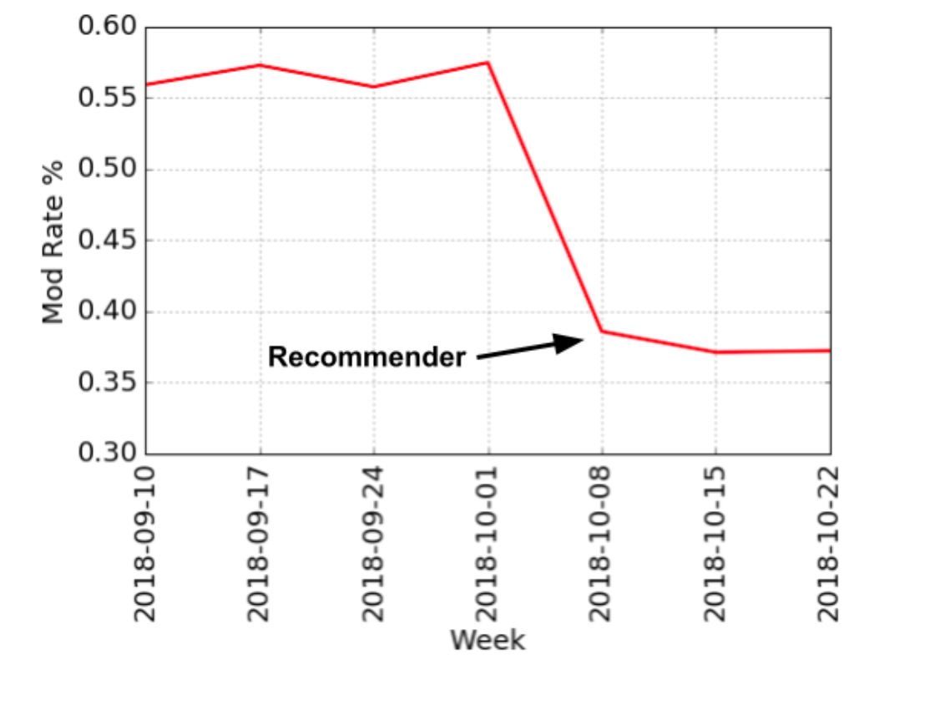
Better Customer Experience Through Data Science:
Auto Curation & The Recommender Engine
Customer Ratings/Reviews
MOD Behavior
Favorability Score
Novelty (newness)
Vector mapping (ingredient, macros,culinary styles/ethnicities)
Seasonality trends

Slide 5
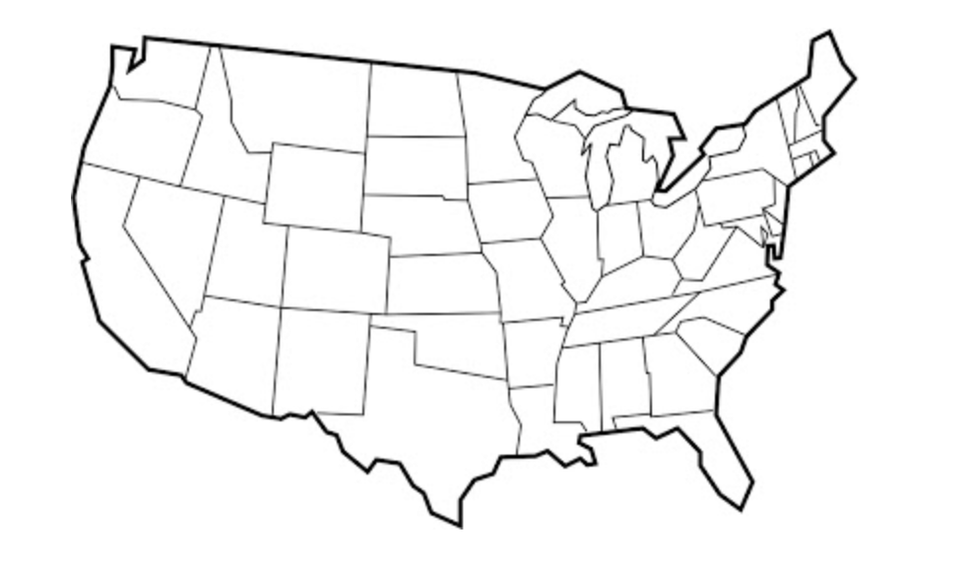
Our Territory!
HQ

Slide 6
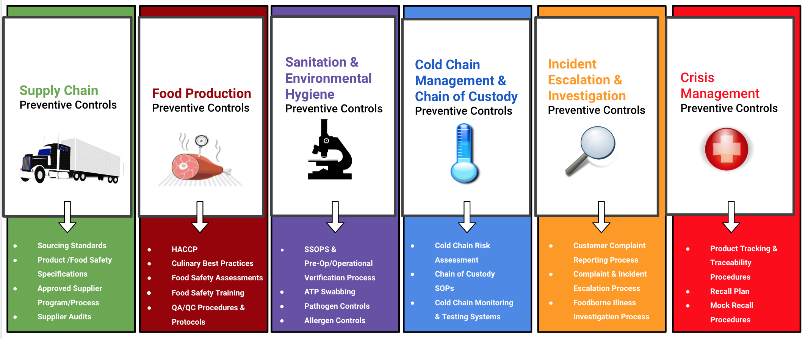
Our approach to food safety: Preventive Controls

Slide 7
Three pillars of Total Quality Management
Written Procedures - Remote Monitoring - Direct Observation
Quality Assurance & Quality Control
Food Safety &
Regulatory Compliance
Production
Optimization & Scale

Slide 8
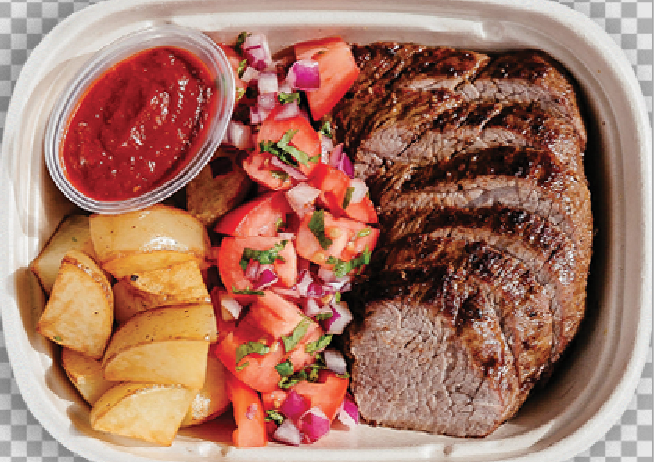
Safe, Quality, Scalable Food - by design!

Slide 9
Supply Chain Preventive Controls
Chef FSQA Assessments/CAPAs
R & D (Concept, Bench top, Scale, Validation, Launch)
Sourcing Standards
Awareness Training/Certification
2020 Goals & Initiatives:
Supplier approval process
Supplier FSQAs
Standardization
Local

Slide 10
FSQA/CAPA Process
Chefs audits are conducted to ensure compliance with local/federal guidelines for food handling, and quality control.
Each Chef receives at minimum one audit per quarter, and remedial visits should they be necessary.
Audits are scored and unannounced, conducted during Territory production
Results of the audits are provided same-day and require a Corrective Action Plan to demonstrate understanding and prevent issues from reoccurring.
Focus of these audits is to maintain a standard, but ensure understanding and proper education on processes.

Slide 11
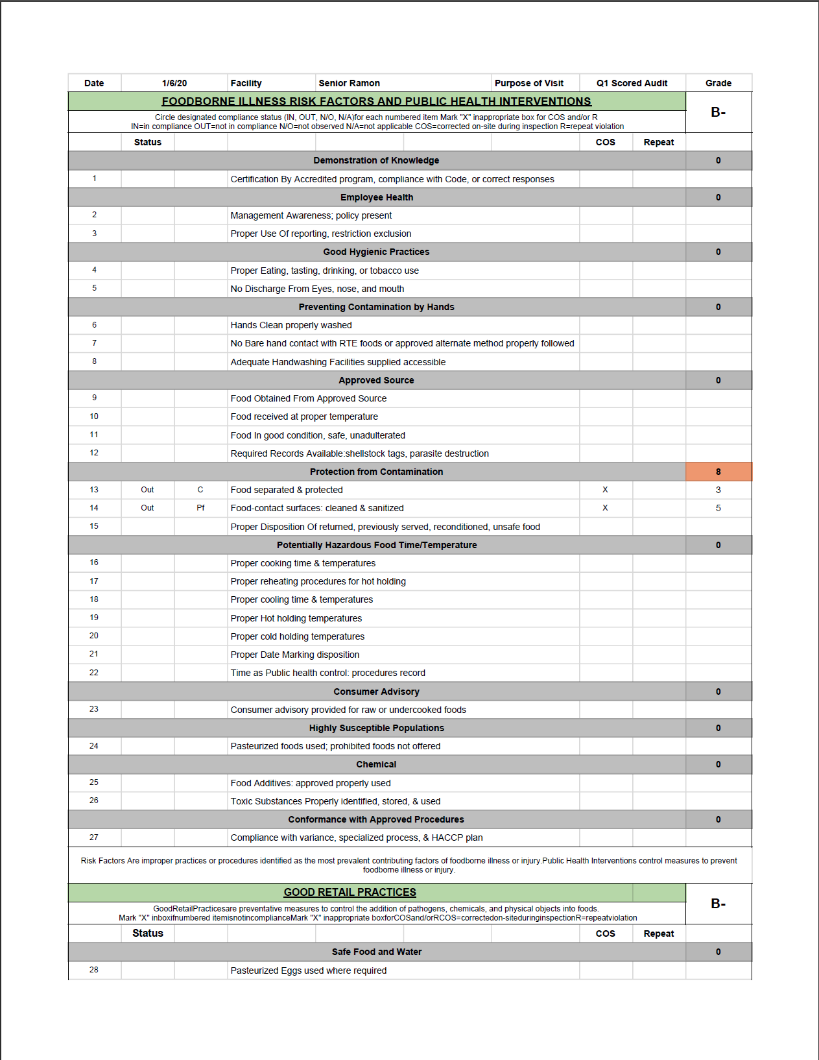
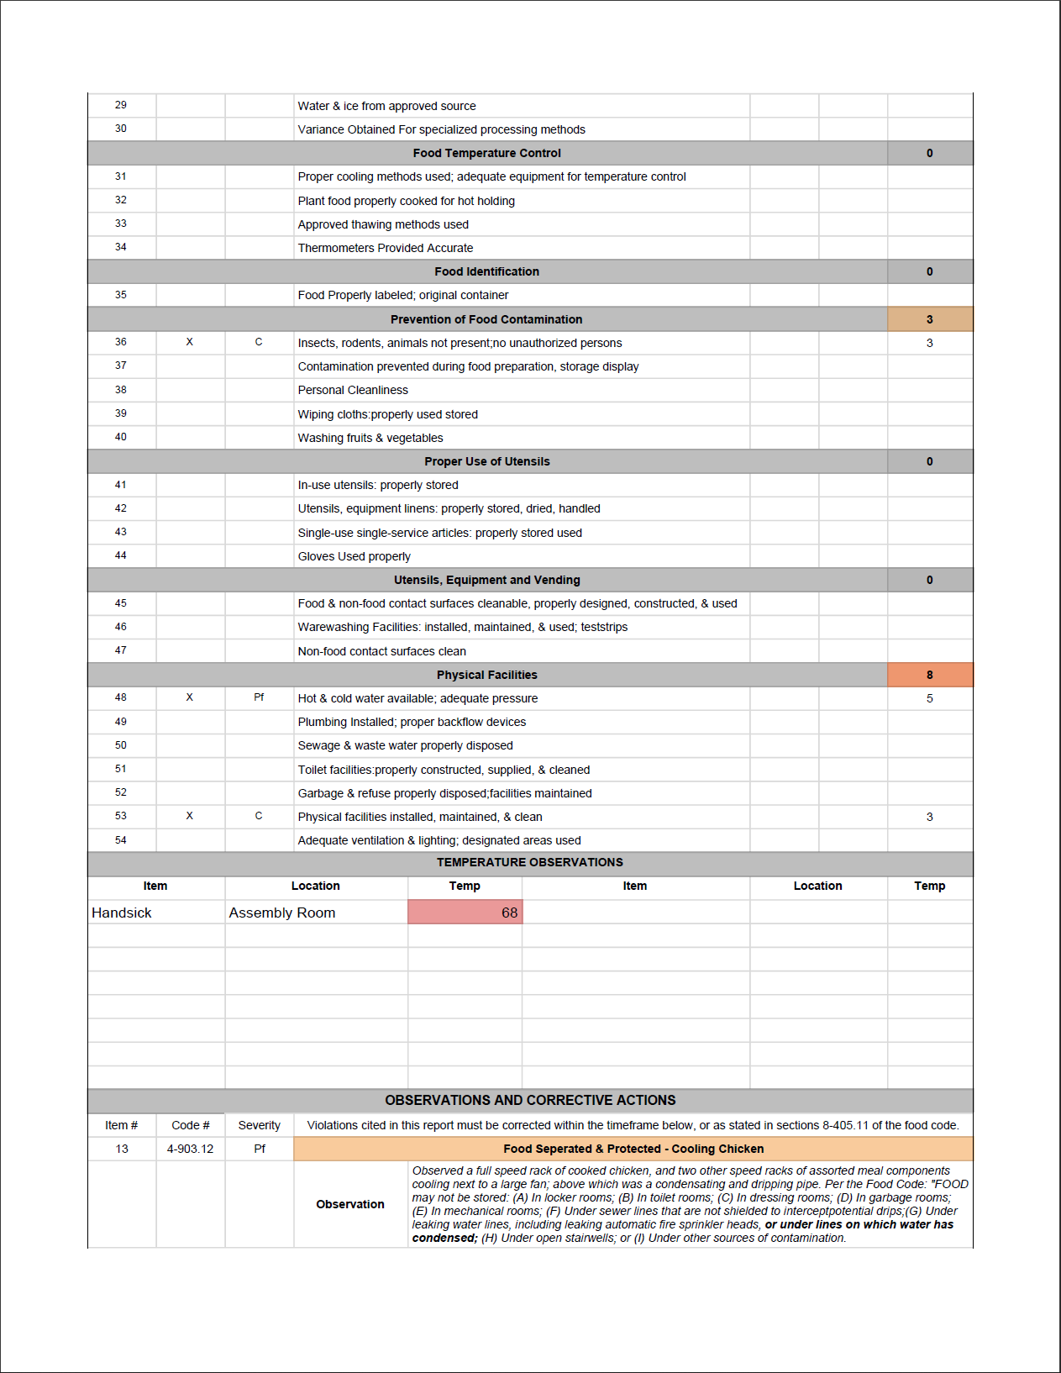
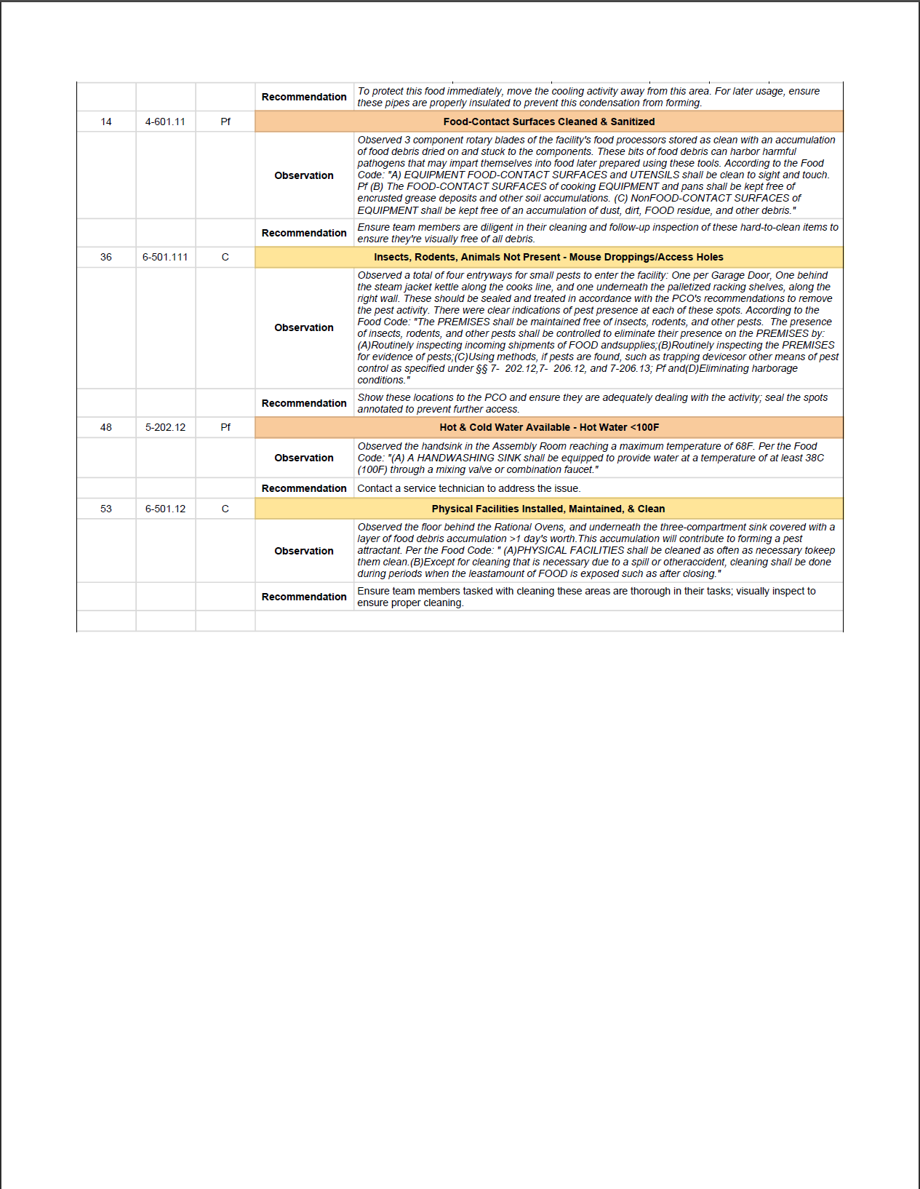
FSQA Audit Form

Slide 12
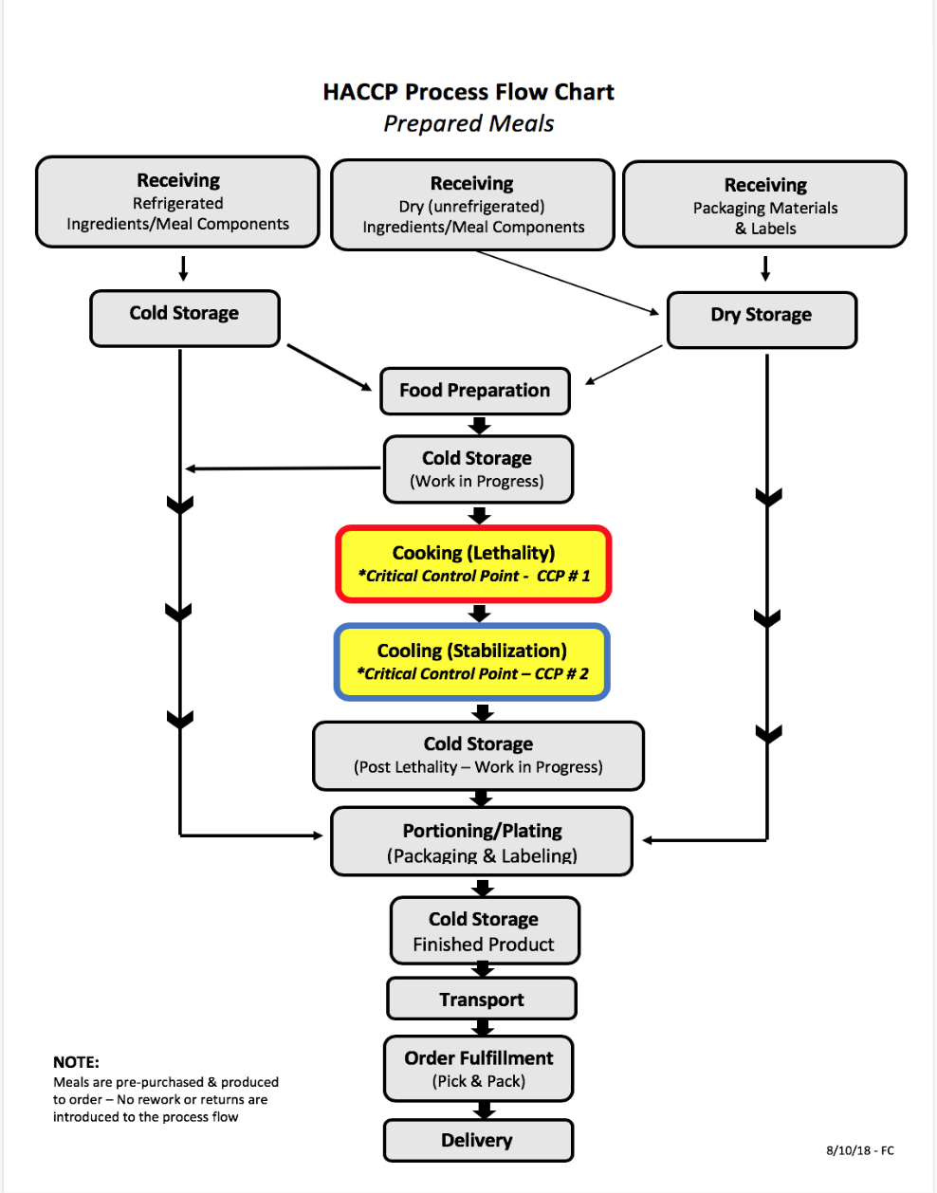
Food Production (Process) Preventive Controls
HACCP
Culinary Best Practices/SOPs
Allergen Controls (customer preferences)
Production reporting/Remote surveillance
2020 Goals & Initiatives:
Real-time HACCP reporting (Jolt)
HACCP Certification
Production scaling/automation

Slide 13
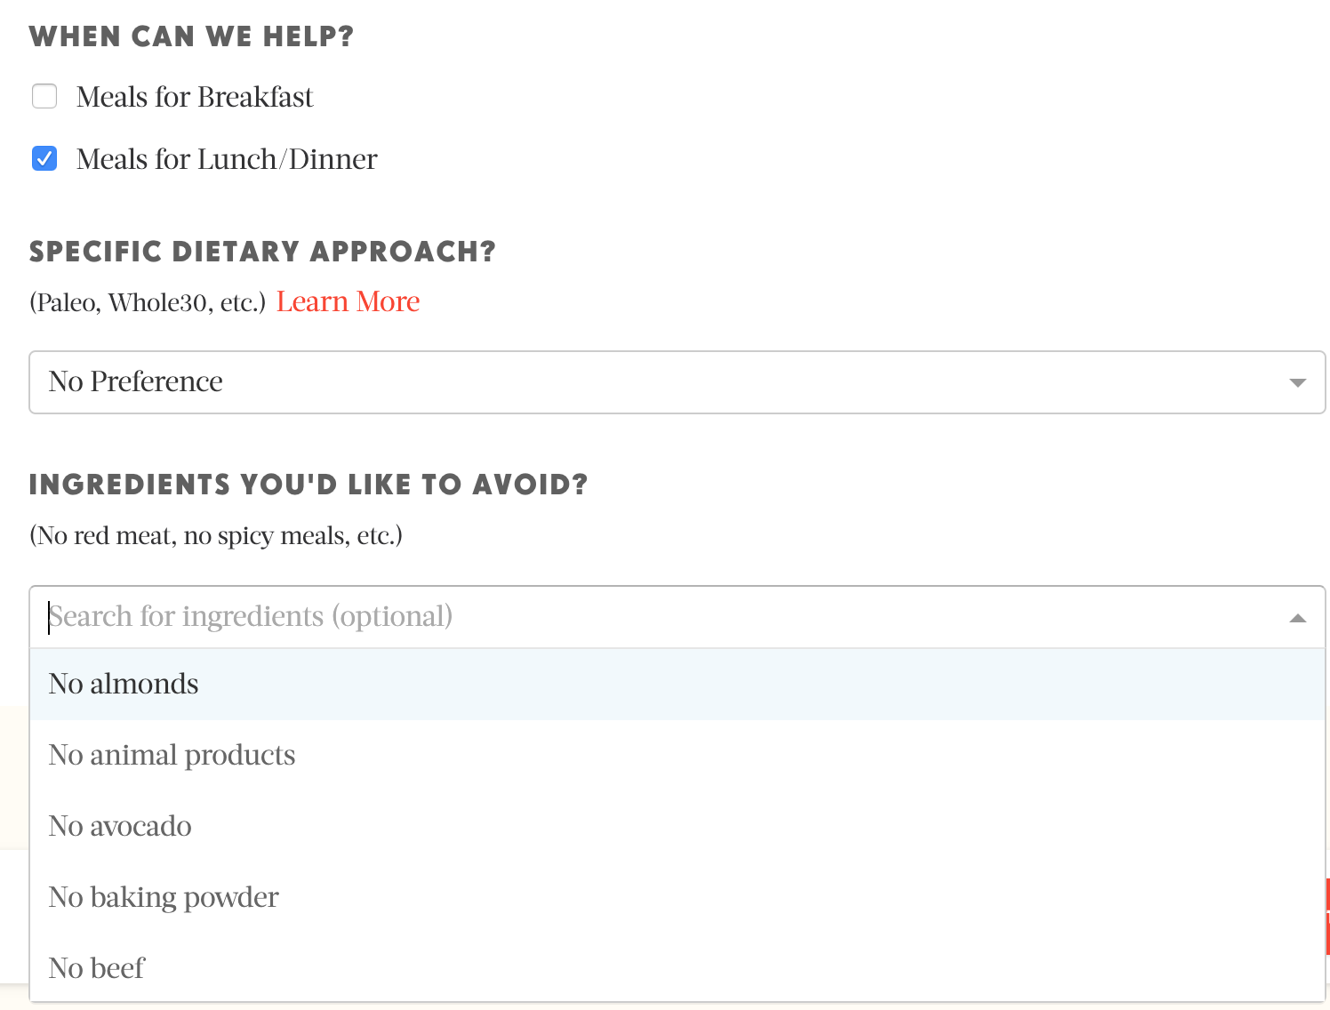
Allergen/Ingredient Avoidance Process

Slide 14
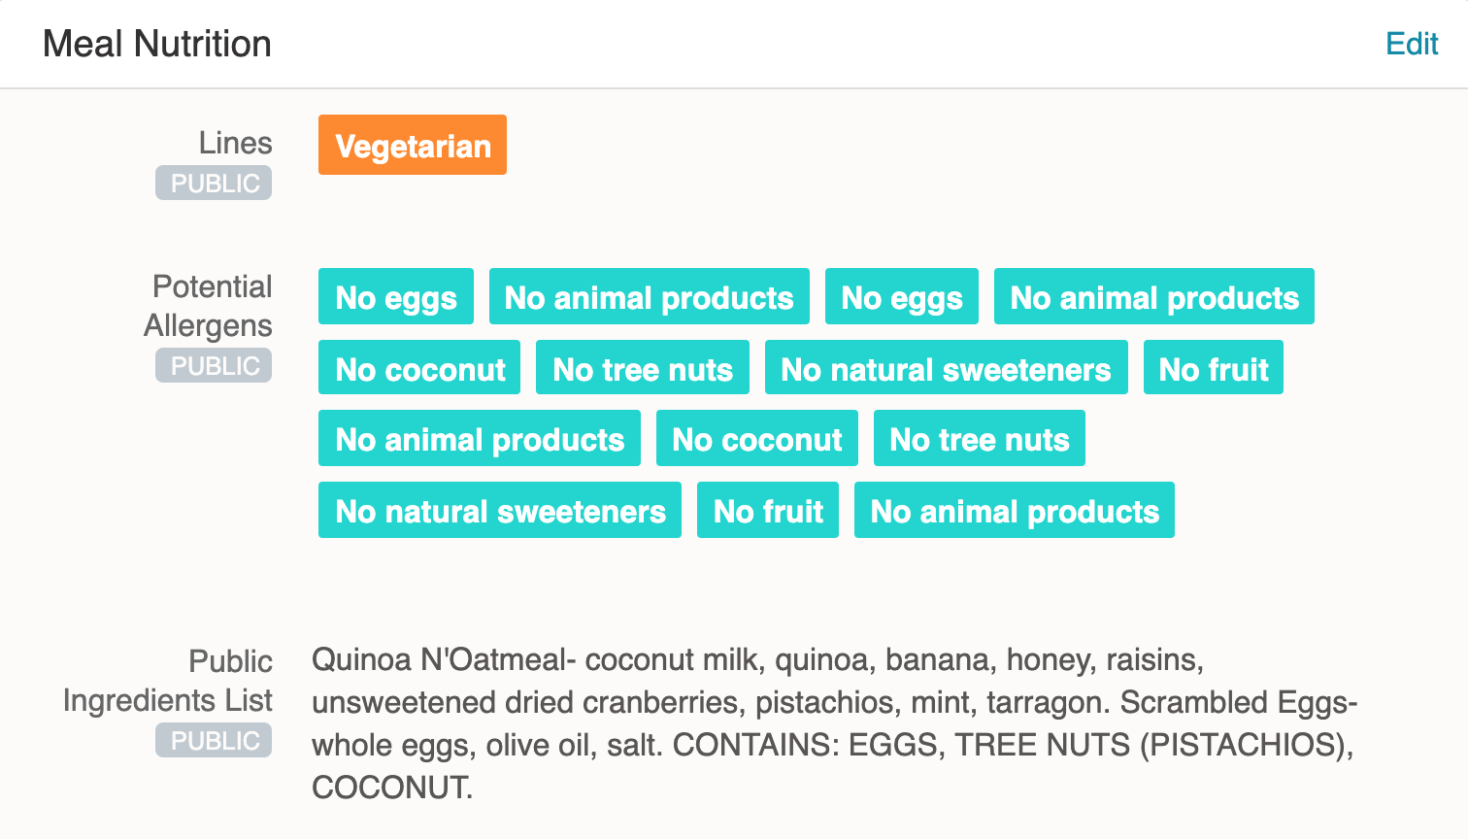
Allergen/Ingredient Avoidance Process (cont’d.)

Slide 15
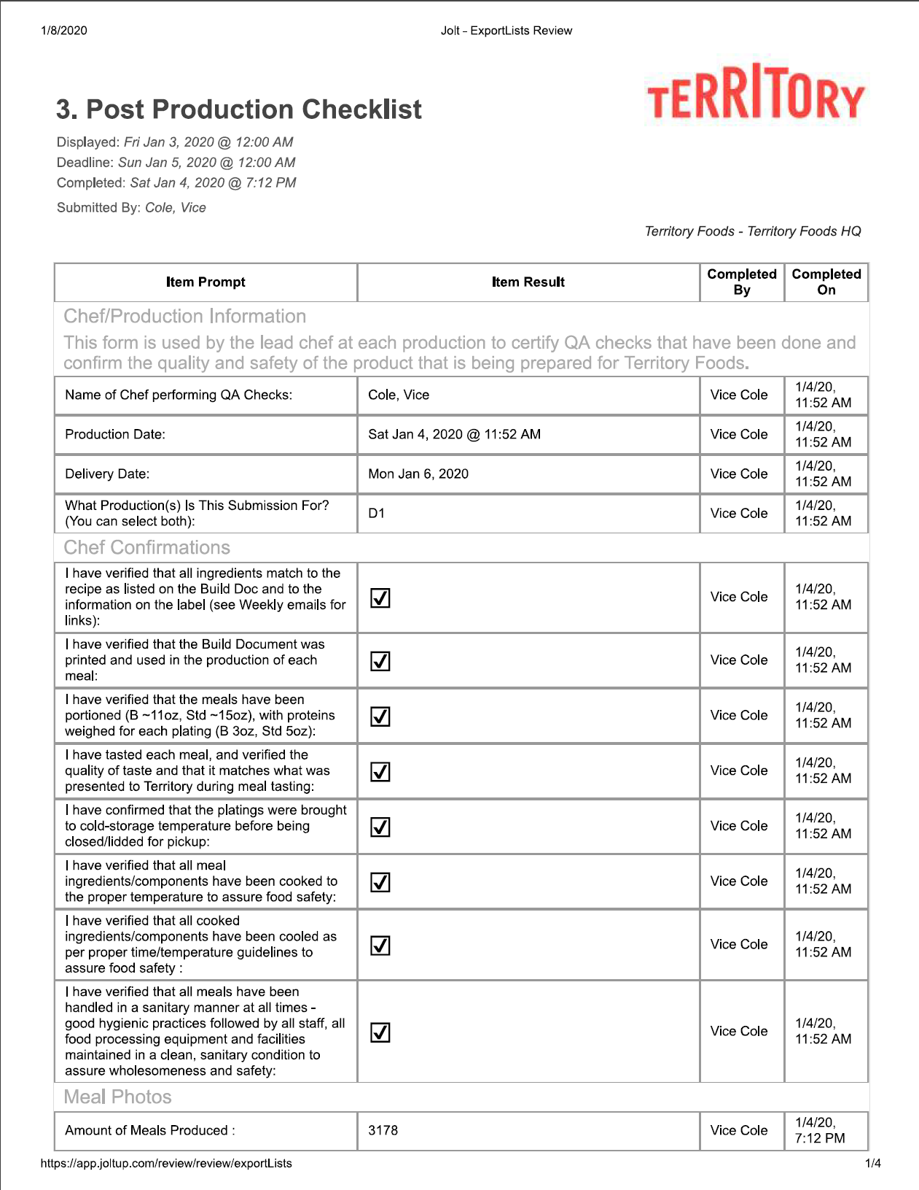
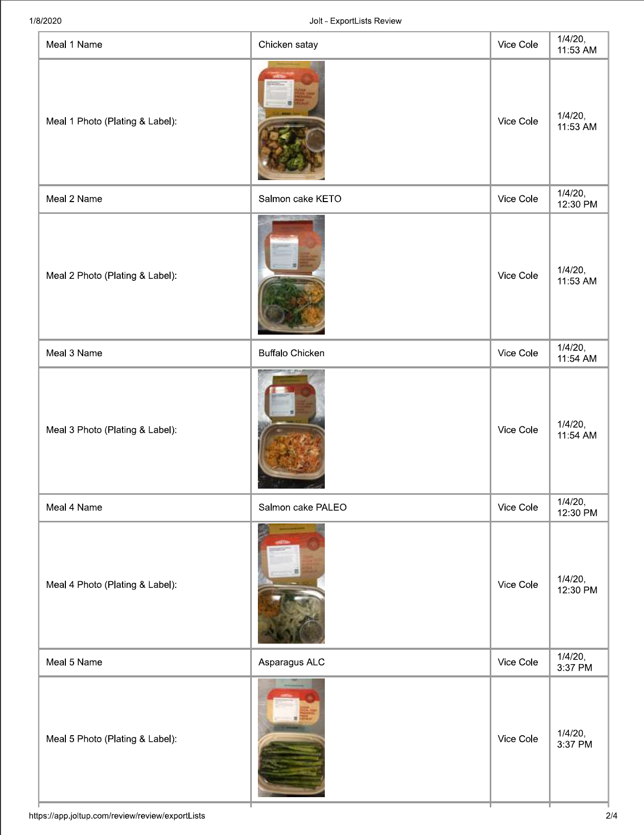
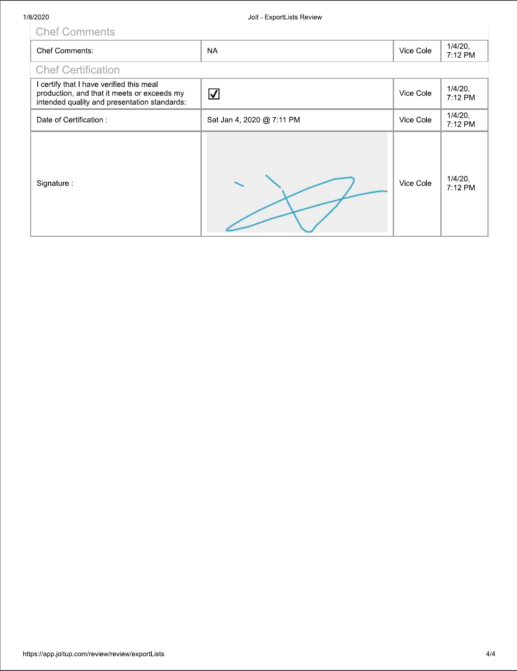
Jolt

Slide 16
Sanitation & Environmental Preventive Controls
Sanitation standard operating guidelines
Chef FSQA assessments
2020 Goals & Initiatives:
Self monitoring procedures - (Pre-operational/operational)
Sanitation verification inspections (Direct observations)
ATP swabbing
Allergen swabbing
Listeria monitoring program
Norovirus prevention/awareness

Slide 17
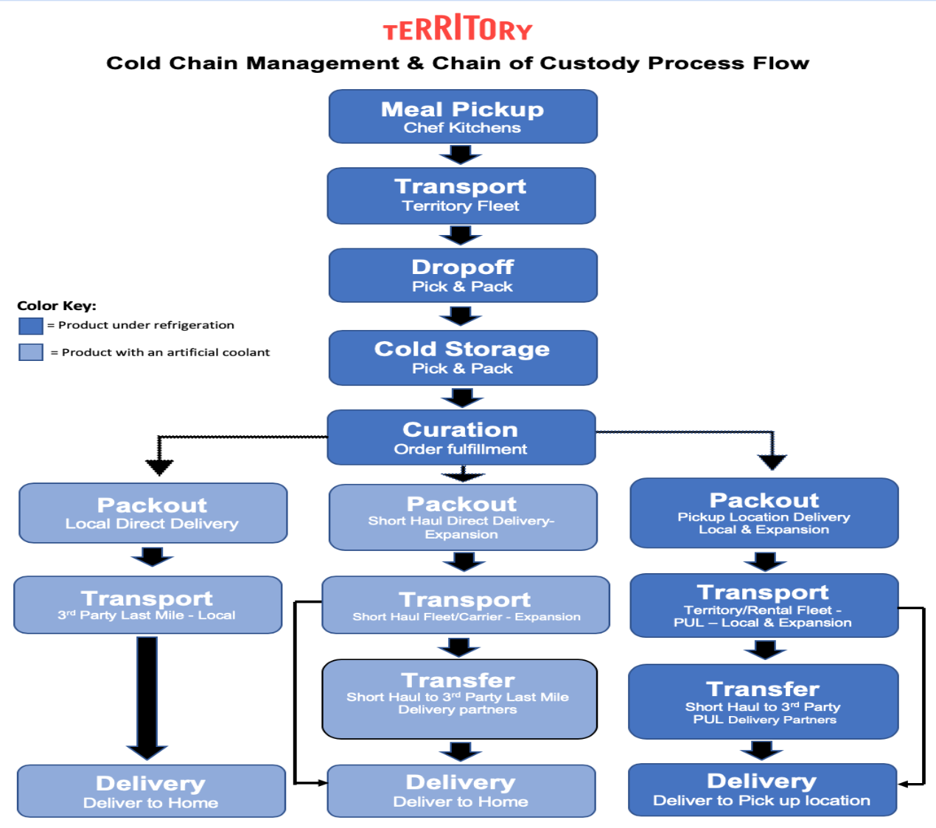
Cold Chain Mgmt. & Chain of Custody Preventive Controls
Continuous monitoring & notification systems
Cold chain risk assessment (Hazard Analysis)
Chain of custody SOPs
Testing, Validation & Supporting scientific data
(Data loggers, TTIs, Combase)
2020 Goals & Initiatives:
Continuous improvement & innovation - NEW
Technology
Actionable event Validation - testing & scientific data

Slide 18
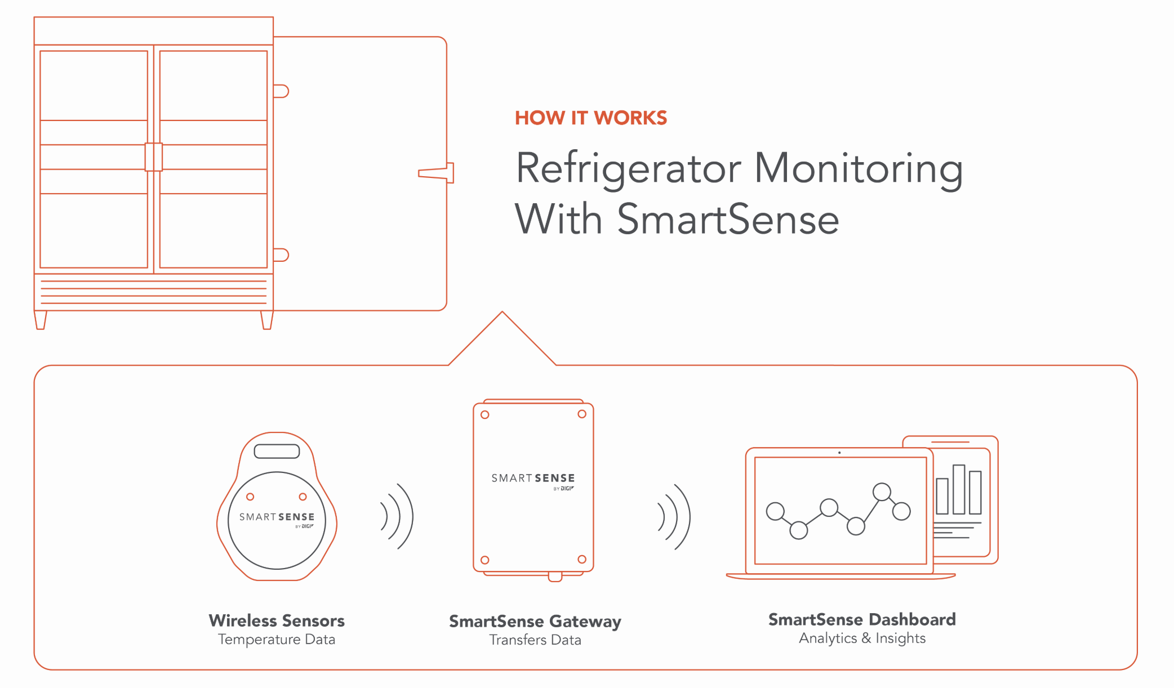
Remote Cold Chain Monitoring Systems

Slide 19
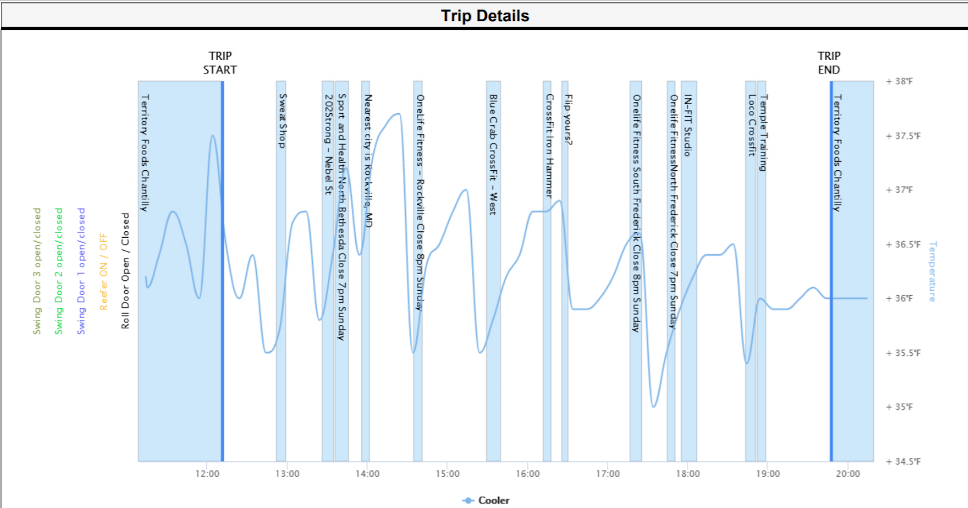
Digi

Slide 20
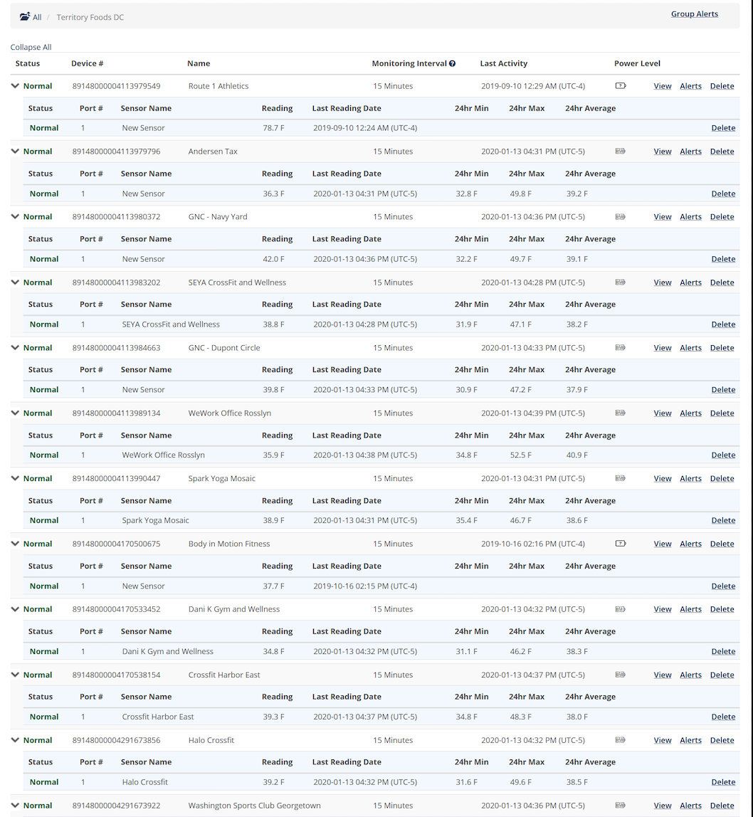
Digi

Slide 21
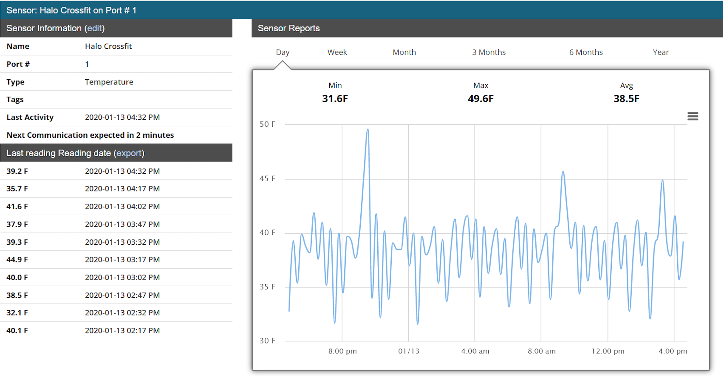
Digi

Slide 22
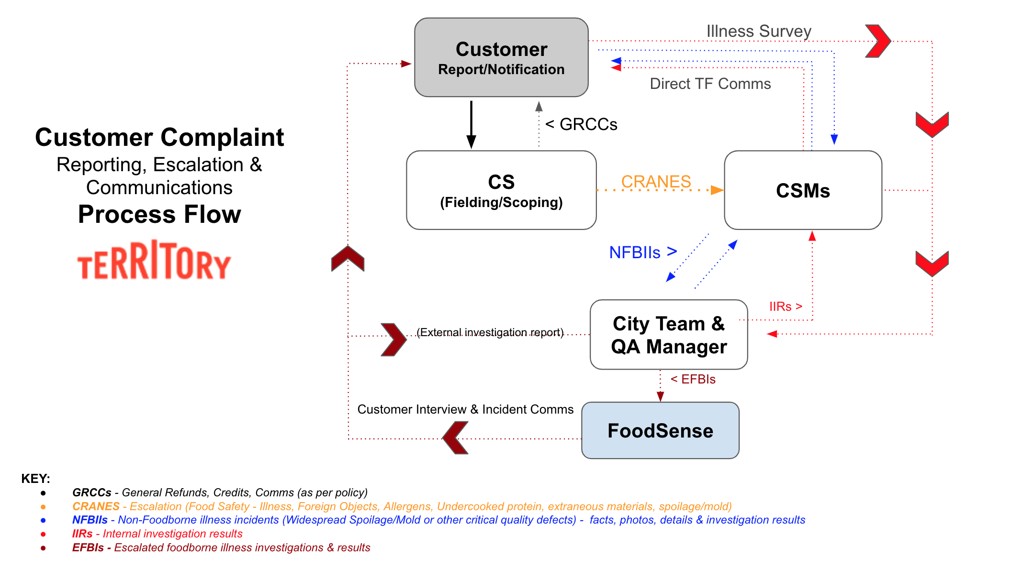
Incident Escalation & Investigation Preventive Controls
Customer service/QA - CRANE reporting & investigation process
FoodBorne illness investigation (FoodSense)
2020 Goals & Initiatives:
Prevention!
Trend analysis & performance metrics
Continuous improvement

Slide 23
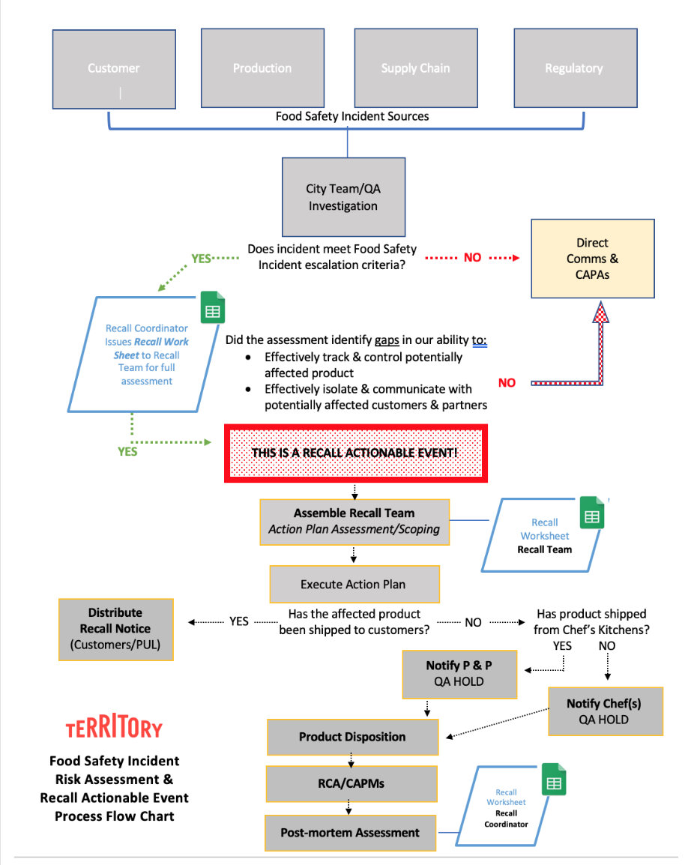
Crisis Management Preventive Controls
Recall Plan
Mock Recall procedures
Identify - contain, control, communicate!
2020 Goals & Initiatives:
Prevention!
Tracking system exploration
Continuous improvement

Slide 24
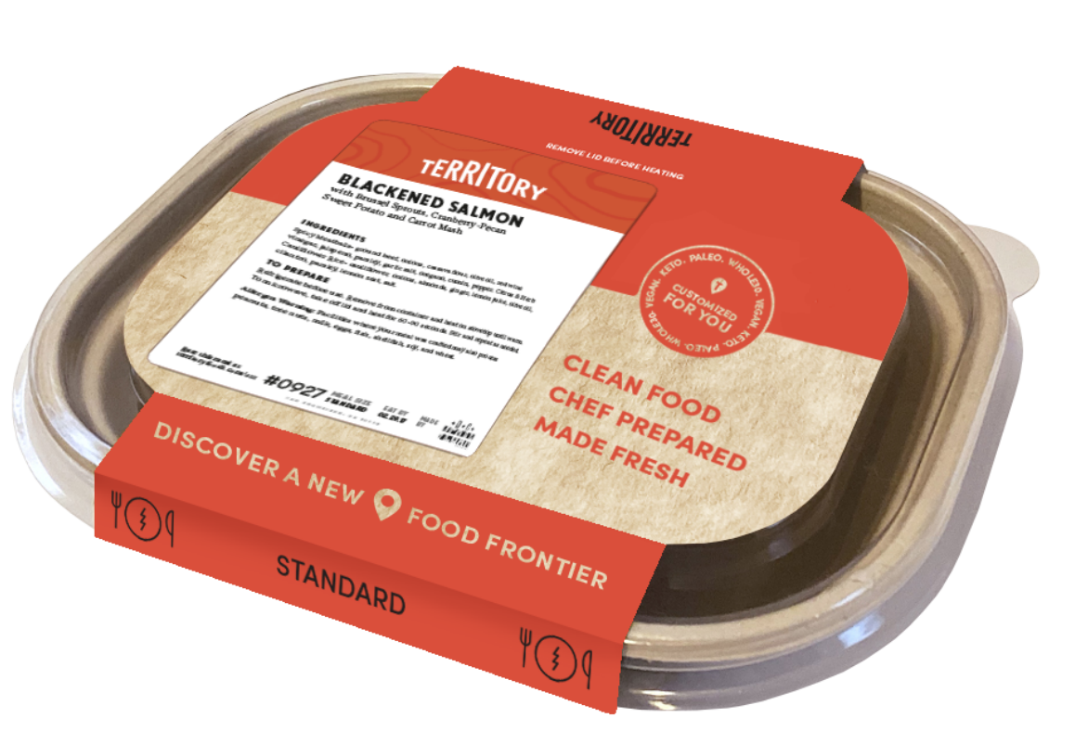
Packaging Innovation
Sustainability/Eco-friendly
Compostable/Biodegradable
Wheat straw fiber/PLA
2020 Goals & Initiatives:
Packaging technology exploration
MAP, VSP, Film barriers (OTRs)
Performance, shelf life potential, food safety

Slide 25
Our affiliations

